Slide 1
How do we know anything?
And how can we know things better?
A talk about why measurement matters & the recent redefinition of four SI units
Michael de Podesta
King’s College, London
13th November 2019

Slide 2
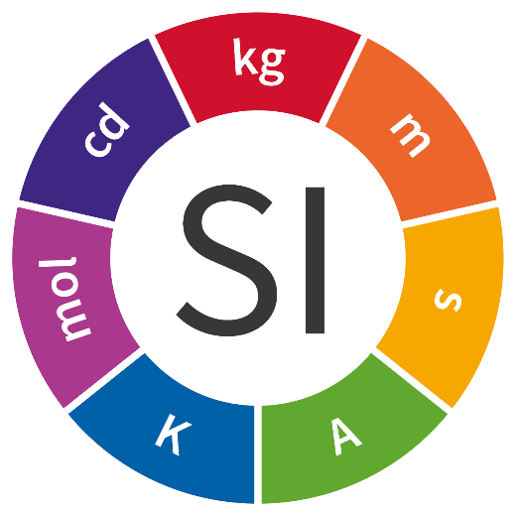
How do we get to know anything?
Introduction
An Alternative System of Units
The International System of Units: the SI
Details, Details, Details.
Summary
Notes:
2

Slide 3
imperceptible
familiar
vast
?
?
Measurement is the key to understanding the world around us
Notes:
The perceptible and the imperceptible
A feather falls onto the shoulder of a man as he gets into a train. Does the train use up more fuel to carry him than if he left the feather at home?
The tides are affected by the motion of the Moon around the Earth. Are the tides affected by the motion of Jupiter?
When you jump, does the Earth move?
Does driving your car to work (or choosing not to) affect the CO₂ concentration in the atmosphere?
Does a fan really cool a room, or heat it up?

Slide 4
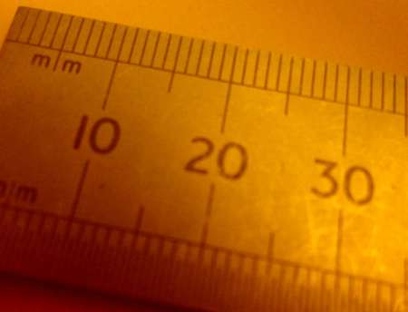
It is measurement that makes science scientific. Not Maths.
Notes:
4

Slide 5
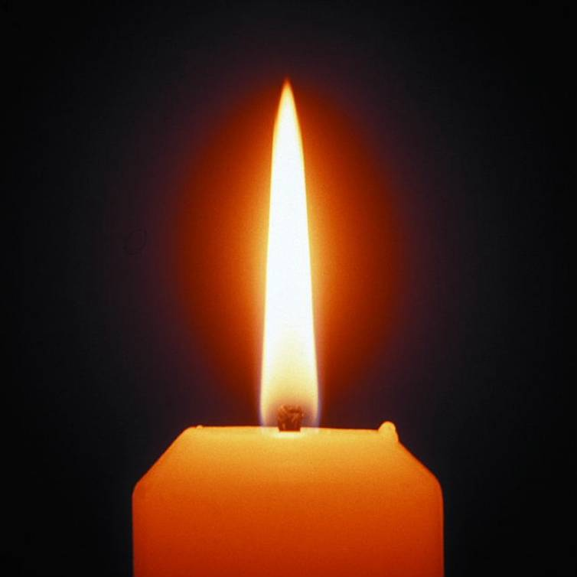

Slide 6
Measurement is…
Quantitative Comparison
Unknown
…of an unknown quantity
with a standard quantity
Standard
Notes:
6

Slide 7
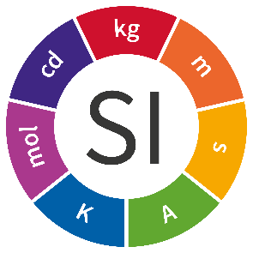
Measurement is…
Quantitative Comparison
Unknown
Standard
Grade #3 Copy
Grade #2 Copy
Grade #1 Copy
Even More
Time
&
Distance
More
Time
&
Distance
Time
&
Distance
Notes:
7
The key point here is that the perfection of a standard quantity represents a limit to how well anything can be measured.
SI represents that limit

Slide 8
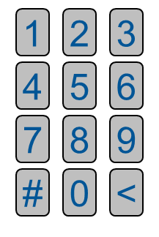
Measurement is…
Quantitative Comparison
Unknown
Candle
Standard
3.14
3.141
3.1415
1
2
3
4
5
6
7
8
9
#
0
<
Notes:
8
The key point here is that the perfection of a standard quantity represents a limit to how well anything can be measured.
SI represents that limit

Slide 9
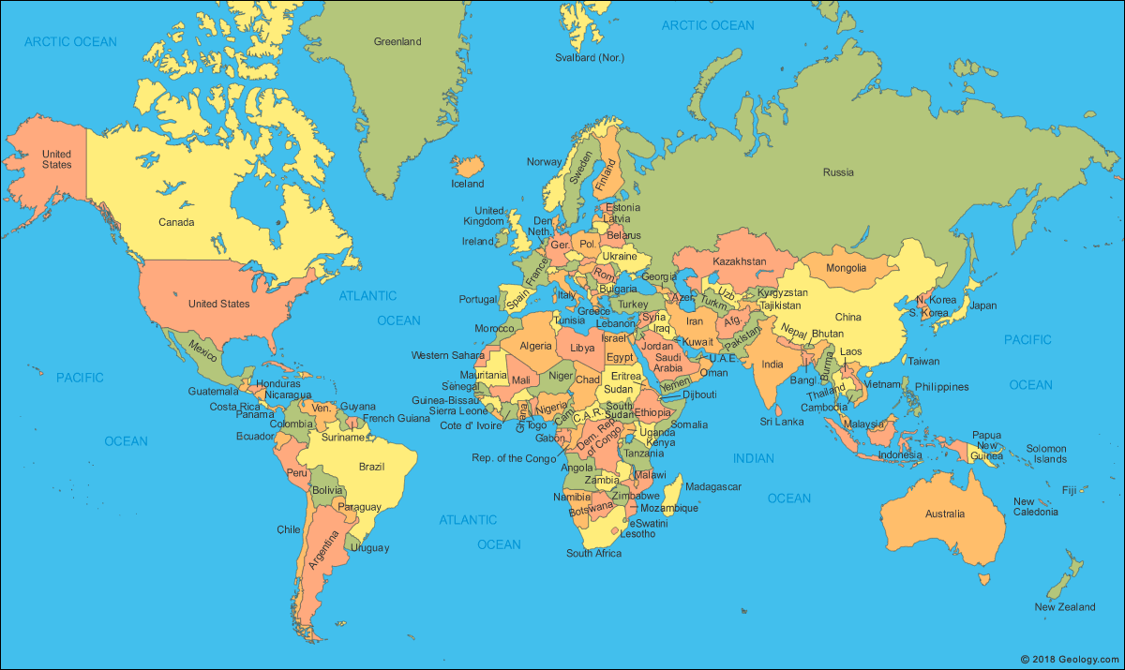

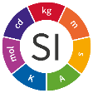

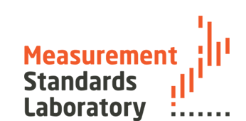
World-wide comparison of X
X_{UK}
X_{EU}
X_{Russia}
X_{China}
X_{Canada}
X_{Japan}
X_{USA}
X_{New} _{Zealand}
X_{Argentina}
X_{Nigeria}
X_{India}
Notes:
9
X is some quantity which we wish to compare – perhaps the size of a component.
If the measurements of X in Australia and Nigeria are both traceable to the SI standard, then they can be meaningfully compared with each other.

Slide 10
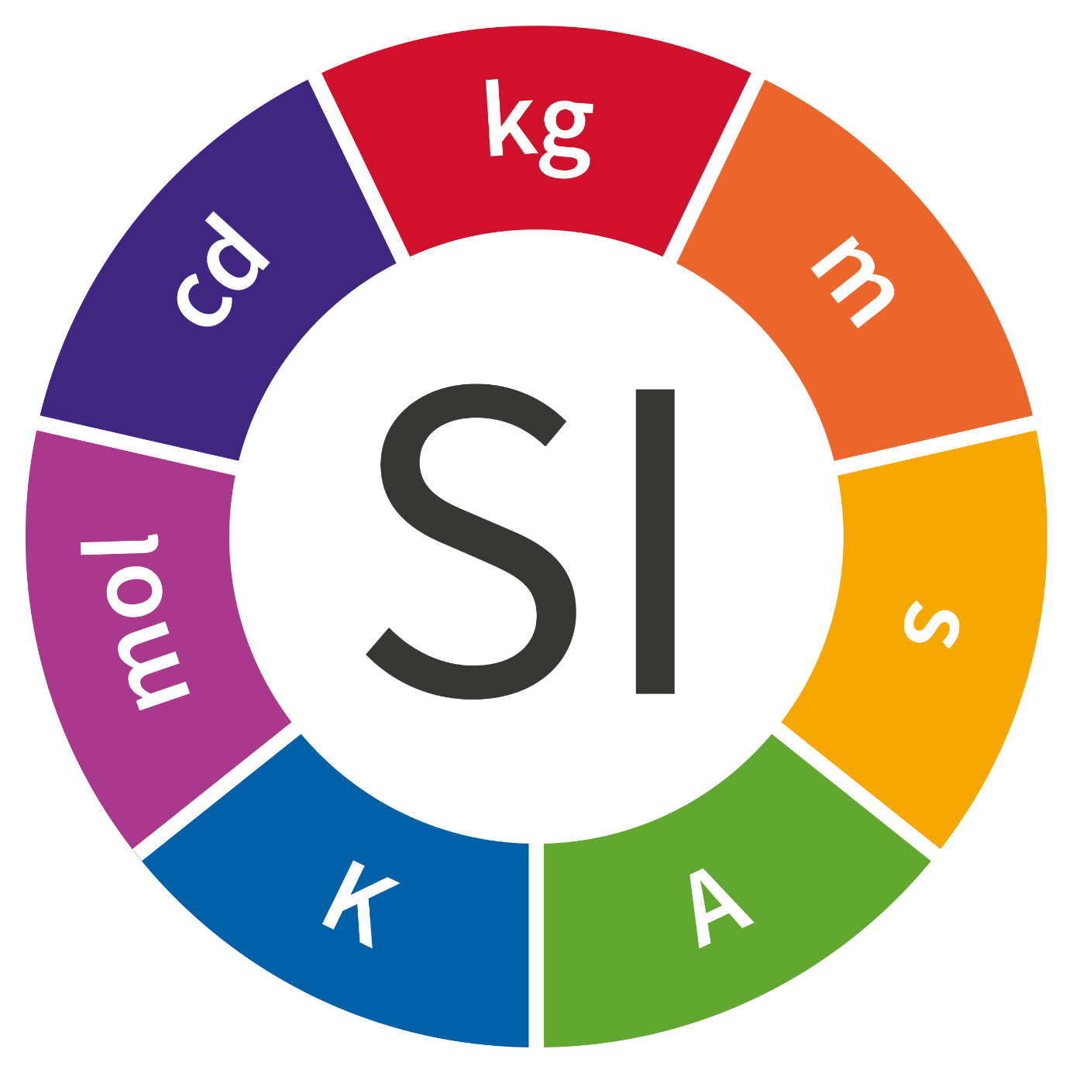
The Base Units of the SI
kilogram
candela
metre
mole
second
kelvin
ampere
Notes:
A nice big picture of the SI roundel

Slide 11
Summary of Introduction
Measurement is at the heart of all science & engineering
If we can measure something then we can begin to:
  Understand it (science)
  Improve it (engineering)
Every culture has a system of measurement
On Earth, the International System of Units – the SI – is the only coherent system of units in use.
Notes:
Measurement is the quantitative comparison of an unknown object with a standard object

Slide 12
How do we get to know anything?
Introduction
An Alternative System of Units
The International System of Units: the SI
Details, Details, Details.
Summary
Notes:
12

Slide 13
My System of Units
Base Units
at 20 degrees Christian
A standard length
Michael
Stephanie
A standard mass
A standard time
Maxwell
1 Maxwell is the period of a pendulum
with length of 1 Michael
and a spherical mass of 1 Stephanie
measured in Teddington

Slide 14
Measurement is…
Quantitative Comparison
Unknown
…of an unknown quantity
with a standard quantity
Standard
Notes:
14

Slide 15
Multiples
Base Units
We can create multiples and sub multiples-of these ‘units’.
Create copies of the standard Michael
Re-assemble to make multi-Michaels e.g. a pentaMichael
Michael
Michael
Michael
Michael
Michael
Michael
Michael
Notice that the standard Michael does two jobs
It defines what we mean by a Michael – definition
It forms the seed for dissemination of the unit - realisation
Michael
Michael
Notes:
Measurement is the quantitative comparison of an unknown object with a standard object

Slide 16
Multiples and Sub-Multiples
We can create multiples and sub-multiples of these ‘units’.
Create copies of the standard Michael to make multi-Michaels e.g. a pentaMichael
Create demiMichaels and check
  DemiMichaels are equal to each other
  Add up to one Michael
Michael
Michael
Michael
Michael
Michael
Michael
Mich
Mich
Notes:
Measurement is the quantitative comparison of an unknown object with a standard object

Slide 17
Now we can make measurements!
Base Units
Michael
Michael
Mich
Michael
a
e
2.875 Michaels
Unknown Length
Notes:
Measurement is the quantitative comparison of an unknown object with a standard object

Slide 18

Time Multiples
Base Units
Just count Maxwells
It took 5 Maxwells for the ball to go up and down
1
2
3
4
5

Slide 19
Time Sub Multiples
Base Units
Or count deciMaxwells
It took 52 deciMaxwells for the ball to go up and down
1
2
3
4
5

Slide 20
Speed
Derived Units
Michael
Michael
Mich
a
e
Length = 2.875 Mic
Speed = 2.875/1.1 Michaels per Maxwell
Speed = 2.614 Mic O’Max
The unit of speed is called the
Mic O’Max
Time = 1.1 Maxwells
Notes:
Measurement is the quantitative comparison of an unknown object with a standard object

Slide 21
Energy
Derived Units
Michael
Michael
Mich
a
e
Length = 2.875 Mic
Mass = 1 Steph
Speed = 2.614 Mic O’Max
Energy = ½ mass x speed²
Energy = 6.833 Steph Mic Mic O’Max O’Max
The unit of energy is called the
Steph Mic Mic O’Max O’Max
XiaoJuan (晓 娟)
Notes:
Xiao means "morning" and Juan means "graceful" or "beautiful".
Xiao is 晓 and Juan is 娟。

Slide 22
My System of Units
Base Units
Max
Mic
Maxwell
Michael
Steph
Stephanie
Notes:
Measurement is the quantitative comparison of an unknown object with a standard object

Slide 23
Acceleration
Time (Max) | Velocity (Mic O’Max) | Acceleration (Mic O’Max O’Max)
1.667 | 0.150
0.690 | 0.362 | 0.127
0.530 | 0.472 | 0.159
 |  | 0.143
0.25 Mic
a
0.25 Mic
a
0.25 Mic
a
0.25 Mic
a
0.25 Mic
a
0.25 Mic
a
Acceleration = 0.143 Mic O’Max O’Max
0.25 Mic
a
0.25 Mic
a
0.25 Mic
a
0.25 Mic
a
Notes:
Measurement is the quantitative comparison of an unknown object with a standard object

Slide 24


Force
Newton’s second law:
Force is proportional to mass and acceleration
Force = K x mass x acceleration
Option#1
Option#2
Pick K = 1
Standard Force
force caused by
1 Stephanie
deflecting a
standard spring
by 1 centiMichael
1 Sharmila ≡ 1 Steph Mic O’Max O’Max
So that I can just write F = m a
and get the answer directly in Sharmilas
Stephanie, Michael and Maxwell are base units
Sharmila is a derived unit.
(Its just a special name for
1 Steph Mic O’Max O’Max)
Notes:
Measurement is the quantitative comparison of an unknown object with a standard object

Slide 25
My System of Units
Base & Derived Units
Mic O’Max
XiaoJuan (晓 娟)
Max
Mic
Maxwell
Michael
Andrew
Sharmila
Steph
Michael
Stephanie
degrees Christian
Sharmila
Michael
Inseok
Notes:
Measurement is the quantitative comparison of an unknown object with a standard object

Slide 26
What’s WRONG with My System of Units
No one else uses it!
  The units we use are for other people’s convenience, not ours!
The standard Michael or Stephanie could get damaged or change length or weight
  This is a real risk!
The standard Michael and Stephanie
  (a) define the units and
  (b) form the seed for dissemination of the unit system.
  This is a conflict
Standard values are arbitrary.
  The choices are dominated by family history
Notes:
Measurement is the quantitative comparison of an unknown object with a standard object

Slide 27
How do we know anything?
Introduction
An Alternative System of Units
The International System of Units: the SI
Details, Details, Details.
Summary
Notes:
27

Slide 28
The Base Units of the SI
kilogram
candela
metre
mole
second
kelvin
ampere
Notes:
A nice big picture of the SI roundel

Slide 29
The SI
Exa, E
kilogram
Derived Units
Base Units
Peta, P
joule
Tera, T
tesla
candela
metre
Giga, G
volt
newton
Mega, M
ohm
pascal
kilo, k
Prefixes
farad
hertz
mole
milli, m
Nm
micro, µ
m/s
second
V/m
nano, n
rad/s
J/K
pico, p
femto, f
Ωm
Communication
Torque = 3.7 N m
kelvin
ampere
atto, a
Notes:
A nice big picture of the SI roundel

Slide 30
What’s RIGHT with the International System of Units
Everyone uses it!
  It is humanity’s universal language of measurement!
But like ‘My System’…
  …its just made up!
Notes:
Measurement is the quantitative comparison of an unknown object with a standard object

Slide 31
What’s RIGHT with the International System of Units
Everyone uses it!
  It is humanity’s universal language of measurement!
But it is like ‘My System’ in many ways.
Base Units are combined to create complex Derived Units
  And, its just made up! – But by agreement.
Notes:
Measurement is the quantitative comparison of an unknown object with a standard object

Slide 32
What’s WRONG with the International System of Units
The kilogram could be damaged
  This is a real risk!
The kilogram and the kelvin still conflate definitions and realisations of units
  This is still a conflict – but small in practice.
Standard values are arbitrary – not ‘natural’.
  The choices are dominated by history
Notes:
Measurement is the quantitative comparison of an unknown object with a standard object

Slide 33
The Base Units of the SI
kilogram
New!
candela
metre
mole
second
kelvin
ampere
Notes:
A nice big picture of the SI roundel

Slide 34
Re-defining the base units of the SI?
Why?
Notes:
34

Slide 35
Measurement is…
Quantitative Comparison
Unknown
…of an unknown quantity
with a standard quantity
Standard
Could we choose our
standards more wisely?
Notes:
35
This is the question behind the re-definition

Slide 36

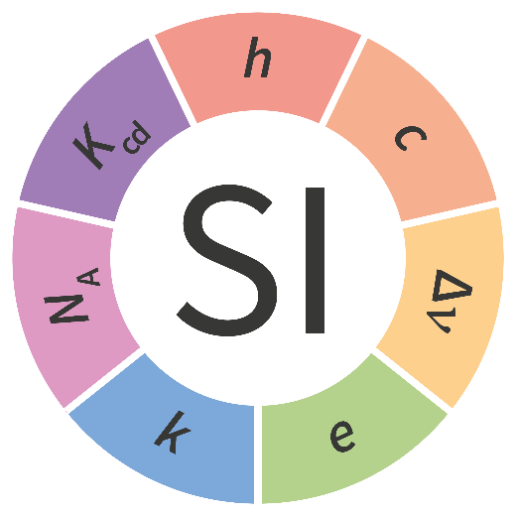
SI Base Units and Natural Constants
Unit Definitions
in terms of
Unit Definitions
Natural Constants
measure
realise
Notes:
36
Using the human based standards of the SI, we have measured natural features of the universe that appear to be constant: Natural Constants
Note: The phrase ‘natural constants’ has been carefully chosen. Avoid the use of ‘fundamental’ constants – they are not all fundamental.
Natural Constants appear to be more stable than ANYTHING human made – more later – they appear to be at least one million times more stable than the most stable human artefact – the kilogram.
The idea of the unit re-definitions is to base our system of units on these natural constants.

Slide 37
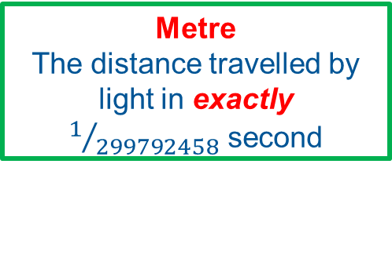
Redefining the metre in 1983
Second
Exactly 9 192 631 770
periods of ¹³³Cs radiation
Metre
Exactly 1,650,763.73 wavelengths of light
from ⁸⁶Kr atoms
Second
Exactly 9 192 631 770
periods of ¹³³Cs radiation
Speed of Light
Exactly
299 792 458 m s⁻¹
Metre
The distance travelled by light in exactly $1/{299792458 }$second
Speed of Light
in metres per second
299 792 458 ±0.6 m s⁻¹
Measurement of speed of light improves
Measurement of length improves
1970
1980
1990
2000
Metre Re-defined
Notes:
This is the story of the way in which the metre was re-defined in terms of the speed of light in vacuum.
This is the same kind of switch we wish to carry out with the ampere and kilogram.

Slide 38
SI Base Units and Natural Constants
Unit Definitions
in terms of
Unit Definitions
Natural Constants
measure
realise
Notes:
38
Using the human based standards of the SI, we have measured natural features of the universe that appear to be constant: Natural Constants
Note: The phrase ‘natural constants’ has been carefully chosen. Avoid the use of ‘fundamental’ constants – they are not all fundamental.
Natural Constants appear to be more stable than ANYTHING human made – more later – they appear to be at least one million times more stable than the most stable human artefact – the kilogram.
The idea of the unit re-definitions is to base our system of units on these natural constants.

Slide 39
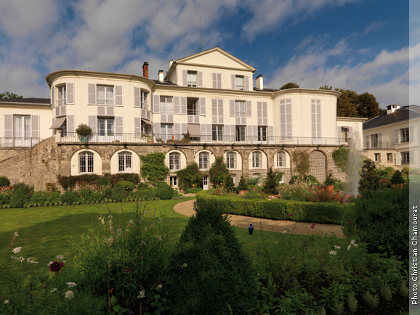



SI. The International System of Units
Administered from BIPM
  International Bureau of Weights & Measures
Run by the CIPM
International Committee for Weights & Measures
Agenda set by the CGPM
General Conference on Weights & Measures
DRAFT Resolution A: CGPM 2018
Should decide to make the change from 20th May 2019
Resolution 12: CGPM 2007
Recommends laboratories pursue the relevant experiments so that the International Committee can come to a view on whether it may be possible to redefine the kilogram, the ampere, the kelvin, and the mole
The aim of all this ‘measuring’ was to ensure that:
size of the units defined by the new definitions
were indistinguishable from
the size of the unit defined by the previous definitions
Start
Measure
Measure
Measure
Measure
Measure
Measure
Measure
Measure
Measure
STOP!
2007
2008
2009
2010
2011
2012
2013
2014
2015
2016
2017
2018
2019
Notes:
39
CGPM 13th November to 16th November 2018

Slide 40
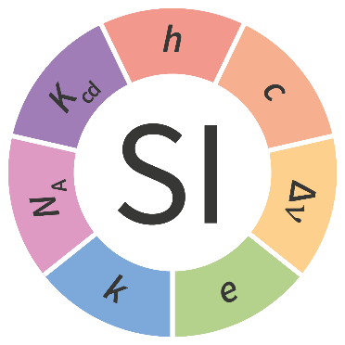
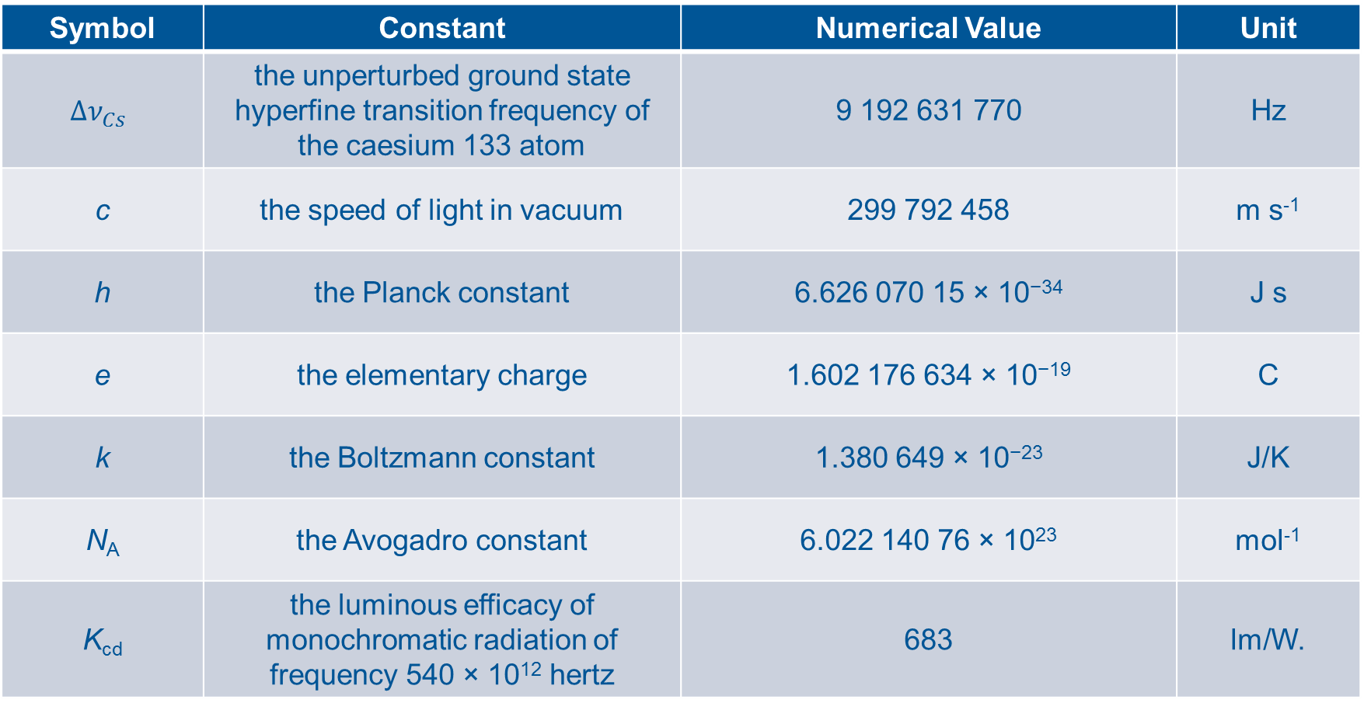
The SI is the system of units in which the following constants have these exact values.
Symbol | Constant | Numerical Value | Unit
$$Δν_{Cs}$$ | the unperturbed ground state hyperfine transition frequency of the caesium 133 atom | 9 192 631 770 | Hz
c | the speed of light in vacuum | 299 792 458 | m s⁻¹
h | the Planck constant | 6.626 070 15 × 10⁻³⁴ | J s
e | the elementary charge | 1.602 176 634 × 10⁻¹⁹ | C
k | the Boltzmann constant | 1.380 649 × 10⁻²³ | J/K
N_{A} | the Avogadro constant | 6.022 140 76 × 10²³ | mol⁻¹
K_{cd} | the luminous efficacy of monochromatic radiation of frequency 540 × 10¹² hertz | 683 | lm/W.
Notes:
40
This is the question behind the re-definition

Slide 41
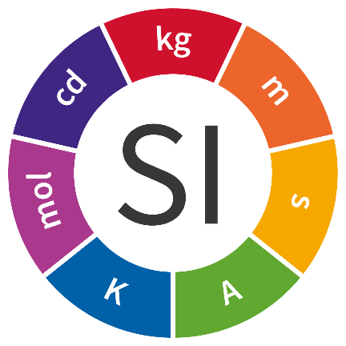
The previous structure of the SI
kg m² s^{–3} A^{–1}
volt,V
kg m² s^{–3}
watt, W
kg m² s⁻²
joule, J
Derived Units
kg m s⁻²
newton, N
m s⁻²
kg m⁻³
m s⁻¹
A s
coulomb, C
Base Units
kg
m
s
A
K
mol
cd
Reality
Notes:
41

Slide 42
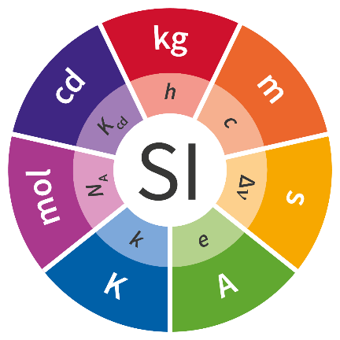

















The new structure of the SI
kg m² s^{–3} A^{–1}
volt,V
$$h e^{−1}ν_{Cs}^{}$$
kg m² s^{–3}
watt, W
$$hν_{Cs}^{2}$$
kg m² s⁻²
joule, J
$$hν_{Cs}$$
Derived Units
kg m s⁻²
newton, N
$$hν_{Cs}^{2} c^{−1}$$
Units
m s⁻²
$$cν_{Cs}$$
$${h ν}_{Cs}^{4}c^{−5}$$
kg m⁻³
m s⁻¹
$$c$$
A s
coulomb, C
$$e$$
Base Units
kg
m
s
A
K
mol
cd
$${h ν}_{Cs}^{}c^{−2}$$
$${c ν}_{Cs}^{−1}$$
$$ν_{Cs}^{−1}$$
$${e ν}_{Cs}^{}$$
$${h ν}_{Cs}^{}k_{B}^{−1}$$
$$N_{A}$$
$${hν_{Cs}^{2} K}_{cd}$$
Reality
Natural Constants
h
c
$$ν_{Cs}$$
e
k_{B}
N_{A}
K_{cd}
Notes:
42

Slide 43
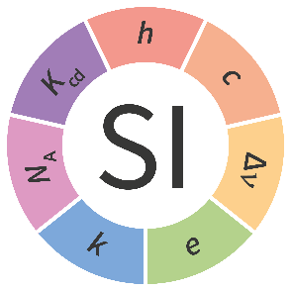
Measurement is…
Quantitative Comparison
Unknown
Realisation
Grade #3 Copy
Grade #2 Copy
Grade #1 Copy
Standard
Even More
Time
&
Distance
More
Time
&
Distance
Time
&
Distance
Definition
Expected to
improve with time
Expected to
remain unchanged
Notes:
43
This harks back to the earlier diagram showing how the constants are ‘abstracted’ and should never change.

Slide 44
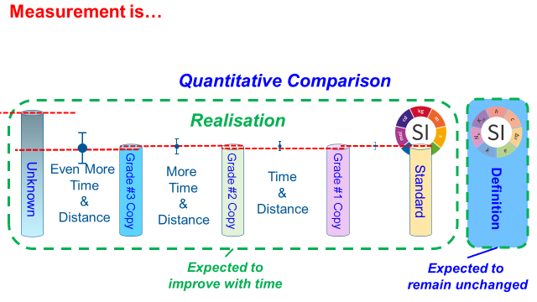
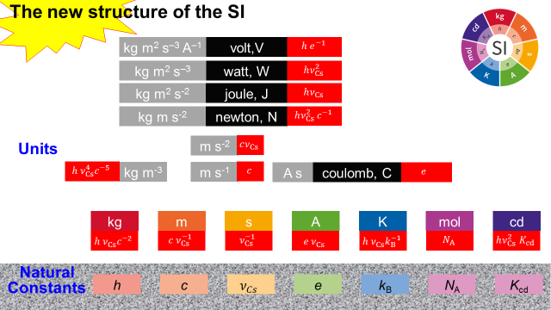
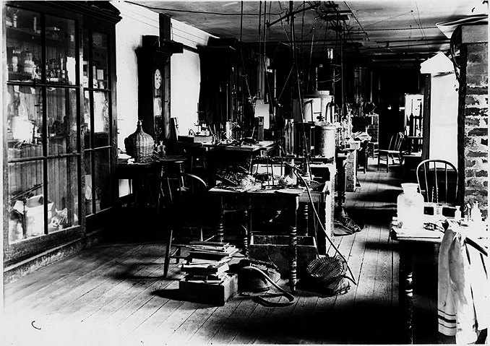
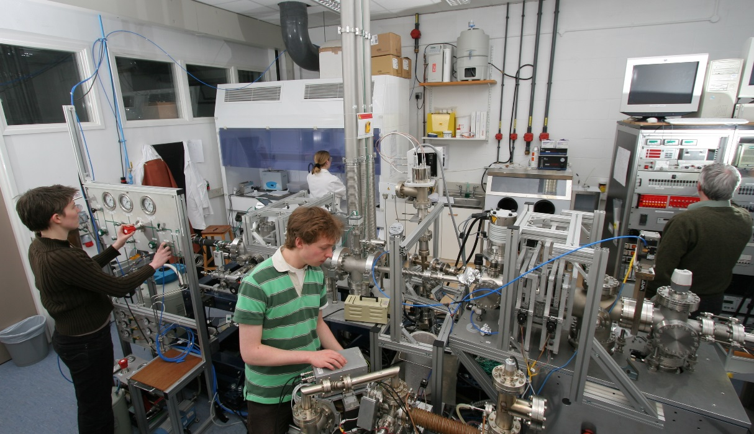
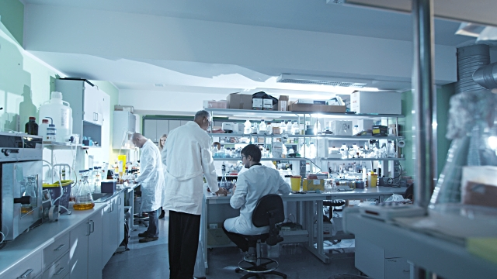
The 2019 changes…
Remove uncertainty from unit definitions.
Ends the use of defining artifacts & materials.
Blur the distinction between:
base units
derived units
Provides foundations for future developments
?
Notes:
Measurement is the quantitative comparison of an unknown object with a standard object

Slide 45
How do we get to know anything?
Introduction
An Alternative System of Units
The International System of Units: the SI
Details, Details, Details.
Summary
Notes:
45

Slide 46
Detail#1
The kilogram problem
Notes:
46

Slide 47
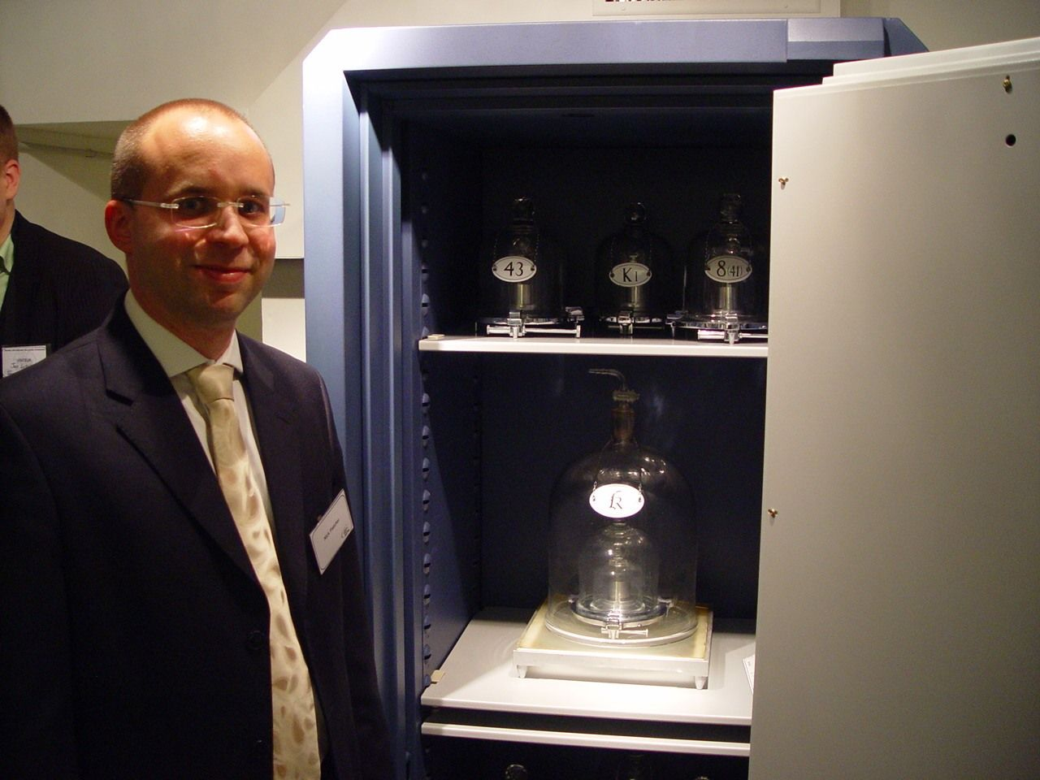
The International Prototype of the Kilogram (The IPK)
The kilogram is the unit of mass;
it is equal to the mass of the international prototype of the kilogram.
Notes:
47

Slide 48
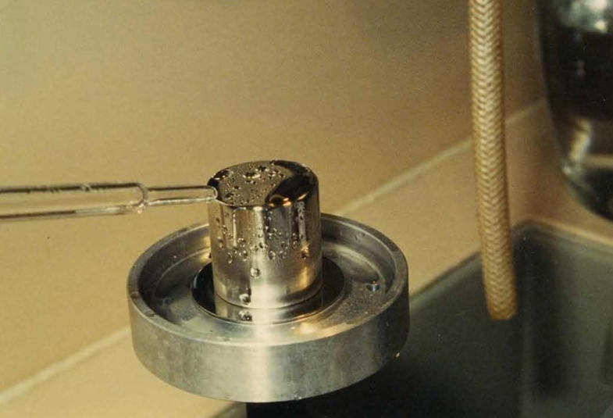
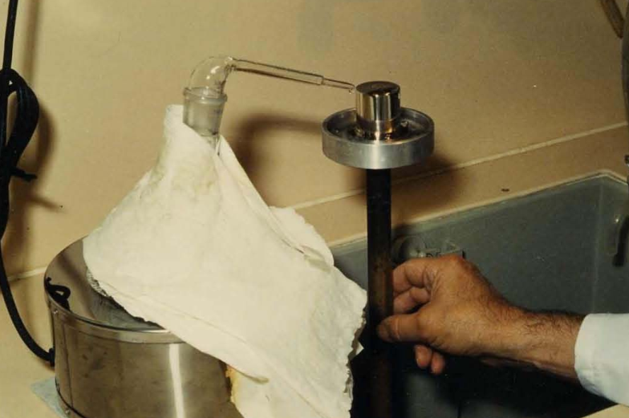
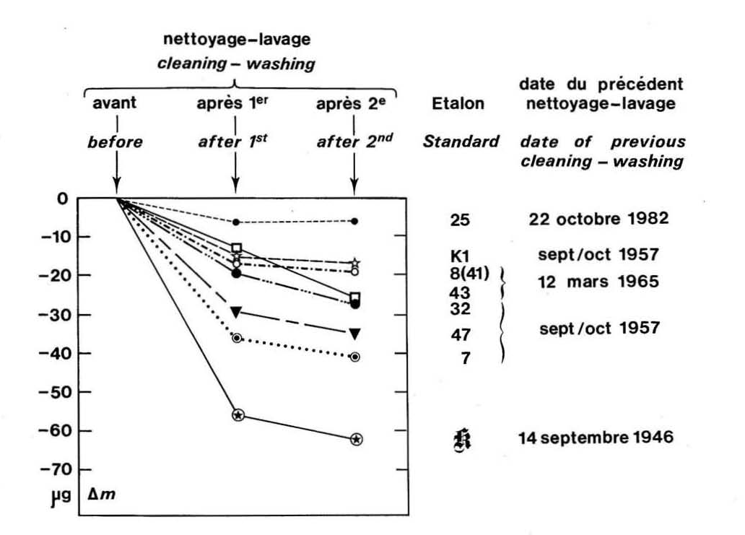
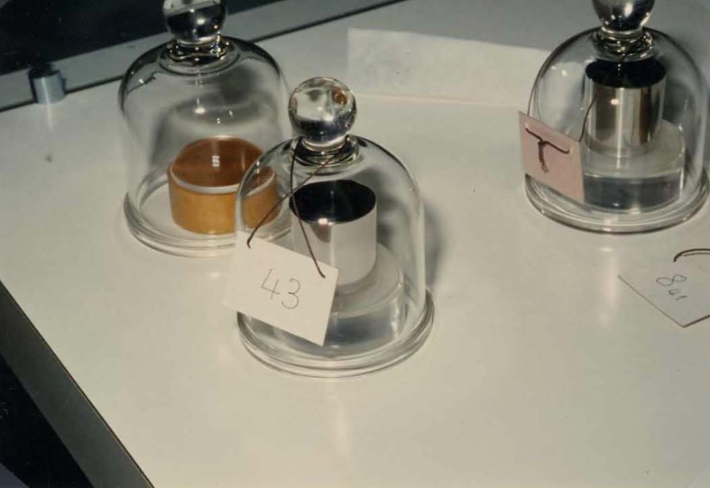
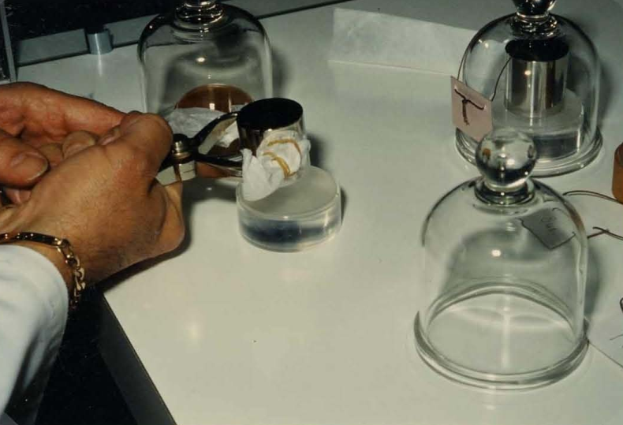
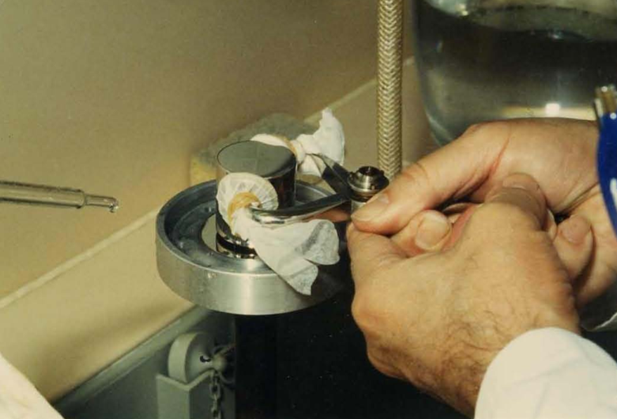
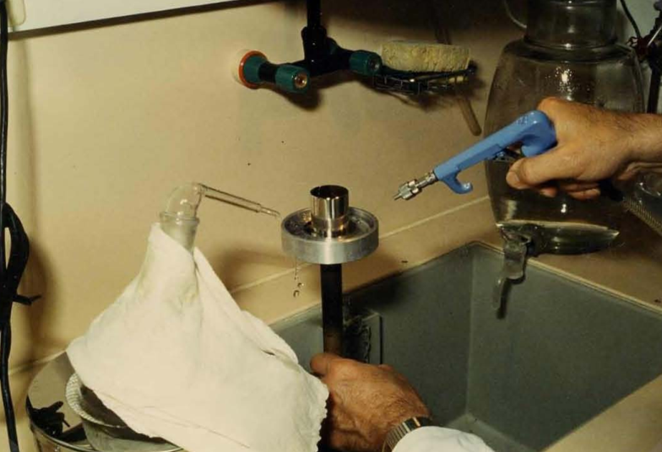
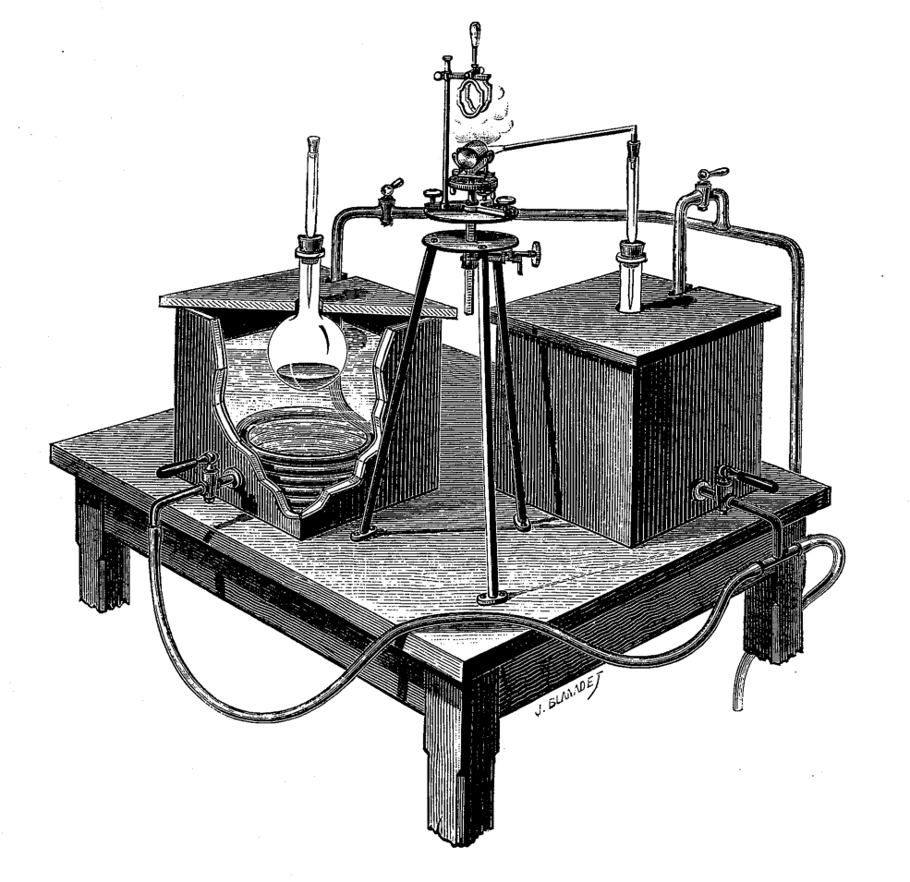
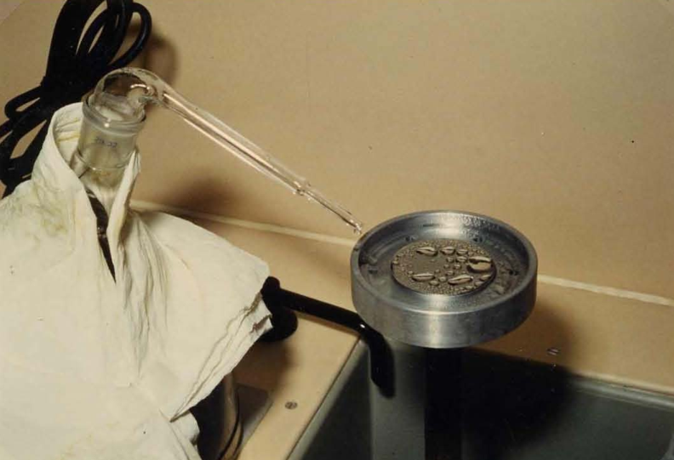
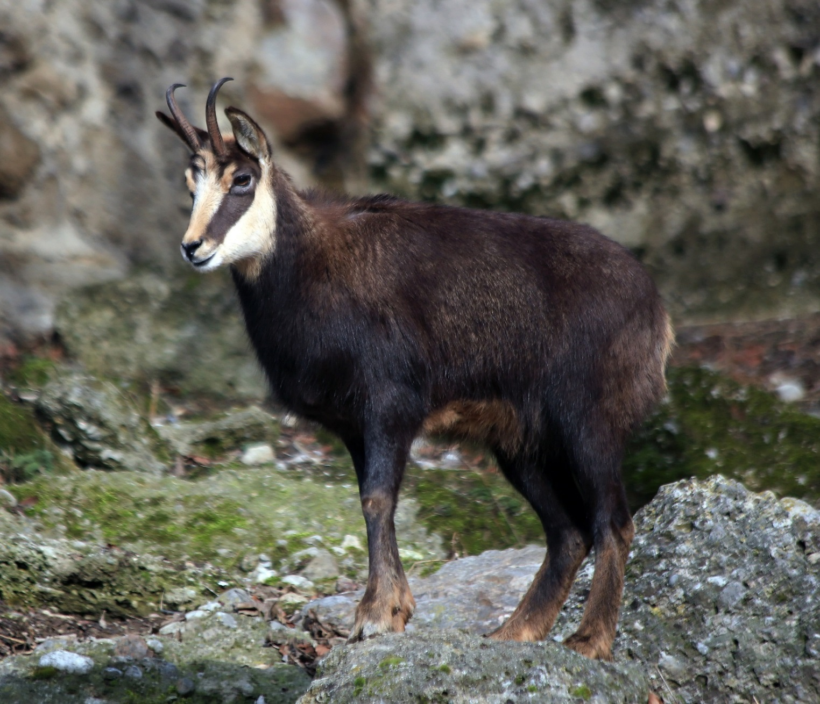
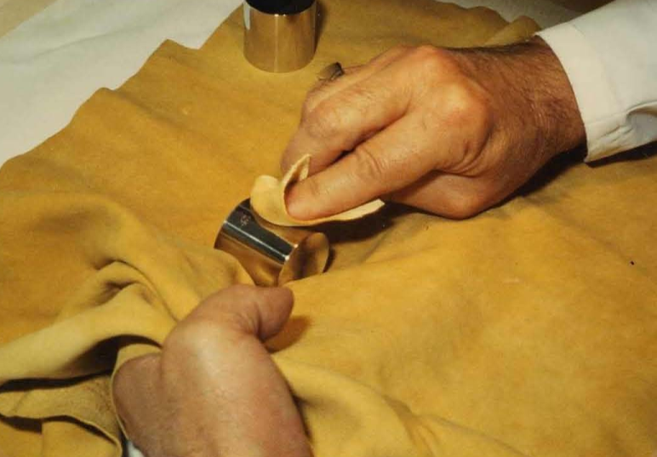
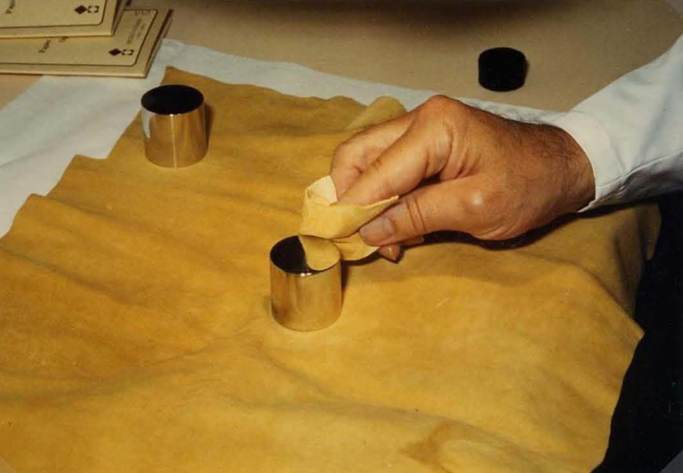
The IPK doesn’t normally weigh one kilogram
Nettoyage
Chamois leather soaked for 48 hours in a mixture of ethanol and ether.
Rubbed ‘fairly hard’ by hand
Lavage
Steam clean
https://www.bipm.org/utils/common/pdf/monographies-misc/Monographie1990-1-FR.pdf
Notes:
https://www.youtube.com/watch?v=VlJSwb4i_uQ

Slide 49
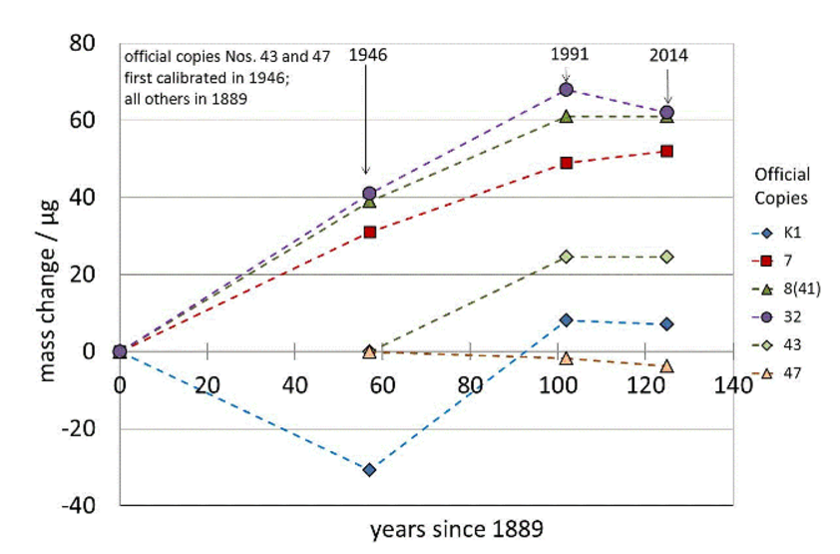
Has the mass of the IPK changed over time?
1 part in 10¹⁰
per year

Slide 50
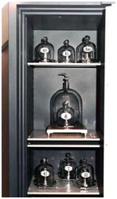
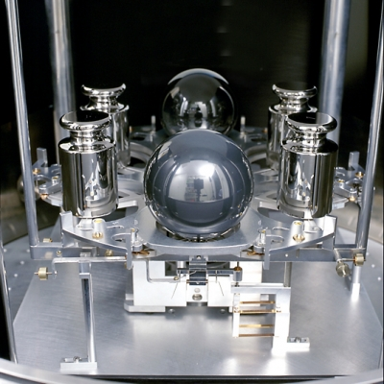
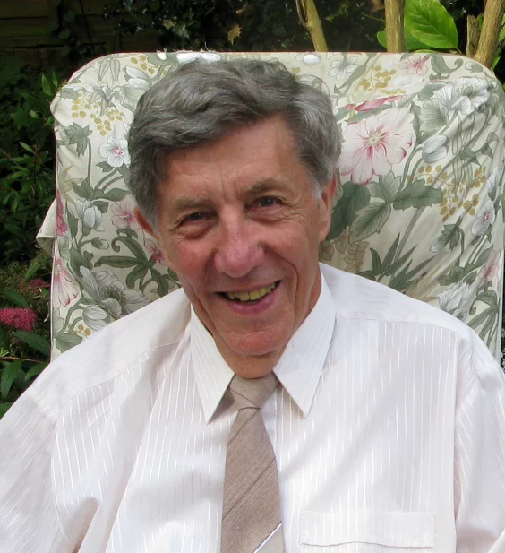
How can we replace the IPK?
Option#1
A recipe for creating artifacts of known mass
The Avogadro Project
Option#2
Measure gravitational force in terms of electromagnetic forces.
Originally, a Watt Balance, now called a Kibble balance.
Bryan Kibble
1939 - 2016
Notes:
https://www.youtube.com/watch?v=VlJSwb4i_uQ

Slide 51
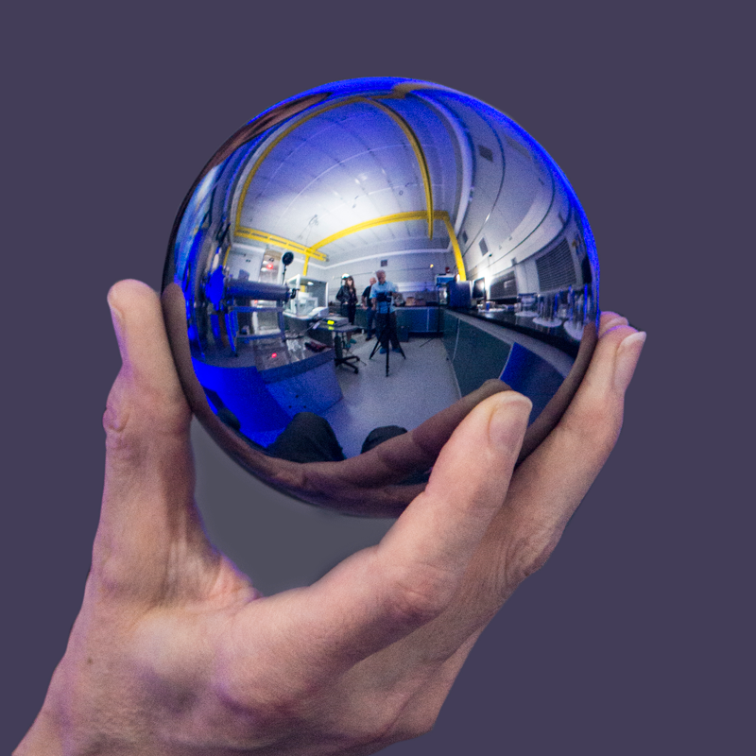
The Avogadro Approach
NIST

Slide 52
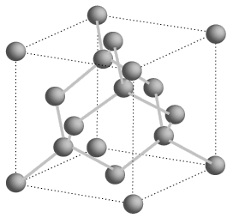
Recipe for a kilogram of silicon
3. Using 1 & 2 we can work out
the number of atoms in the sphere, N
4. Silicon atomic mass
known from spectroscopy
in terms of h/m_{Si}
(unit m²/s - known without
reference to the SI kg)
gives m_{Si} = K h
2. X-ray analysis gives
lattice constant
traceable to the metre
1. Dimensions
traceable to the metre
5. From 3 & 4 the mass of the sphere is N m_{Si}
²⁸Si
6. Surface layers characterised

Slide 53
The Kibble balance
Notes:
53

Slide 54
The Kibble Balance
When balanced…
Electro-magnetic Force
on M depends on
Mass of M
Electric Current
Coil Shape
Magnetic Field
X
Rigid
Frame
Magnet
When falling…
M
N
S
N
Voltage Induced
depends on
Speed
Coil Shape
Magnetic Field
Current Source
Voltmeter
Coil
Combining…
Interferometer
Mass can be deduced from
A voltage measurement
A current measurement

Slide 55
The Kibble Balance
When balanced…
Electro-magnetic Force
on M depends on
Mass of M
Electric Current
Coil Shape
Magnetic Field
X
Rigid
Frame
Magnet
When falling…
M
N
S
N
Voltage Induced
depends on
Speed
Coil Shape
Magnetic Field
Current Source
Voltmeter
Coil
Combining…
Interferometer
Mass can be deduced from
A voltage measurement
A current measurement
Maths
No Maths

Slide 56


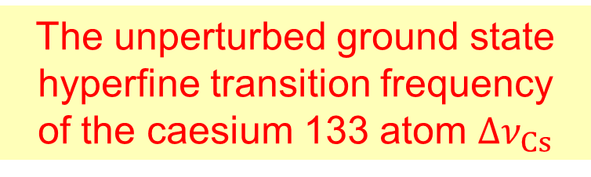



The Kibble Balance
When balanced…
$$F_{down}=\left(M−X\right)g$$
X
$$F_{up}=BLi$$
Rigid
Frame
$$ΔM=\frac{BLi}{g}$$
Magnet
M
When falling…
N
S
N
Current Source
$$V=BL×speed$$
Voltmeter
$$BL=\frac{V}{speed}$$
Combining…
Interferometer
$$ΔM=\frac{Vi}{g×speed}$$

Slide 57
The Kibble Balance
When balanced…
$$F_{down}=\left(M−X\right)g$$
X
$$F_{up}=BLi$$
Rigid
Frame
$$ΔM=\frac{BLi}{g}$$
Magnet
M
When falling…
N
S
N
Current Source
$$V=BL×speed$$
Voltmeter
$$BL=\frac{V}{speed}$$
Coil
Combining…
Interferometer
$$ΔM=\frac{Vi}{g×speed}$$

Slide 58
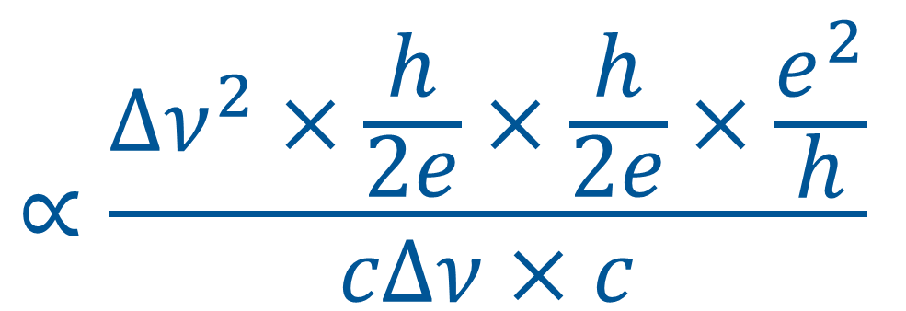
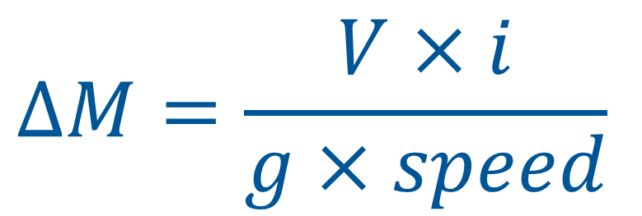
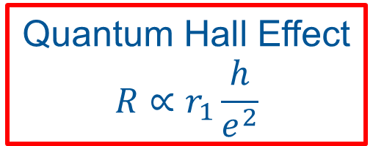
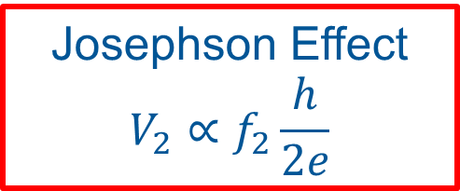
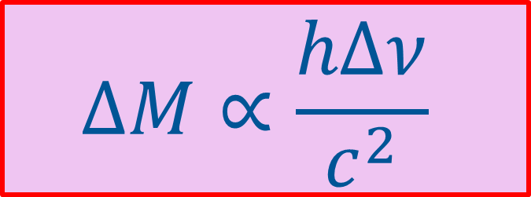




The Kibble Equation
Josephson Effect
$$V_{2}∝f_{2}\frac{h}{2e}$$
Josephson Effect
$$V_{1}∝f_{1}\frac{h}{2e}$$
Ohms Law
$$i=\frac{V}{R}$$
Quantum Hall Effect
$$R∝r_{1}\frac{h}{e^{2}}$$
$$∝\frac{Δν^{2}×\frac{h}{2e}×\frac{h}{2e}×\frac{e^{2}}{h}}{cΔν×c}$$
$$ΔM=\frac{V×i}{g×speed}$$
$$ΔM∝\frac{hΔν}{c^{2}}$$
Gravimeter
$$g∝cΔν$$
Interferometer
$$speed∝c$$

Slide 59
The Kibble Equation
Josephson Effect
$$V_{2}∝f_{2}\frac{h}{2e}$$
Josephson Effect
$$V_{1}∝f_{1}\frac{h}{2e}$$
Ohms Law
$$i=\frac{V}{R}$$
Quantum Hall Effect
$$R∝r_{1}\frac{h}{e^{2}}$$
$$∝\frac{Δν^{2}×\frac{h}{2e}×\frac{h}{2e}×\frac{e^{2}}{h}}{cΔν×c}$$
$$ΔM=\frac{V×i}{g×speed}$$
$$ΔM∝\frac{hΔν}{c^{2}}$$
Gravimeter
$$g∝cΔν$$
Interferometer
$$speed∝c$$
$$ΔM=\frac{Vi}{g×speed}$$

Slide 60


Slide 61


Slide 62
Measurement is…Quantitative Comparison
Phenomenon
traceable to
h, c and Δν_{Cs}
Now
Unknown
N
S
N
Standard
Before May 2019
Notes:
62
Playing this idea out for traceability of mass measurement before and after the redefinition

Slide 63
Redefining the kilogram
Kilogram
Exactly defined by the
Planck constant
Kilogram
Exactly the mass of the
international prototype
of the kilogram
Planck Constant
Exactly
6.626 070 150 x 10⁻³⁴
joule seconds
Planck Constant
6.626 070 150 ±
0.000 000 069
x 10⁻³⁴ joule seconds
Measurement of Planck constant improves
Measurement of mass improves
1900
2000
2100
2200
Kilogram Re-defined
Notes:
This is the story of the way in which the metre was re-defined in terms of the speed of light in vacuum.
This is the same kind of switch we wish to carry out with the ampere and kilogram.

Slide 64
Detail#2
Are the constants really constant?
Notes:
64

Slide 65



Constancy of Constants
$α$is dimensionless
it has the same value in any unit system
We can check our belief that c, h and e are stable in time
The stability of the $α$ can be measured using atomic clocks
  Some oscillations depend on $α$
  Others depend on $α^{2}$
If we compare the ratio of the clock frequencies over (say) a year, we can tell if $α$ is changing.
$$α=\frac{1}{4πε_{0 }}\frac{e^{2}}{hc}$$
Notes:
Improved Limit on a Temporal Variation of mp/me from Comparisons of Yb+ and Cs Atomic Clocks
N. Huntemann, B. Lipphardt, Chr. Tamm, V. Gerginov, S. Weyers, and E. Peik
Phys. Rev. Lett. 113, 210802 – Published 17 November 2014
Frequency Ratio of Two Optical Clock Transitions in Yb+171 and Constraints on the Time Variation of Fundamental Constants
R. M. Godun, P. B. R. Nisbet-Jones, J. M. Jones, S. A. King, L. A. M. Johnson, H. S. Margolis, K. Szymaniec, S. N. Lea, K. Bongs, and P. Gill
Phys. Rev. Lett. 113, 210801 – Published 17 November 2014

Slide 66

2014 Experimental tests of the stability of $α$
NPL
−0.7±2.1×10⁻¹⁷ per year
Fundamental constants appear to be at least
one million times
more stable than the kilogram
PTB
−2.0±2.0×10⁻¹⁷ per year
$$\frac{1}{α} \frac{dα}{dt} ({10}^{−16} per year)$$
Notes:
66
In contrast the kilogram has copies (e.g. copy 7) that have changed by:
~ 50 micrograms in 125 years
4×10⁻¹⁰ per year

Slide 67
Detail#3
Artifacts vs Abstractions
Notes:
67

Slide 68

Defining artifacts and materials
Kilogram
  Defined as the exact mass of the International Prototype of the Kilogram
Kelvin
  Defines the temperature of the Triple Point of Water to be exactly 273.16 K
Notes:
Measurement is the quantitative comparison of an unknown object with a standard object

Slide 69


The triple point
of water
Pure Water
Vienna Mean Standard Ocean Water (VSMOW)
Dissolved glass?
Glass vessel
273.16 K
1. Fill with ‘water’
2. Remove the air
3. Seal
4. Water Vapour fills the space
5. Chill the middle
6. Leave to equilibrate
Liquid Water
Water Vapour
Solid Water
All co-exist
in equilibrium
Notes:
https://www.youtube.com/watch?v=VlJSwb4i_uQ

Slide 70
The lesson of history
Avoid using artifacts to define units
  It’s fine to use artifacts to disseminate copies.
Abstraction is our friend
  Using exact constants removes the uncertainty from definitions
?
Notes:
Measurement is the quantitative comparison of an unknown object with a standard object

Slide 71
How do we get to know anything?
Introduction
An Alternative System of Units
The International System of Units: the SI
Details, Details, Details.
Summary
Notes:
71

Slide 72


The New International System of Units
Notes:
Graphical illustration of the way the constants are represented along with the units in the logo.

Slide 73




Precision Measurement…
…brings the world into focus

Slide 74


Thank you:
michael.depodesta@npl.co.uk
The National Physical Laboratory is operated by NPL Management Ltd, a wholly-owned company of the Department for Business, Energy and Industrial Strategy (BEIS).

Slide 75
Detail#3
Electrical Units
Notes:
75

Slide 76
The previous structure of the SI
kg m² s^{–3} A^{–1}
volt, V
kg m² s^{–3} A^{–2}
ohm, Ω
kg m² s^{–3}
watt, W
kg m² s⁻²
Hard work to realise volts and ohms
in terms of the base units
joule, J
Derived Units
kg m s⁻²
newton, N
m s⁻²
kg m⁻³
m s⁻¹
A s
coulomb, C
Base Units
kg
m
s
A
K
mol
cd
Reality
Notes:
76

Slide 77




An experiment to absolutely realise volts
kg m² s^{–3} A^{–1}
volt, V
$$V=\sqrt{\frac{2d^{2}ρgΔz}{ε}}$$
Voltage
Source
For d = 1 mm,
~50 volts raises mercury by only 0.01 mm
$$d$$
$$Δz$$
V
Mercury
$$density, ρ$$

Slide 78


A history lesson
1960: SI Ampere defined in terms of µ₀.
Implies realisations of the ampere must be in terms of magnetic forces.
1962:Josephson Effect
Microwaves with frequency f
produce a DC Voltage
  $$V_{DC}=n\frac{f}{K_{J}} K_{J}=\frac{2e}{h}$$
1980: Quantum Hall Effect
2-dimensional electron gas
  $$R=\frac{R_{K}}{n} R_{K}=\frac{h}{e^{2}}$$
Since 1990
The 1990 estimates of h and e have been used to disseminate electrical standards worldwide.
These values changed slightly on Monday 20th May 2019
Notes:
Since 1984, an array of 20,208 junctions has been used to make 1 Volt.
https://www1.bipm.org/cc/CCEM/Allowed/29/CCEM-15-06-electrical-units-in-new-SI.pdf

Slide 79
Most significant change
Search ‘BIPM Voltage Redefinition’
Monday’s sudden ‘jump’
Drift of a high-quality 10 V Zener reference against Josephson standards
Notes:
Since 1984, an array of 20,208 junctions has been used to make 1 Volt.
https://www1.bipm.org/cc/CCEM/Allowed/29/CCEM-15-06-electrical-units-in-new-SI.pdf

Slide 80


The new structure of the SI
kg m² s^{–3} A^{–1}
volt,V
$$h e^{−1}ν_{Cs}^{}$$
kg m² s^{–3} A^{–2}
ohm, Ω
$$h e^{−2}$$
Units
kg
m
s
A
K
mol
cd
$${h ν}_{Cs}^{}c^{−2}$$
$${c ν}_{Cs}^{−1}$$
$$ν_{Cs}^{−1}$$
$${e ν}_{Cs}^{}$$
$${h ν}_{Cs}^{}k_{B}^{−1}$$
$$N_{A}$$
$${hν_{Cs}^{2} K}_{cd}$$
Natural Constants
h
c
$$ν_{Cs}$$
e
k_{B}
N_{A}
K_{cd}
Notes:
80

