Slide 1

Earth Observation for Addressing Global Challenges
Dr Emma Tebbs
Department of Geography, King’s College London
emma.tebbs@kcl.ac.uk

Slide 2
“Right now we are facing a man-made disaster of global scale, our greatest threat in thousands of years: climate change. If we don't take action, the collapse of our civilization and the extinction of much of the natural world is on the horizon.”
David Attenborough, 2018
Notes:
These quotes highlight the urgency of these challenges and the need to identify solutions using science and by bringing together different disciplines. It address these challenges and to mitigate and adapt to climate change we need good observations of how the environment is changing. Satellite EO can contribute to this.

Slide 3
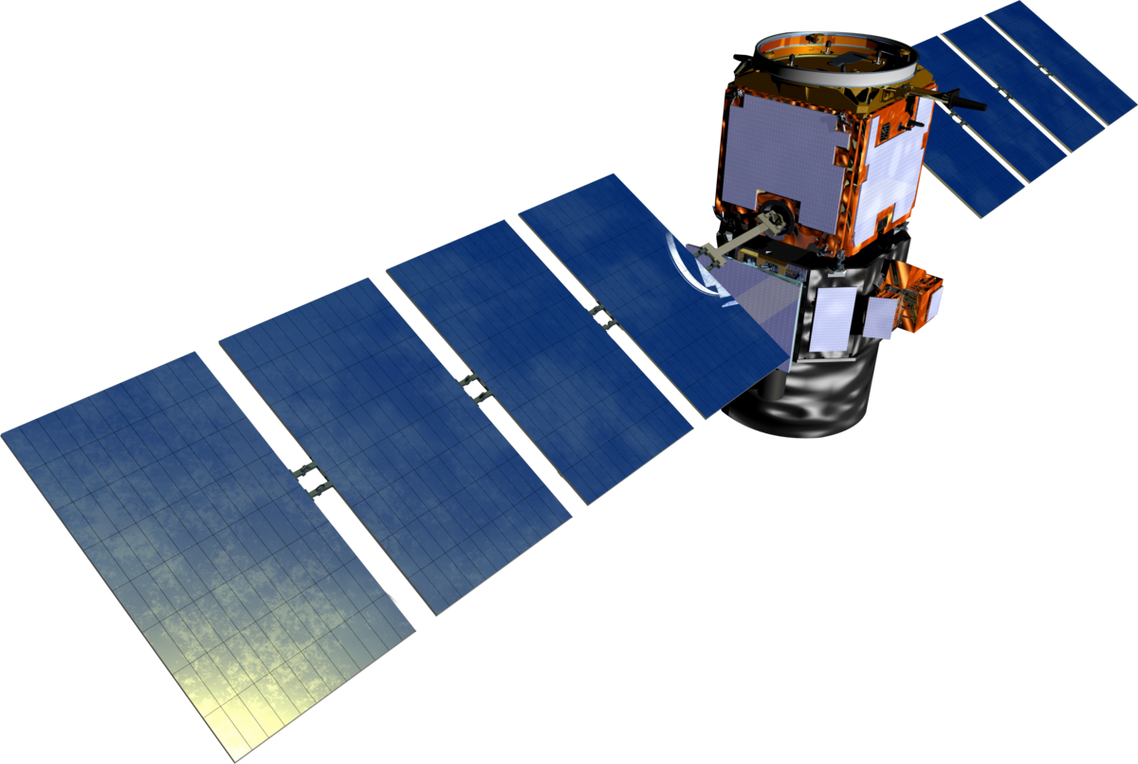
Outline
What is Earth Observation (EO)?
How can EO contribute to addressing global challenges?
Example applications: Satellite EO for sustainable management of water resources.
Limitations of EO
Notes:
Given the range of backgrounds in the room I will give a general introduction to satellite EO starting with some basic concepts.
Why am I starting with a general introduction
My expertise not in gravimetry
Range of backgrounds in the room so start with some of the basics
Many of the fundamental concepts apply across all types of satellite remote sensing
Satellite gravimetry most useful when combined with other satellite products to give a full picture of what is going on.

Slide 4
What is Earth Observation?

Slide 5
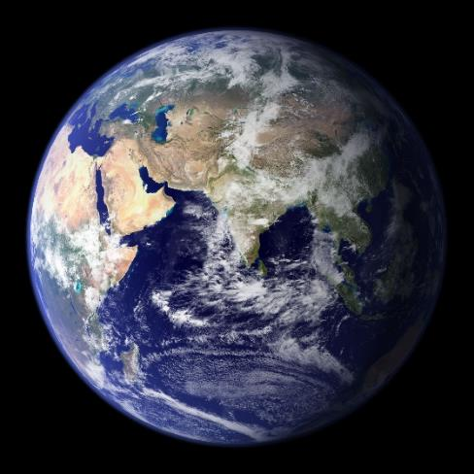
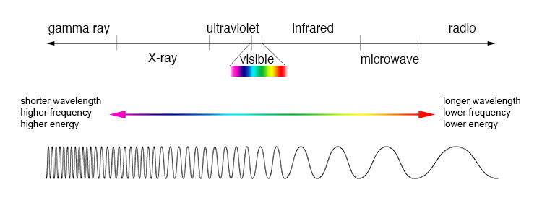
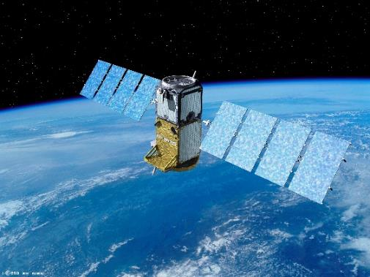
“Earth observation is the gathering of information about planet Earth’s physical, chemical and biological systems via remote sensing technologies, usually involving satellites carrying imaging devices”
European Commission
https://ec.europa.eu/jrc/en/research-topic/earth-observation
Notes:
Has anyone heard of remote sensing?
It is used to make observations from a distance.
Although RS can be carried out from airborne and ground based measurements – in this talk I will be focusing on satellite observations.

Slide 6
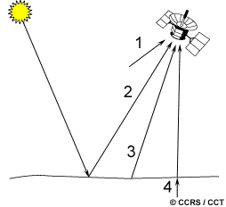
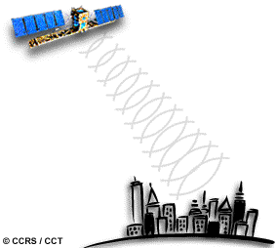
Types of sensor
Passive sensors
Measures natural sources of reflected or emitted electromagnetic radiation.
Active Sensors
Produce their own source of electromagnetic radiation
Notes:
Any questions?
66

Slide 7
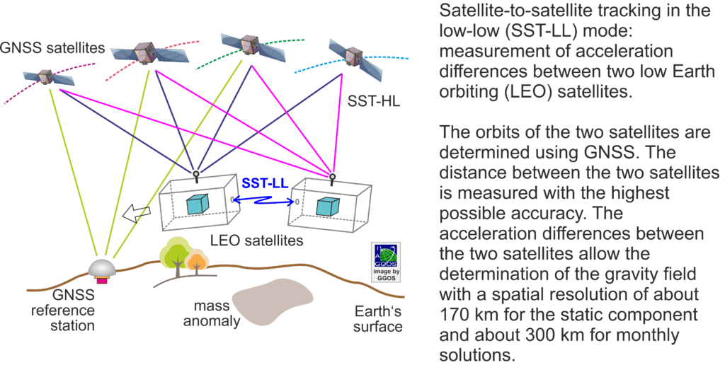
Satellite-based gravity field observations
https://ggos.org/item/satellite-gravimetry/

Slide 8
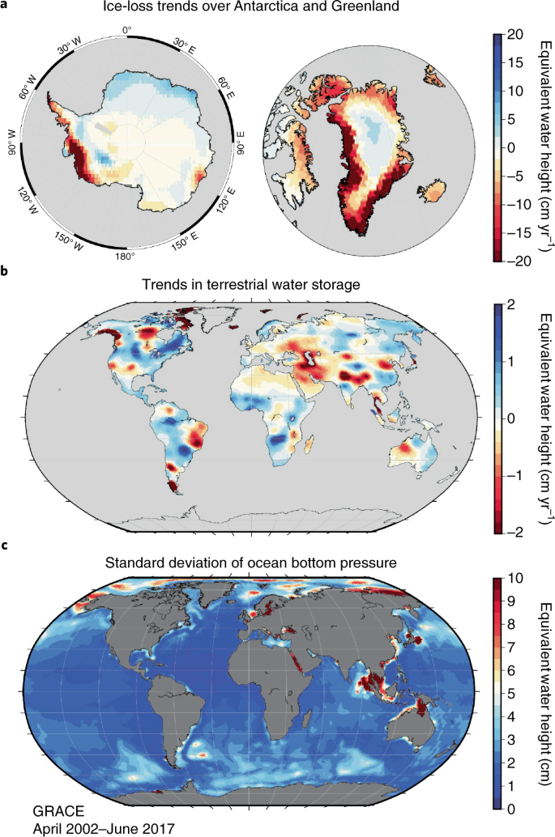
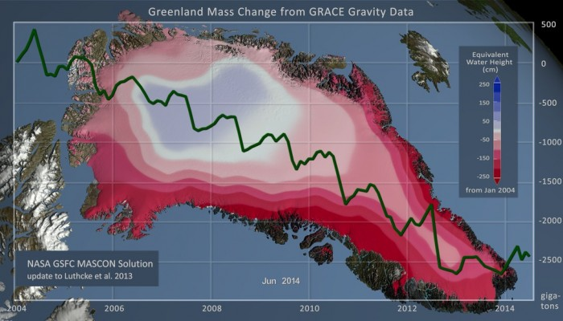
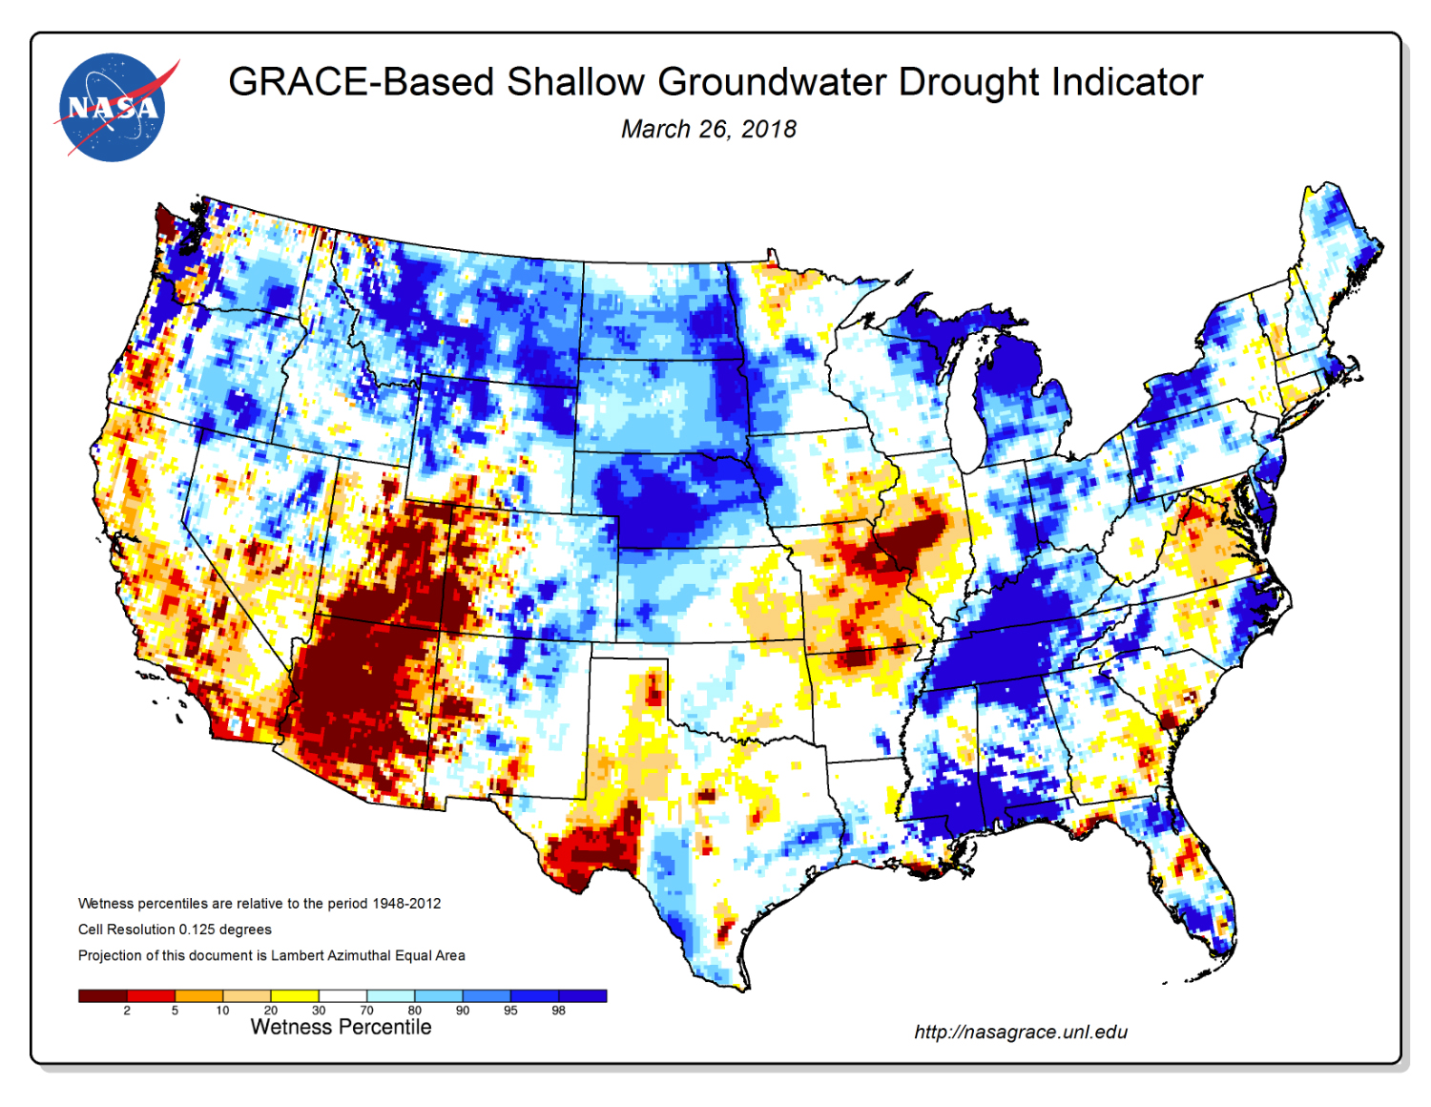
Gravimetry
Tapley et al. 2019 Contributions of GRACE to understanding climate change. Nature Climate Change
https://blogs.egu.eu/divisions/cr/2016/02/19/image-of-the-week-changes-in-the-greenland-ice-sheet-documented-by-satellite/

Slide 9
How can EO contribute to addressing global challenges?

Slide 10




EO 4 SDGs (Sustainable Development Goals)
UN Sustainable Development Goals focus on data driven, evidence-based decision-making.
Satellite EO data can provide observations of our oceans, land surface, freshwaters and atmosphere.

Slide 11
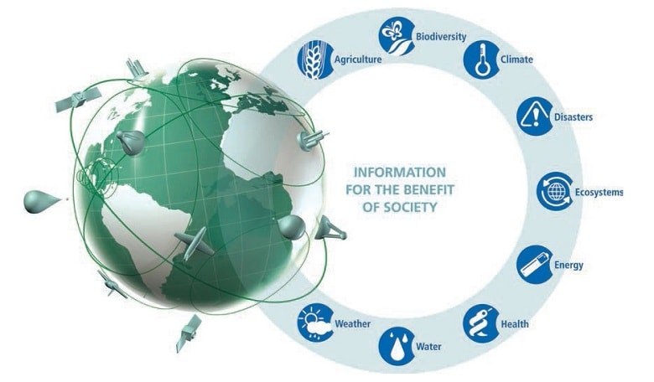
How can EO contribute to addressing global challenges?
EO can be used to observe:
Biosphere
Hydrosphere
Cryosphere
Geosphere
Atmosphere
Source: Group on Earth Observations (GEO)
Notes:
Climate change
Unsustainable use of natural resources.
I will focus primarily on water resources
In this talk I will include a range of examples of Earth Observation applications and not just those are that are directly relevant to cold atoms – later there will be talks that focus more specifically on gravity field measurements and cold atoms for EO.

Slide 12

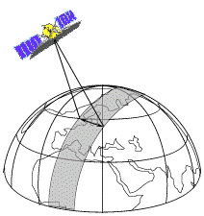
How can EO contribute to addressing global challenges?
More cost-effective than ground-based surveys
Allows regional and global coverage
Satellites provide a consistent long-term dataset
Allows monitoring of a wide range of parameters to assess status and trends.
Can be integrate with other data sources to investigate drivers and impacts of change
The impact of management interventions can also be assessed
Notes:
Satellites make global coverage feasible
Satellites give averaged value which is more meaningful - In situ observations give you a precise value at a particular point
In situ studies used different instruments which leads to questions whether the instruments were calibrated the same.
1212

Slide 13
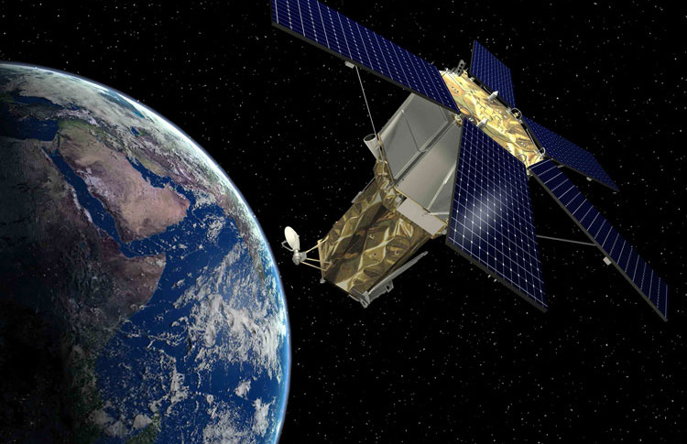
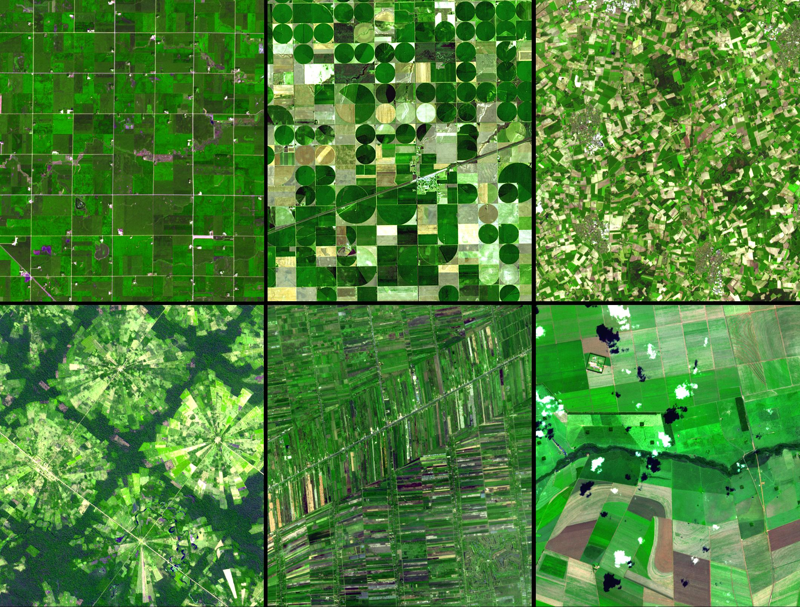
How can EO contribute to addressing global challenges?
Providing consistent, frequent, global observations of how the Earth is changing.
Supporting the science that underpins global decision-making
Can be integrated into models to support projection of future impacts.
Providing powerful imagery and data for advocacy

Slide 14
Example applications:
Satellite EO for sustainable management of water resources.

Slide 15
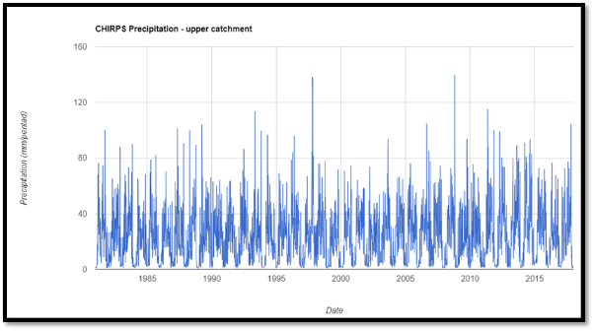
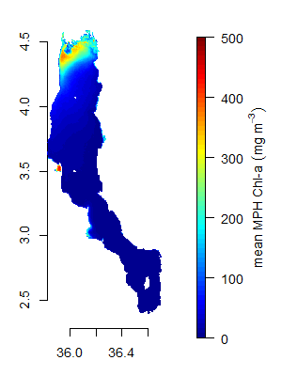
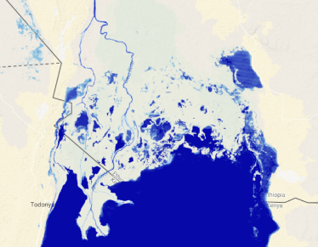
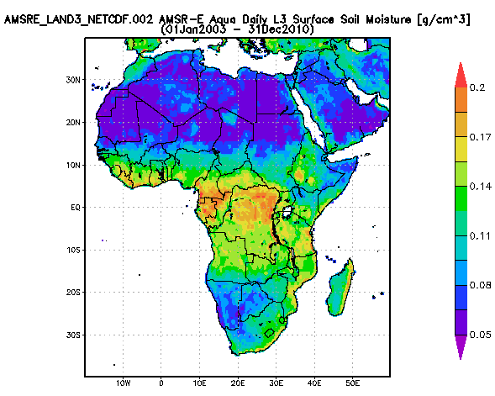
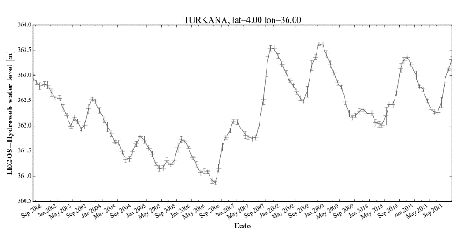
Remote sensing of water resources
Climate - e.g. Rainfall, temperature, ET
https://global-surface-water.appspot.com/
Water quality
Surface waters
Catchment properties
– e.g. land cover
Soil moisture/ groundwater
Water levels
(altimetry)

Slide 16
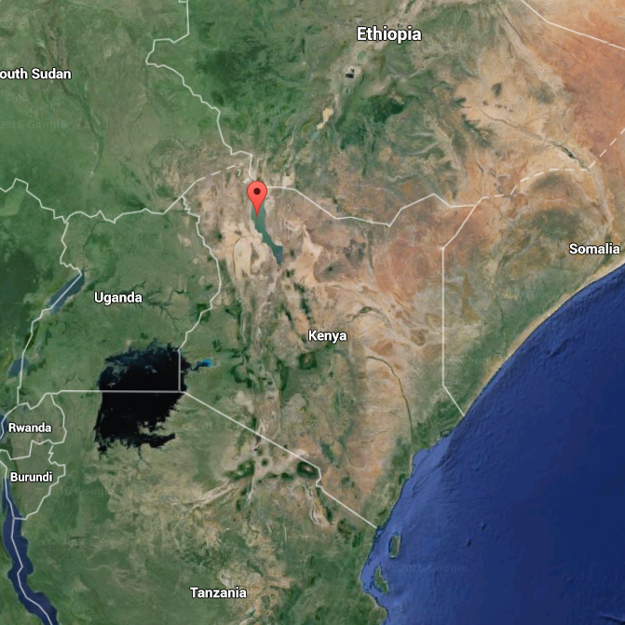

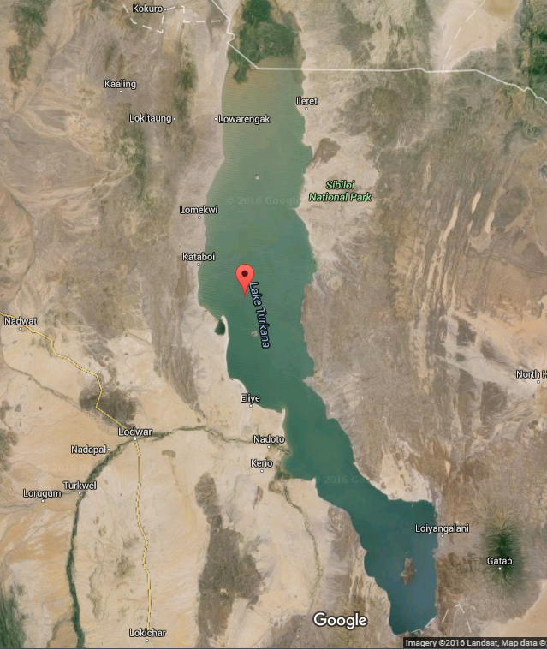
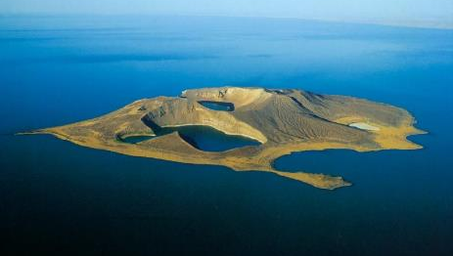
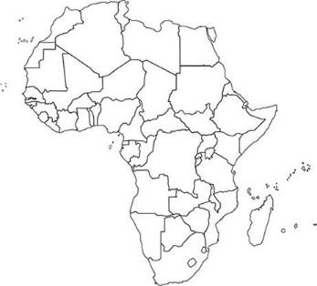
Case Study: Lake Turkana
Diverse and unique indigenous cultures
~300,000 Kenyans rely on the lake for their fishing and agro-pastoralism based livelihoods
Its 3 National Parks form a World Heritage Site
11 endemic fish species
Located in a highly arid area in northern Kenya.
World’s largest desert lake and largest alkaline lake
Max. depth 114m
Length 257 km; width 44 to 13 km
Notes:
Evaporative Basin in arid region, Omo Delta Wetland, Important for biodiversity, Relatively pristine ecosystem, increasing human influence particularly with construction of Gibe III dam which will permanently alter the hydrological cycle.
; Max depth 114m
Length 257 km; width 44 to 13 km
Average depth 30m

Slide 17
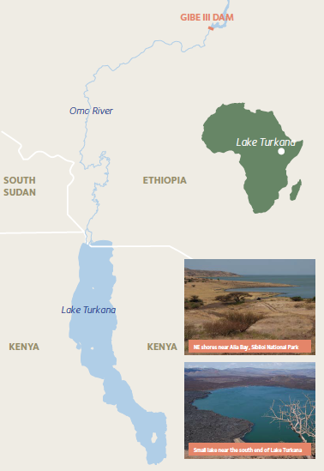
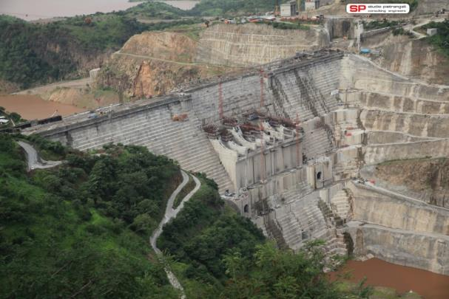
Gibe III dam
Has been built on the Omo River, Ethiopia
Dam will provide hydro-electric power to Ethiopia and surrounding counties
Gibe III dam has permanently altered the hydrological cycle of Lake Turkana
Avery, S. (2012). LAKE TURKANA & THE LOWER OMO: HYDROLOGICAL IMPACTS OF MAJOR DAM & IRRIGATION DEVELOPMENTS. http://www.africanstudies.ox.ac.uk/lake-turkana-and-lower-omo-hydrological-impacts-major-dam-and-irrigation-developments
Notes:
Omo River provides close to 90% of the lake’s inflow

Slide 18
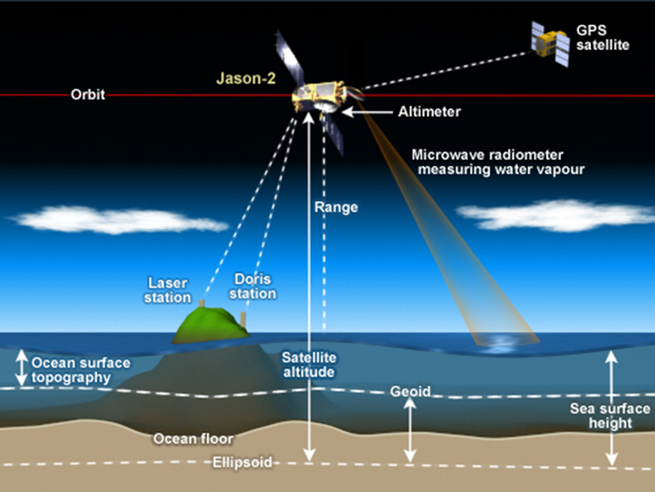
Radar Altimetry

Slide 19
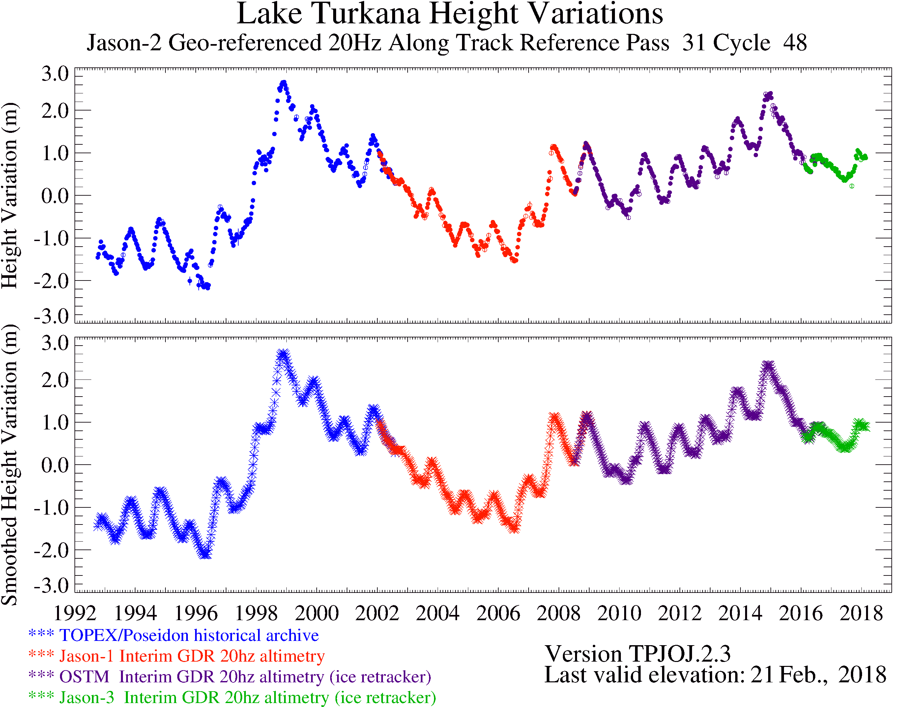
Lake Turkana water levels
Filling of Gibe III reservoir was predicted to cause 2m decline in lake levels and loss of seasonal oscillations (Avery, 2009, 2010)
Lake Turkana Height Variations from TOPEX/POSEIDON/Jason-1 and Jason-2/OSTM Altimetry
~2m decline in lake levels
Lake level data available from: https://ipad.fas.usda.gov/cropexplorer/global_reservoir/
Notes:
Add slide on how radar altimetry works?
This is supported by the radar altimetry data – this is important because the lake ecology is adapted to fluctuating water levels which trigger fish migrations and breeding. The loss of seasonal oscillations is likely to lead to a decline in fish in the lake and impact on local livelihoods and food security.

Slide 20
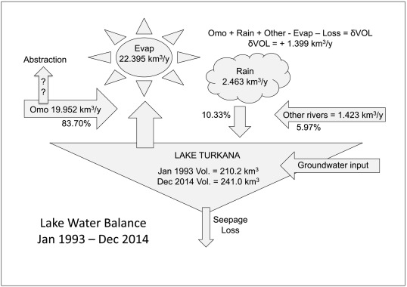
Lake Water Balance
Future improvements in satellite gravity field measurements could refine the water balance model for the lake.
It could help to improve the quantification of lake storage and groundwater inputs and outputs.
Avery and Tebbs 2018
Notes:
To fully understand the impacts of the dam on lake hydrology and ecology we need to understand the lake water balance. We can measure lake levels, surface area, rainfall etc with satellite. More accurate gravimetry measurements will help to constrain the water balance.

Slide 21
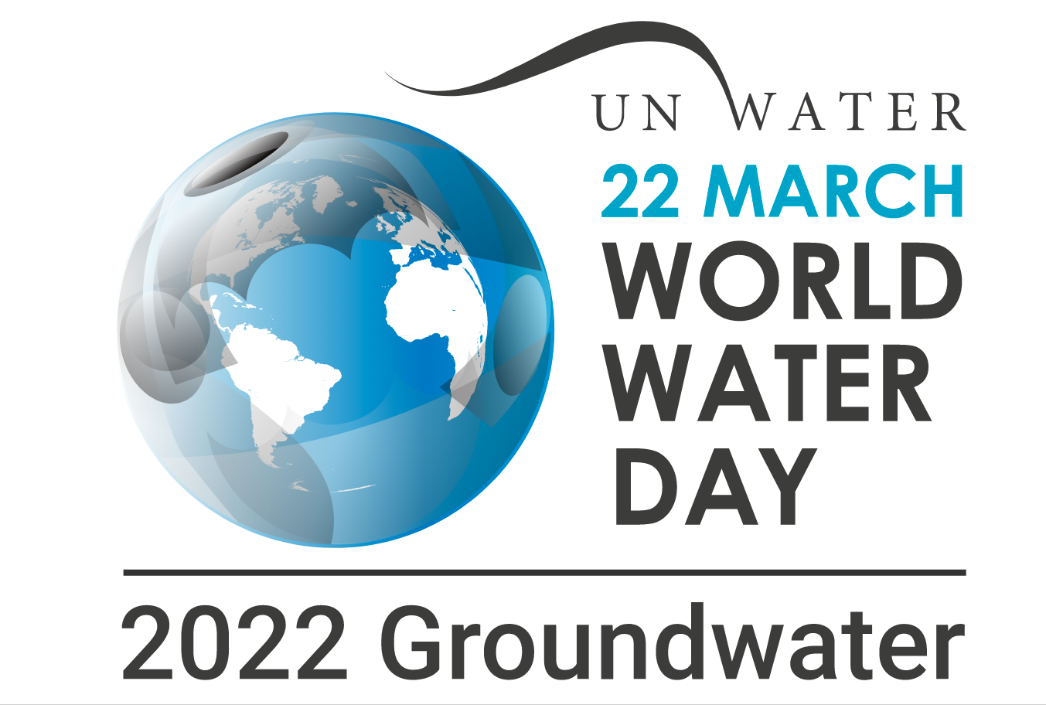
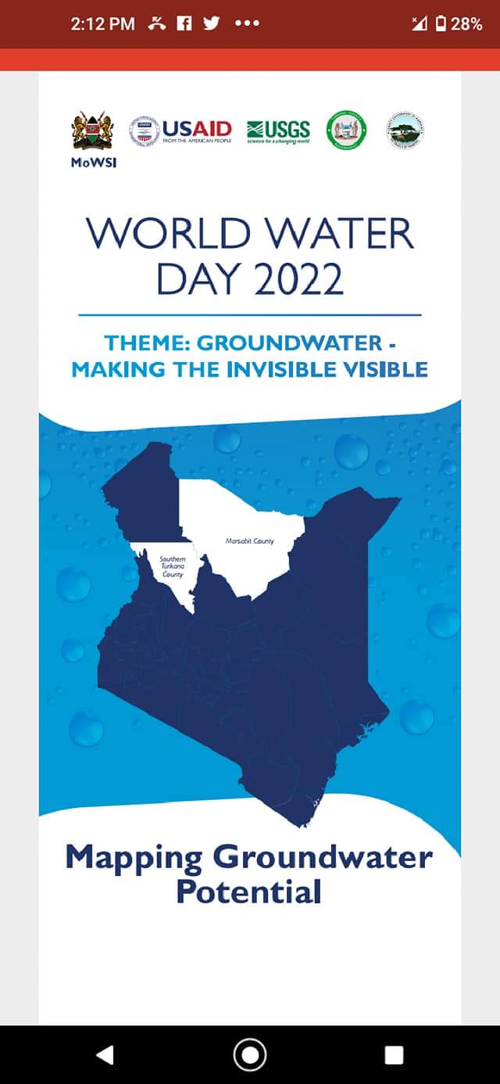
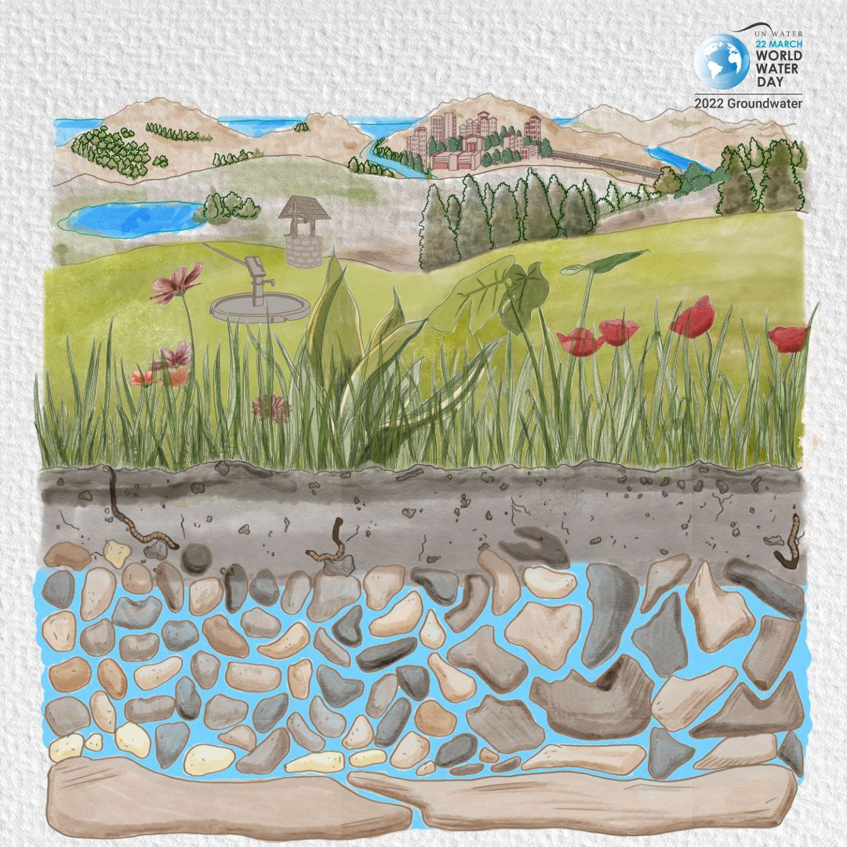

Slide 22
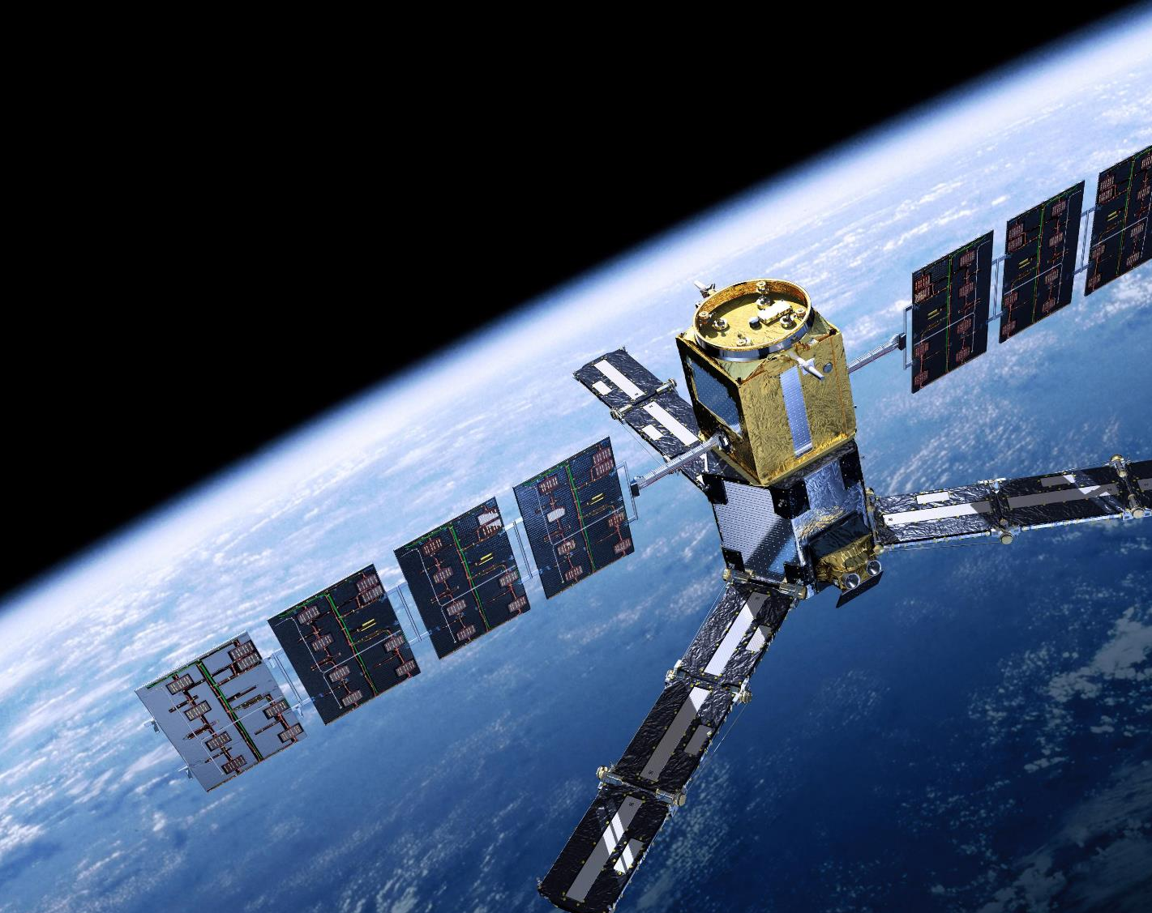



Case study: Soil Moisture
India-UK Water Centre Pump Priming Project “Satellite Soil Moisture Observations: Applications in the UK and India”
Soil moisture plays a critical role in plant growth and partitioning of water and energy fluxes as Earth’s surface, such as evaporation, groundwater recharge and runoff generation.
The last decade has seen a huge increase in the number (and accuracy) of EO-based SM sensors and products (Brocca et al., 2017a), particularly new microwave sensors such as SMOS and SMAP.
Tebbs, E., Wilson, H., Mulligan, M., Chan, K., Gupta, M., Maurya, V. and Srivastava, P. (2019). Satellite Soil Moisture Observations: Applications in the UK and India. Report of Pump Priming Project The India-UK Water Centre; Wallingford and Pune. https://iukwc.org/sites/default/files/images/Tebbs%20PPP%20Report.pdf

Slide 23
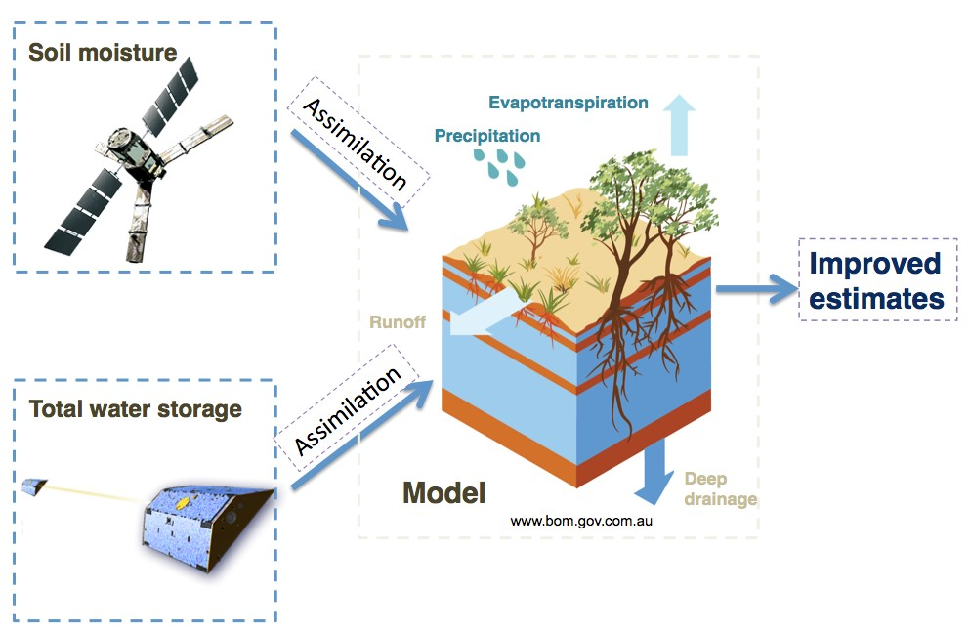

Slide 24
Project Aims
Satellite Soil Moisture Observations: Applications in the UK and India
Review current and future satellite-based SM products and their existing and potential future applications in the UK and India.
Identify barriers, opportunities and user needs for incorporating satellite-based SM products into existing monitoring and forecasting.
Demonstrate the potential for using new and emerging technologies (COSMOS and low-cost sensors) for validation of EO products.
Project Methods
Literature review
User survey
Pilot low-cost soil moisture sensor experiment

Slide 25
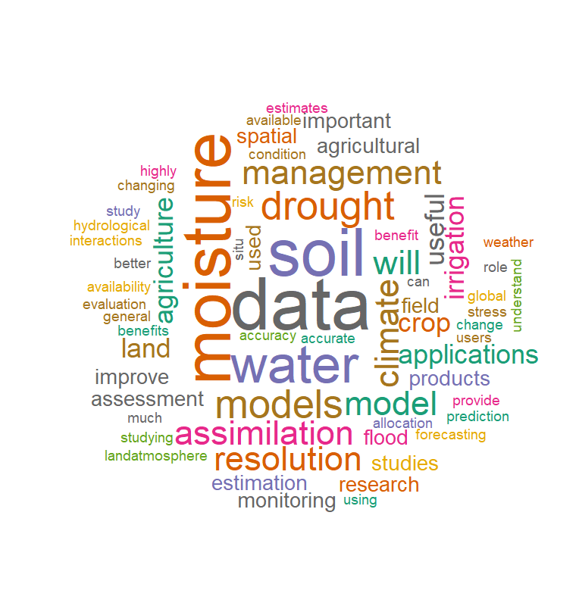
Applications of satellite soil moisture data
Weather Forecasting
Flood Prediction
Drought Monitoring
Agricultural Services

Slide 26
Applications
EO-based SM products have huge potential for improving monitoring and forecasting in India and the UK.
In the UK satellite SM observations are used in two operational Numerical Weather Prediction models. An India-UK collaboration is now exploring the use of satellite SM for improving predictions of the Indian monsoon.
Satellite SM data has great potential for monitoring of water-related hazard, such as regional droughts, particularly in India, and flood forecasting.
Agricultural applications include assessing crop condition, predicting yields and irrigation monitoring. Opportunities to incorporate products into commercial agricultural services or supporting government decision-making.
An accompanying State of the Science Brief summarizing the project can be found at www.iukwc.org

Slide 27
Challenges and opportunities
Barriers: availability of ground data, spatial resolution, data access and lack of awareness.
In the UK, a network of cosmic ray soil moisture sensors (COSMOS-UK, https://cosmos.ceh.ac.uk/) provides in situ observations, and the COSMOS-India project is improving the availability of in situ SM data for India.
Multi-sensors products such as ESA Climate Change Initiative (CCI) SM overcome the limitations of individual sensors and provide long-term SM observations.
An accompanying State of the Science Brief summarizing the project can be found at www.iukwc.org

Slide 28
Limitations of Earth Observation

Slide 29
Limitations
It can’t measure everything.
Ground data are still required for calibration and validation of satellite products.
Sensor/product characteristics:
Spatial and temporal resolutions
Temporal coverage (dataset length)
Uncertainty
Latency
The user requirements depend on the spatial and temporal scale of the process being observed
Notes:
2929

Slide 30
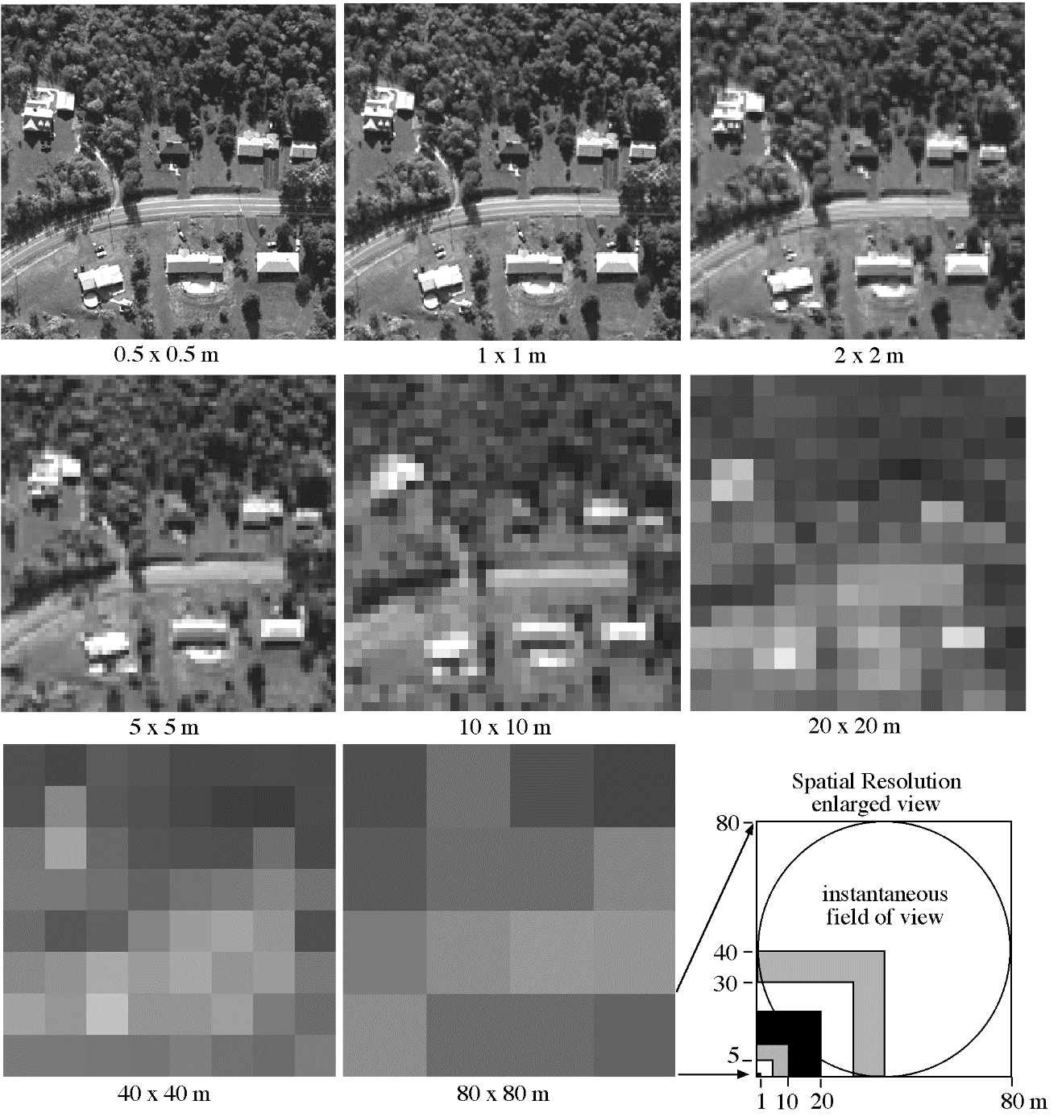
Spatial Resolution

Slide 31
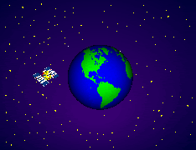
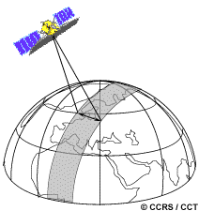
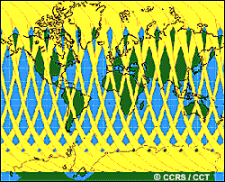
Temporal Resolution
Temporal resolution determines the frequency of observations.
Rapidly evolving processes require higher temporal frequency.
Notes:
31
Temporal resolution better for geostationary

Slide 32
Conclusions
Satellite EO can provide continuous global observations for understanding climate change (and other environmental change) impacts to inform mitigation and adaptation measures.
EO data can provide information on a wide range of parameters to underpin the science that supports decision making.
Limitations include product uncertainty, spatial and temporal resolutions and length of the satellite record.
User requirements depend on the scale and magnitude of the phenomena being observed.
Advances in satellite technology (e.g. using quantum sensors) will enhance current monitoring and open up new potential application areas.

Slide 33
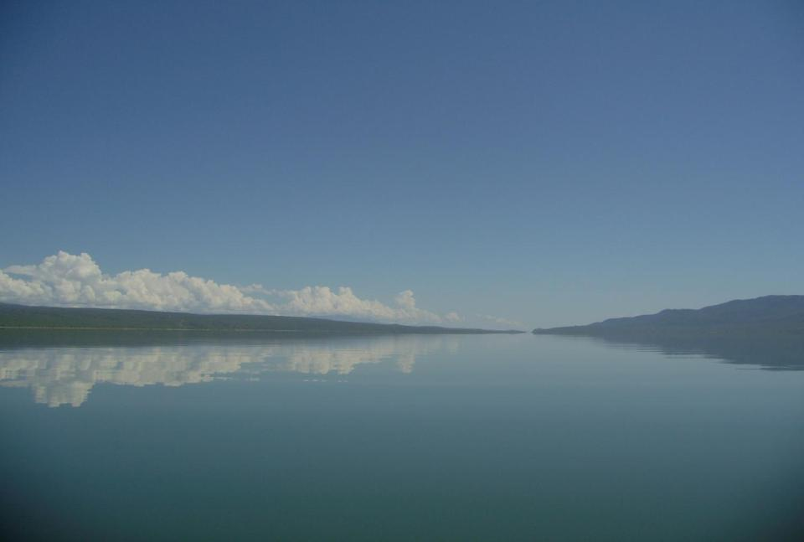
Thanks for listening
Dr Emma Tebbs
emma.tebbs@kcl.ac.uk

