Slide 1

UK Perspectives in Quantum Sensing
KCL Workshop on Cold Atoms and Climate Change
Kai Bongs
University of Birmingham
21.3.2022

Slide 2



























































UK National QT Hub in Sensors and Timing
Funders, Partners and Collaborators
TopGaN Quantum Technologies Ltd
Total project value since 2014: £200M (£60M EPSRC, £140M collaborative projects with industry)

Slide 3
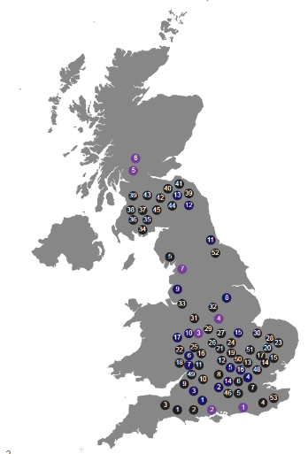





Success: UK Quantum Sensor Ecosystem
>112 collaborative projects with industry
>73 companies invested money
>£120M project value
(in addition to EPSRC £59M)
50 jobs in industry
>15 patent applications
>25 products
Our Hub represents ~10% of worldwide QT activities in Sensors
Note: this situation is different for Quantum Computing and Quantum Communication, where others are investing more)

Slide 4
What we do: Atoms manipulated by laser light
gravity
Also possible: rotation, time, magnetic fields,…

Slide 5

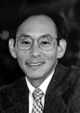
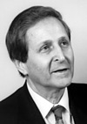
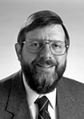

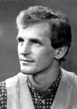

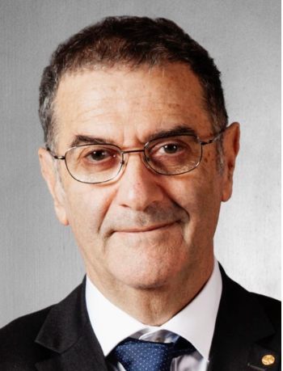
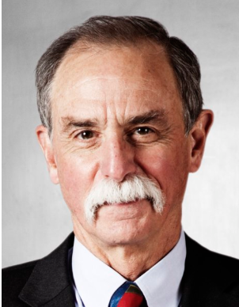
Quantum Sensor Ingredients
The Nobel Prize in Physics 1997
"for development of methods to cool and trap atoms with laser light"
Preparing probe particles
S. Chu
C. Cohen-Tannoudji
W.D. Phillips
The Nobel Prize in Physics 2001
"for the achievement of Bose-Einstein condensation in dilute gases of alkali atoms"
E. A. Cornell
W. Ketterle
C. E. Wieman
The Nobel Prize in Physics 2012
Manipulating probe particles
"for ground-breaking experimental methods that enable measuring and manipulation of individual quantum systems."
S. Haroche
D. J. Wineland

Slide 6
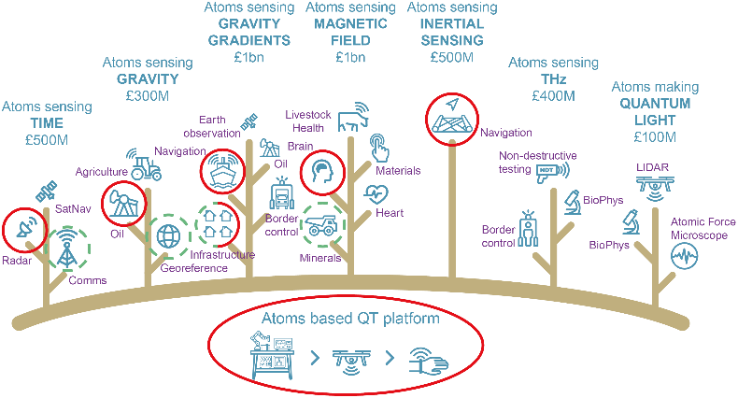
Application focus

Slide 7
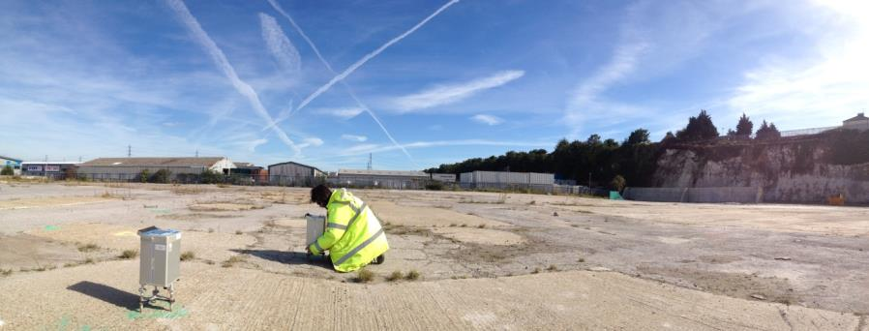
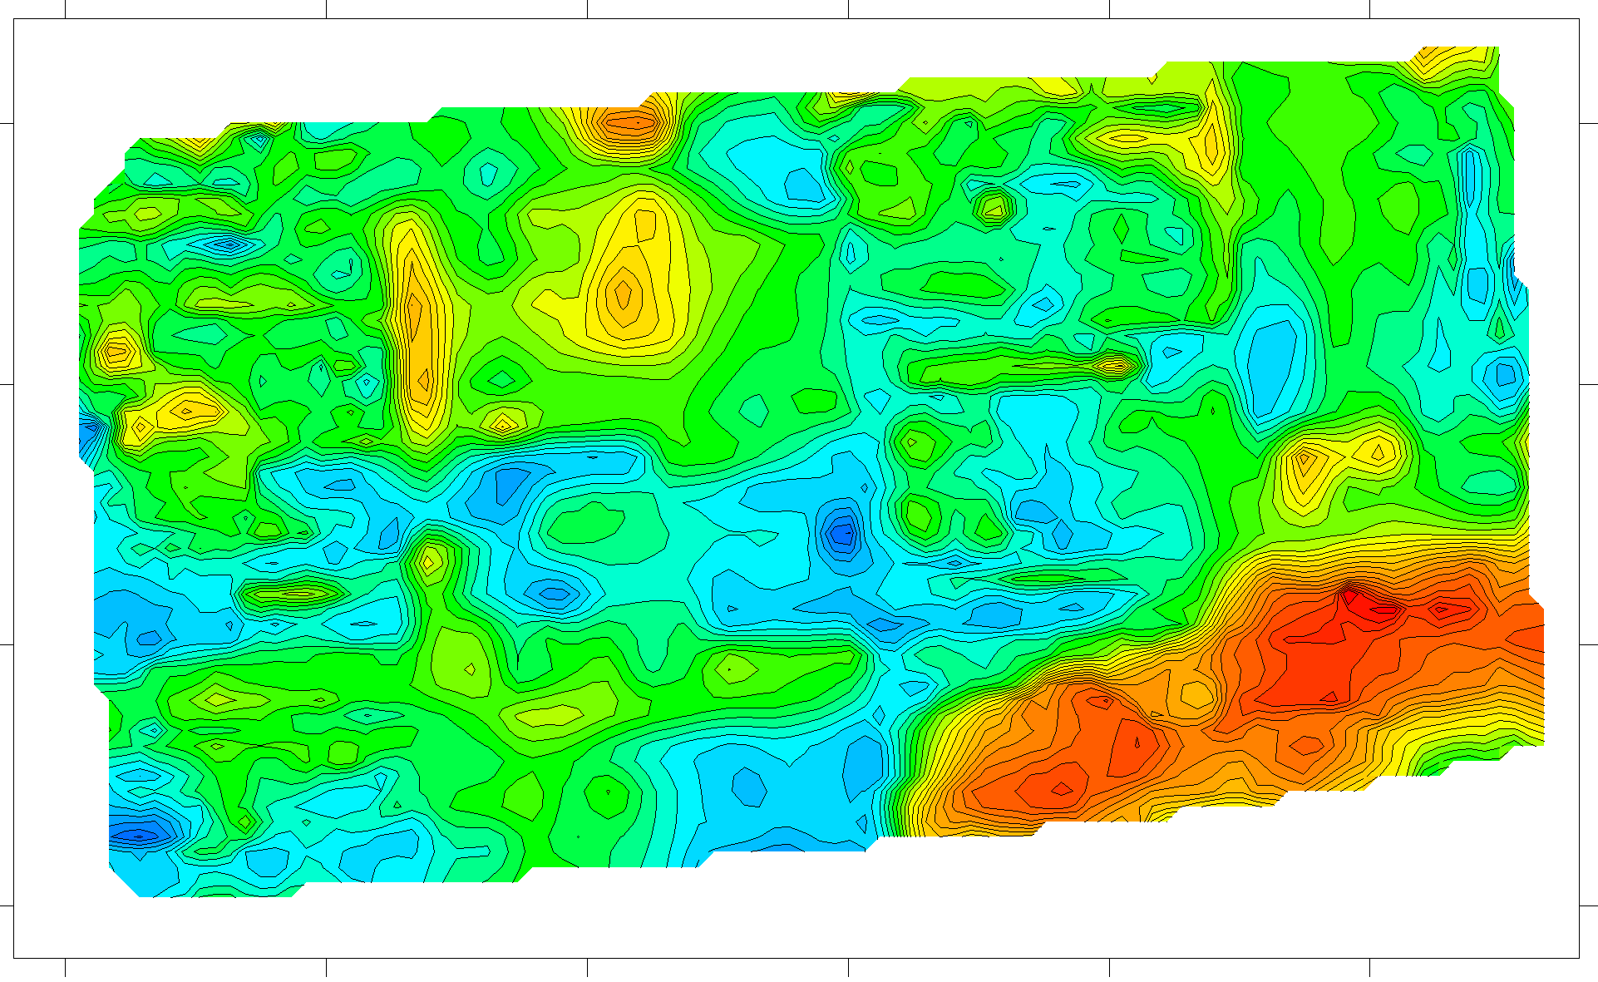


Microgravity Surveys and their Limitations
Example: Brown Field Site Survey
Classical microgravity sensors are sufficiently sensitive to deliver useful information!
BUT:
They take 5-10 min/measurement point
Sensor drift needs to be corrected by periodically returning to a calibration point
In this example: 1 month for 1 ha with 3 sensors and 4 persons
→ Commercial uptake hindered by cost of operation, not the sensitivity of the instrument
Gravity Mapping

Slide 8
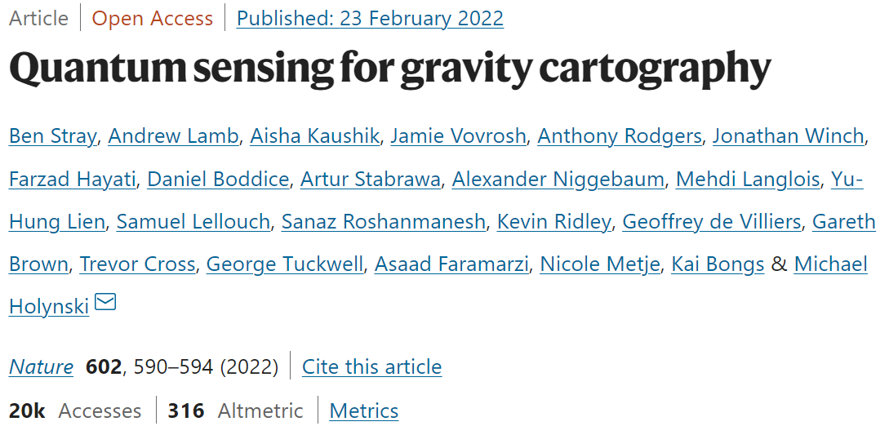







School of Physics and Astronomy
School of Engineering
Funding:
Notes:
Slide about partners and programme

Slide 9
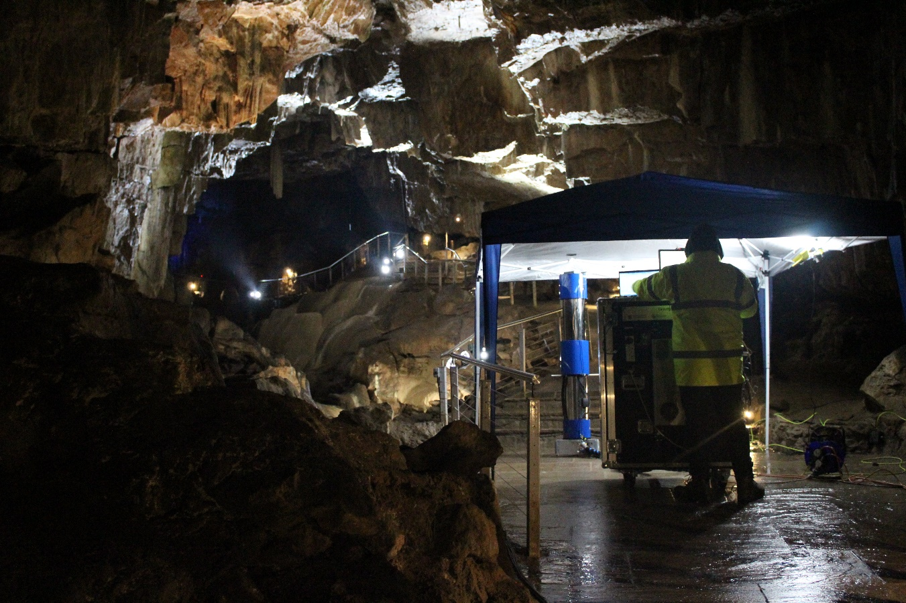
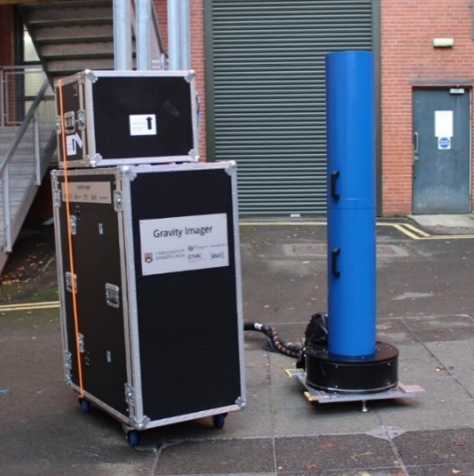
Hourglass gravity gradiometer
Novel robust design from Birmingham (patent pending)
Overcomes challenges for operation in the field

Slide 10
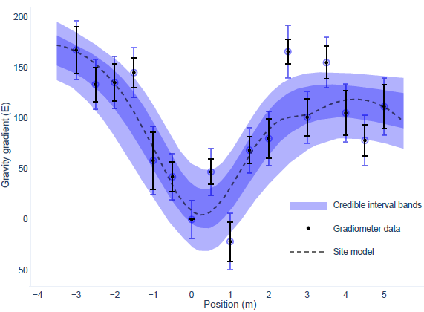
World first detection for quantum gradiometry
Survey over tunnel
2 m
Tunnel centre localised to: ±0.19 m, horizontal; -0.59/+2.3 m, vertical

Slide 11
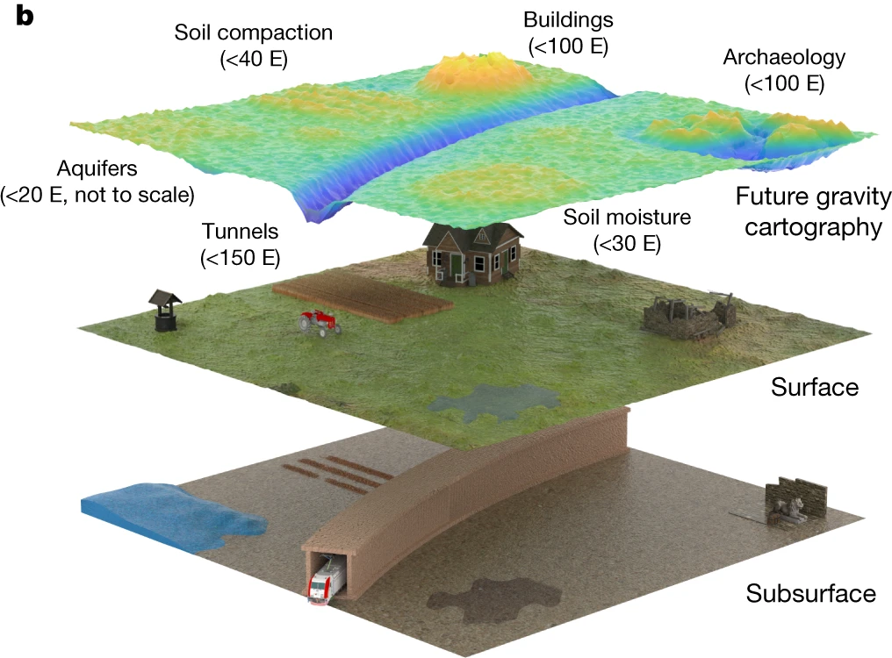
Enabling Gravity Cartography
Relevant to a range of applications, including:
  Water monitoring
  Infrastructure
  Archaeology
  Agriculture
  Navigation

Slide 12
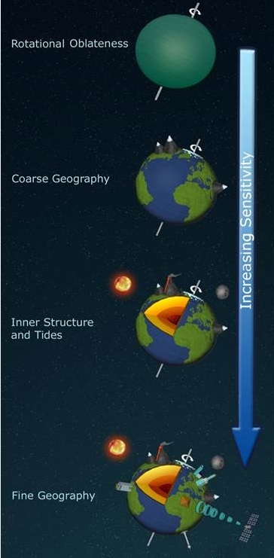
Geophysics Space Applications for Atom Interferometry
Long term
Current missions spatial resolution ≈ 100 km
QT gravity sensing to increase spatial and temporal resolution
≈10 factor improvement in resolution, more localised information
Ψ in the sky
K Bongs, M Holynski & Y Singh
Nature Physics 11, 615 (2015)

Slide 13
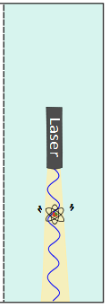
Measuring Gravity
Δφ=
➔ Dropping object next to laser ruler
Advantages over classical instruments:
Ideal test mass (no fabrication tolerances or ageing)
Measurement versus frequency (“absolute”)
Large potential for sensitivity increase
Intrinsic differences possible (suppression of systematics)

Slide 14
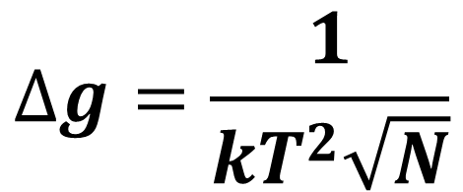
Why Atom Interferometry in µg ?
$$∆g=\frac{1}{kT^{2}\sqrt{N}}$$
GRACE reference:
ONERA Superstar Accelerometer: 10⁻¹⁰ m/s²
T=100ms N=10⁶ | T=1s N=10⁶ | T=10s N=10⁶ | T=1s N=10⁶ 100 pulses | T=1s N=10⁸ 1000 pulses
6 10⁻⁹ m/s² | 6 10⁻¹¹ m/s² | 6 10⁻¹³ m/s² | 6 10⁻¹³ m/s² | 3 10⁻¹⁴ m/s²
Large T → large sensitivity

Slide 15
Instrument capabilities
Achievable spatial resolution with a single sensor sensitivity of 10⁻¹² m s⁻²:
Altitude (km) | 500 | 300 | 200 | 100 | 10 | 1
Spatial resolution (km) | 100 | 60 | 40 | 20 | 2 | 0.2
Spatial scale (km)
1000
100
10
1
0
lakes and river basins
Groundwater, precipitations
long-term
Glaciers and ice sheets
short-term
Oceans
Coastal variations, tides
Eathquakes, plate tectonics
Vulcanoes and ocean ridges
Current limit

Slide 16
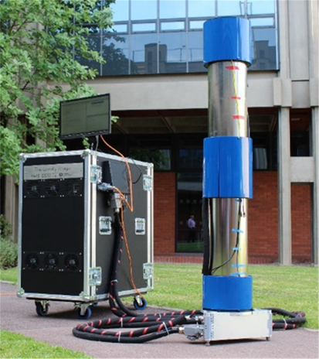
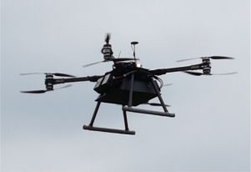
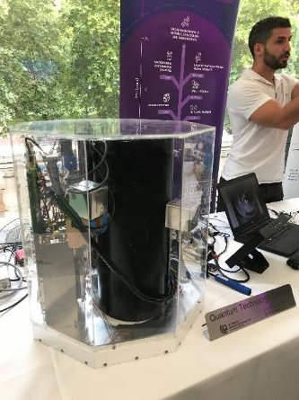
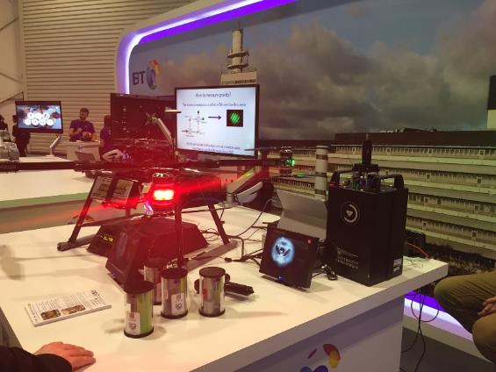
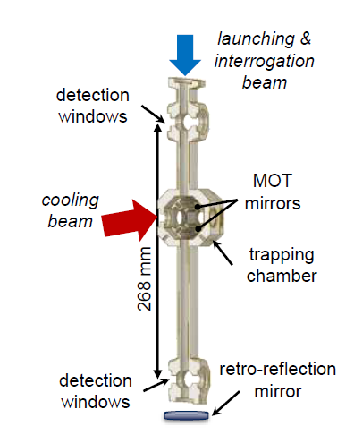
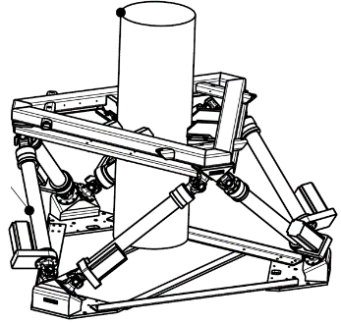
The QT Hub Journey: Reducing SWAP-C and Moving Platforms
Gravity Imager 1 (GI1)
Flying Cold Atoms
Gravity Imager 3 (GI3)
Optics Express 26, 6542 (2018).
Patent app.
US 16/633922, EU 18752226.3

Slide 17
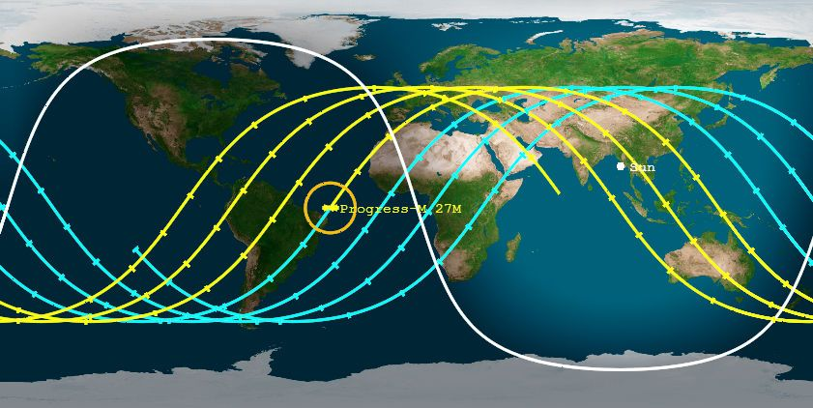
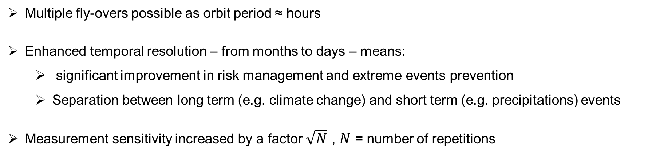
QT Hub developments enable swarm solutions by low cost
Multiple fly-overs possible as orbit period ≈ hours
Enhanced temporal resolution – from months to days – means:
  significant improvement in risk management and extreme events prevention
  Separation between long term (e.g. climate change) and short term (e.g. precipitations) events
Measurement sensitivity increased by a factor $\sqrt{N}$ , $N$ = number of repetitions

Slide 18
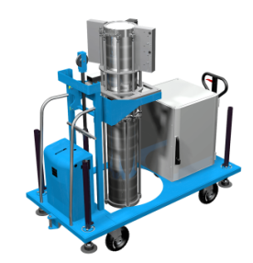
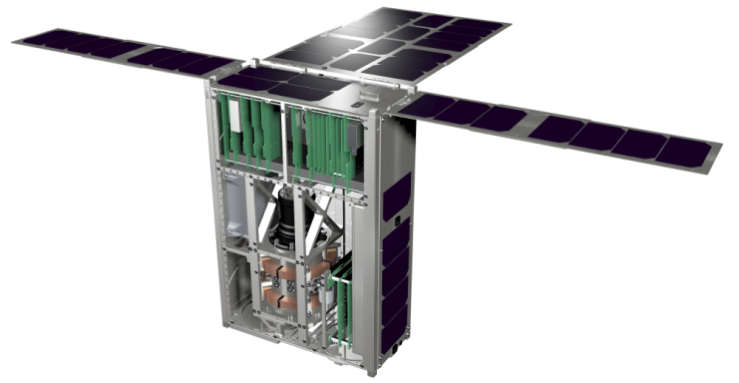
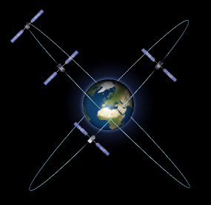
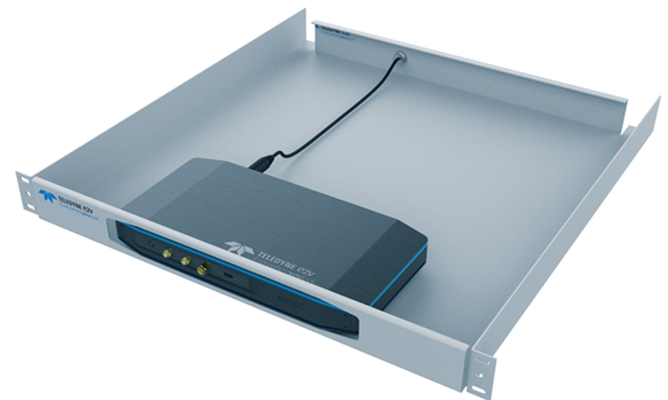
Commercialising Quantum Technologies of the Future
Shaping the future by designing the next generation of quantum technology solutions. Developing products and services that utilise the quantum properties of atoms.
Sensing
Timing
Space
Communications
Gravity gradient sensors for seeing underground
Timing and Frequency solutions including GNSS holdover
Systems for Earth science, timing and navigation
Quantum Key Distribution for ultra secure comms networks

Slide 19
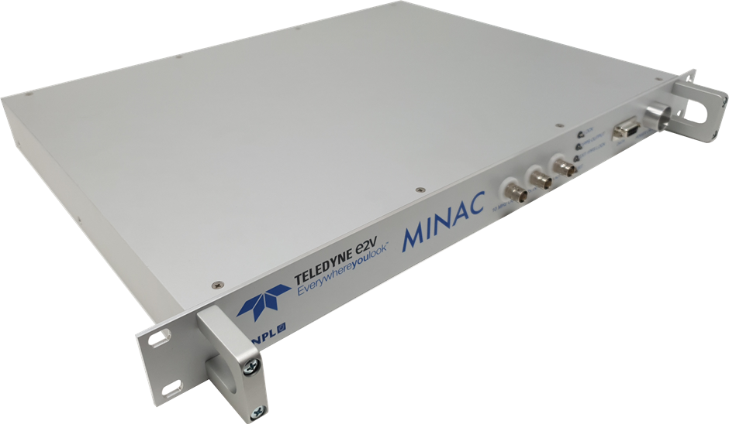
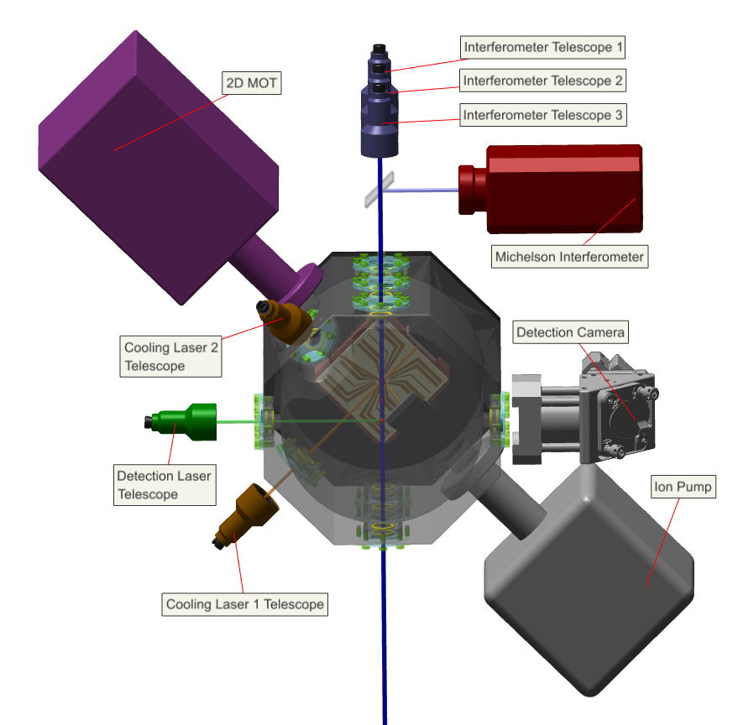
Interest in Space Applications
Frequency References (Clocks)
    Next generation GNSS
    Telecoms and Sensor synchronisation
Gravity
    Gravity maps for ground-based navigation
    Civil Engineering, prospecting
    Earth science (ice sheets, ocean transport, climate change)
Inertial Sensing
    Acceleration & Rotation → Navigation
    Acceleration → Atmospheric Density → Atmospheric Gravity Waves, Space Weather → Precise Orbit Determination
MINAC Clock
CASPA – Cold Atoms on CubeSat
Benefits:
  High sensitivity
  Absolute measurement - low drift
  Repeatability – all 87Rb atoms are the same
  No manufacturing variability / wear & tear
Cold Atom Gravity Explorer (CAGE)
Teledyne UK Limited Export Uncontrolled

Slide 20
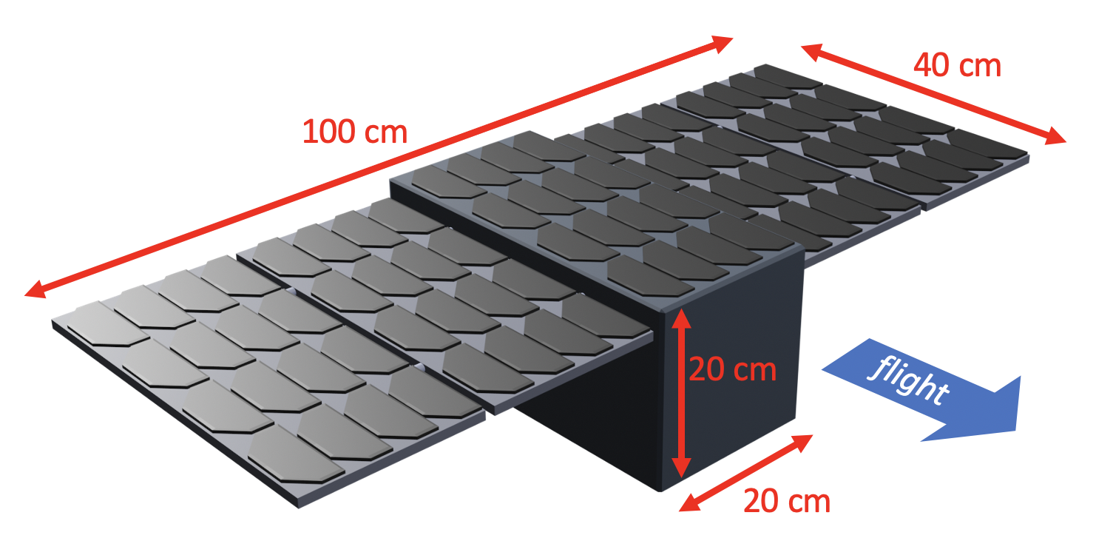

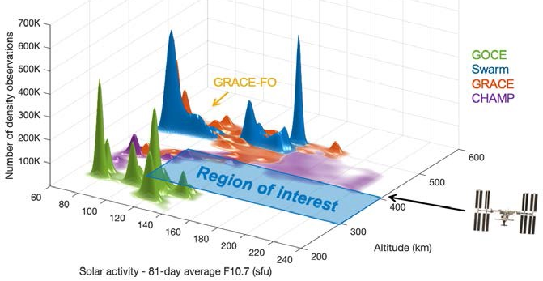




Pathfinder Mission
Cold Atom Technology Pathfinder mission with a science case
Cold Atom tech has flown on sounding rockets, the ISS, Tiangong 2 but only for scientific research and tech demo
Teledyne e2v want to fly a pathfinder Cold Atom EO mission to study atmospheric density with applications in SST, orbit prediction, collision avoidance
Follow on applications in EO (gravity, atmosphere) / navigation / timing / station-keeping and adjacent terrestrial applications
Initial mission studies have been performed and look feasible:
CASPA-ADM (Phase 0 Study)
16U CubeSat with 1 axis accelerometer
Potential ESA SCOUT missions
Q-ACE (Phase 0 Study)
TAS SkimSat with 2 axis accelerometer
Longer lifetime / higher performance
CASPA Accelerometer (CEOI Flagship Project)
Currently building a demonstrator system
Based on previous 6U CubeSat design and build
Image courtesy of C.Siemes, TU Delft
Teledyne e2v are very open for collaborations in this area – please get in touch
Teledyne UK Limited Export Uncontrolled

Slide 21
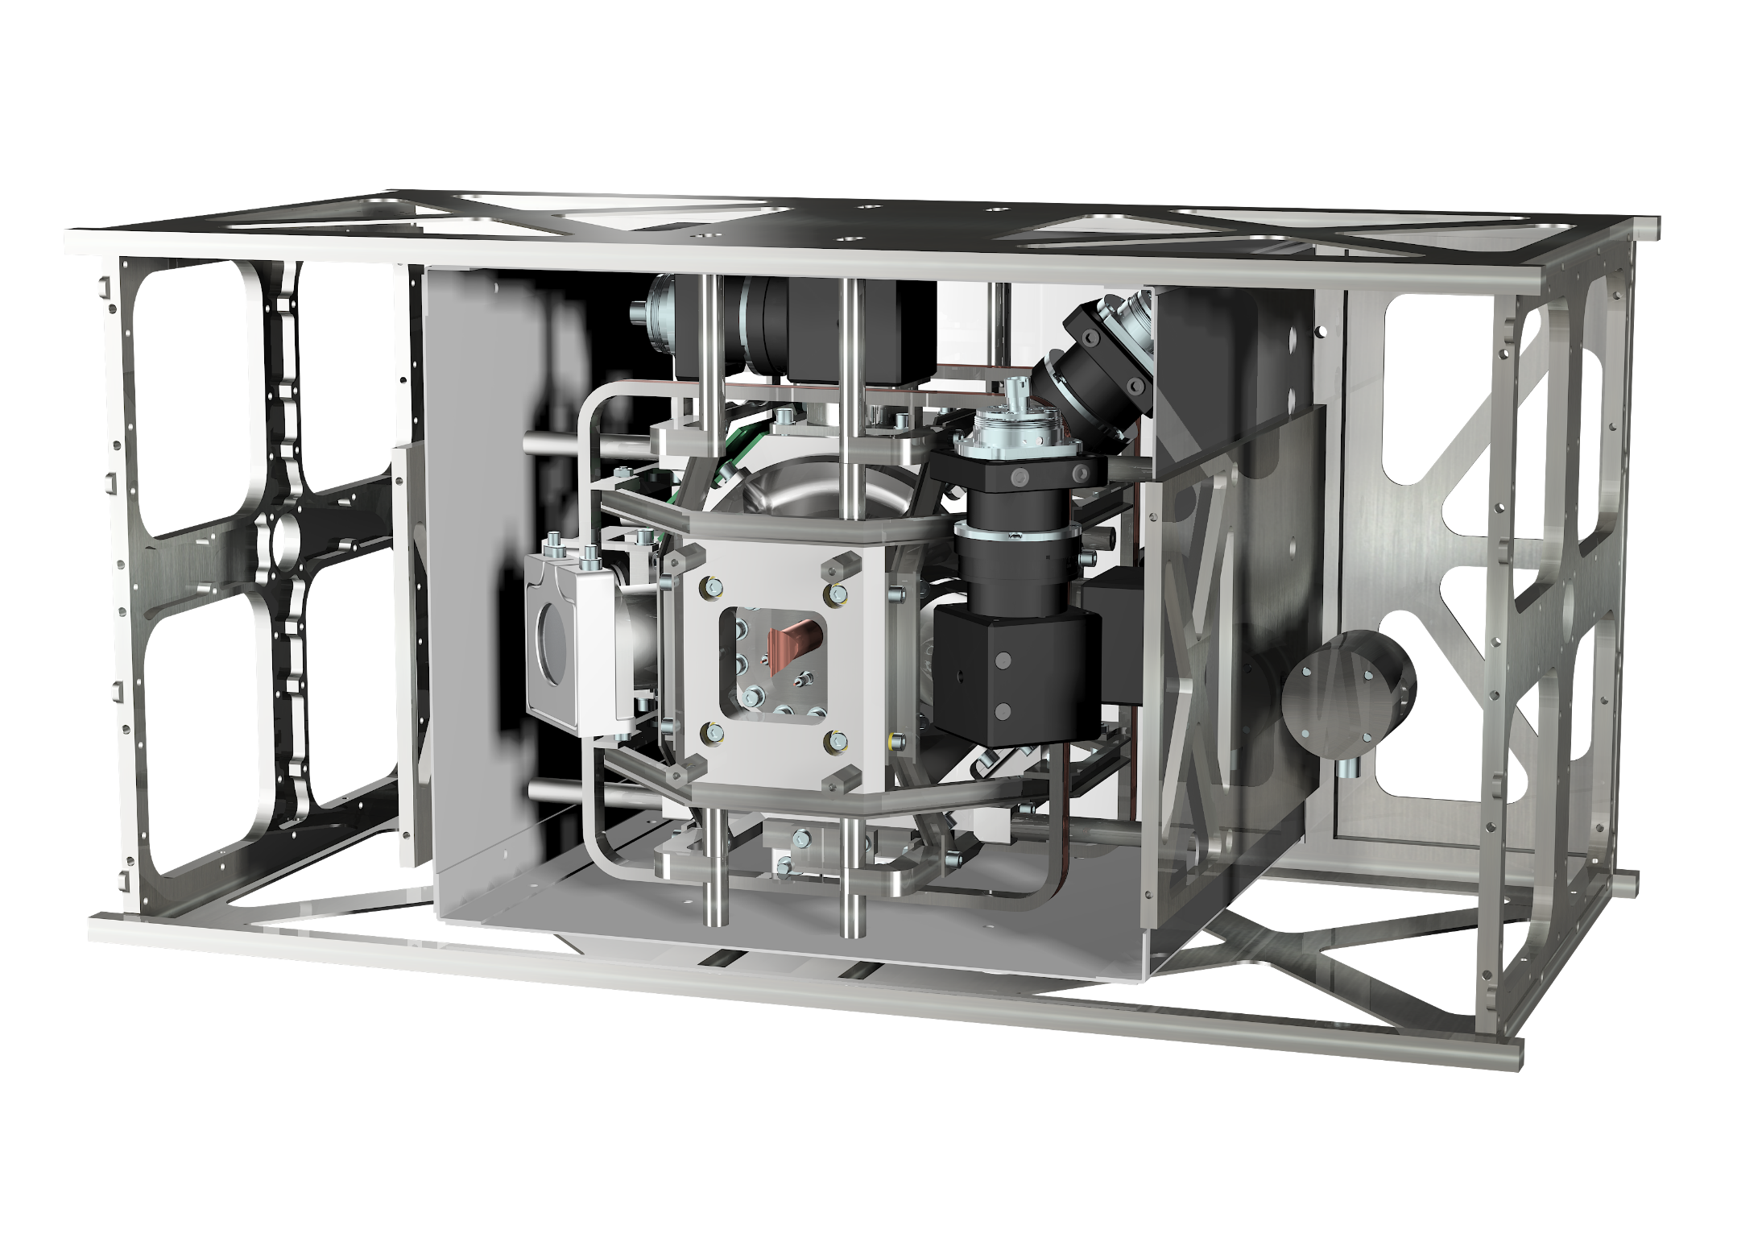
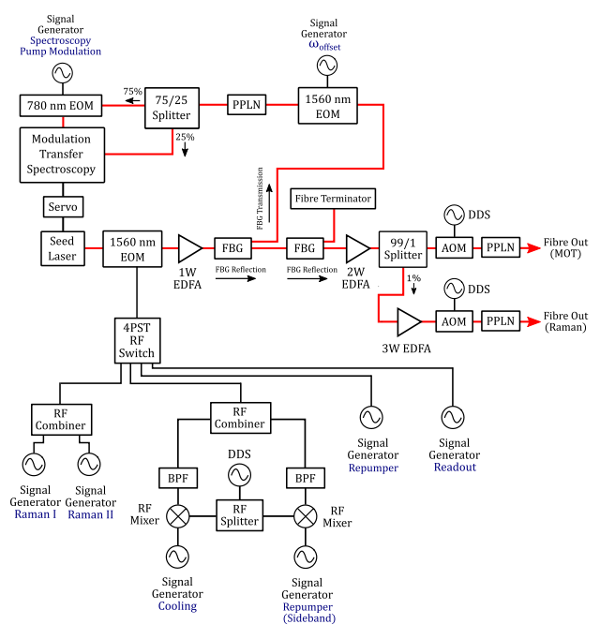
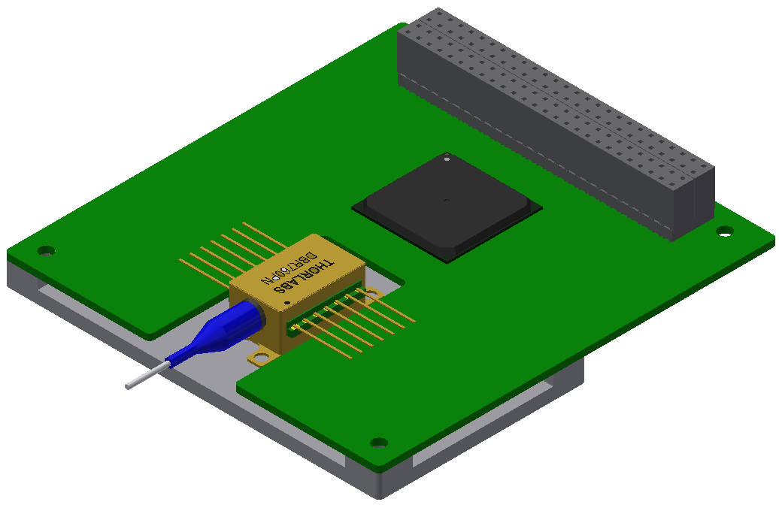
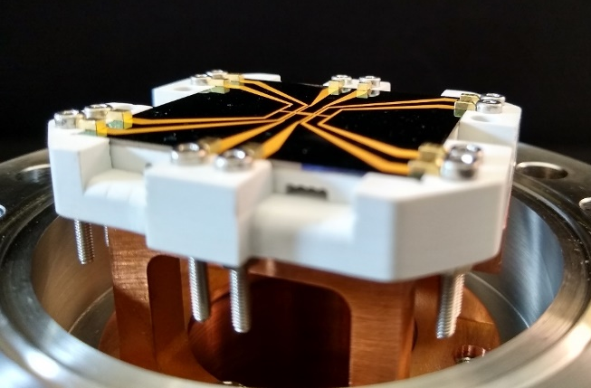


Cold Atom Payload Development
A Breadboard / Engineering Model of the payload is under development with partners University of Birmingham and RAL Space.
Funded by UK Space Agency via the Centre for Earth Observation Instrumentation (CEOI)
Physics Package and Magnetic Shield in CubeSat structure
Credit: Teledyne e2v
Laser System Development
Credit: University of Birmingham; “Optical frequency generation using fiber Bragg grating filters for applications in portable quantum sensing” – C. D. Macrae
Seed Laser Module
Credit: RAL Space
Atom Chip
Credit: RAL Space
Teledyne UK Limited Export Uncontrolled

Slide 22
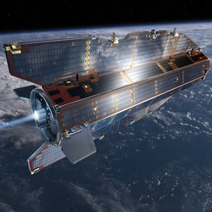
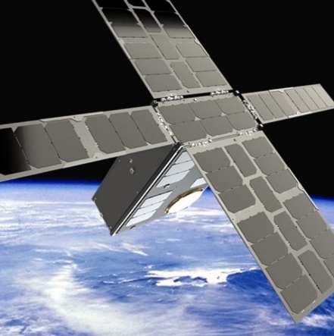

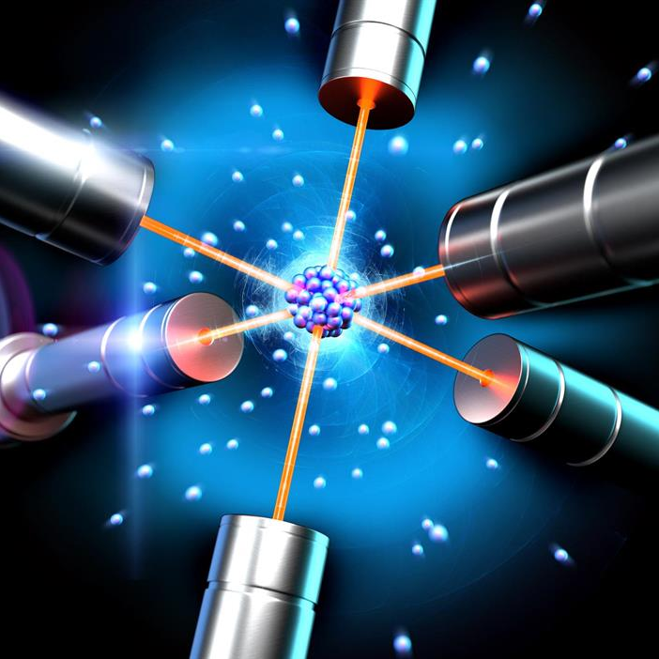
Performance and Technology Timeline
Technology Timeline
GOCE
CASPA-ADM
CAI Technology Demonstrator
Gravity mission pathfinder
Future CAI
5 mE/√Hz*
10 mE/√Hz in 2 axis
20 mE/√Hz in radial direction
* Based on numbers from A. Trimeche et al Class. Quantum Gravity, vol. 36, no. 21, 2019
Teledyne UK Limited Export Uncontrolled

Slide 23
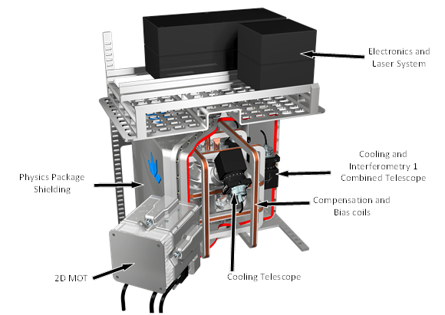
Q-Ace (Quantum Accelerometer Climate Explorer)
UKSA funded study into Climate Change – currently in 2nd year of funding
Uses a Cold Atom Interferometer, as an accelerometer to measure atmospheric drag
This gives measurement of atmospheric density in the thermosphere
(250-500km)
Aim to add mass spectrometer (next phase) for species + temperature
Data downloaded rapidly (aim 1 hour!)
Demonstration mission first
Followed by constellation of ~10 satellites
Used to do meteorology of the thermosphere (space weather)
Currently 50% way through Phase A study, aim to freeze mission
requirements in next financial year

Slide 24

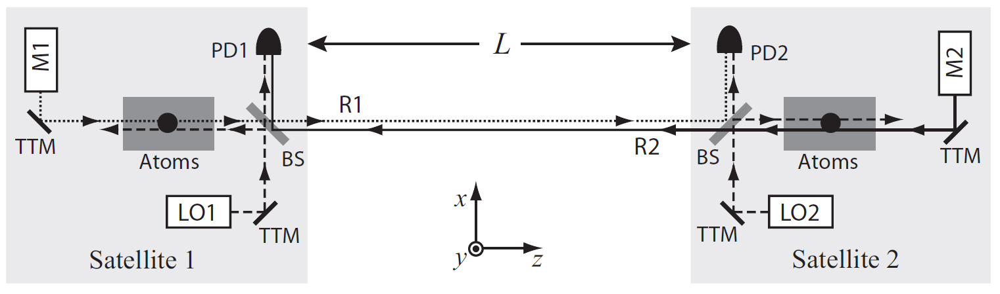
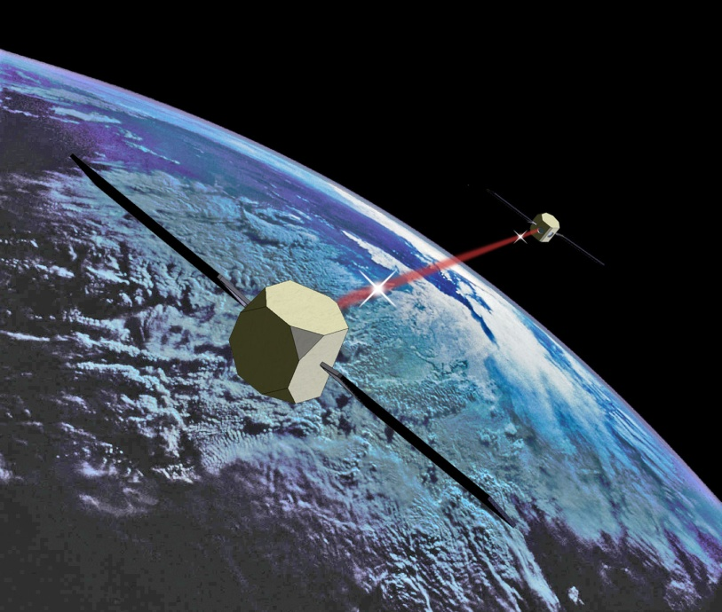

AION & AEDGE
Opportunities for Ultra-COLD Atom technology Development for SPACE
AEDGE:
Atomic Experiment for Dark Matter
and Gravity Exploration
Oliver Buchmueller, Imperial College London

Slide 25
Main AION Physics Goals: Dark Matter and Gravitational Waves
Scientific Leadership in phenomenology already established:
The AION Physics Case:
AION Collaboration, AION: An Atom Interferometer Observatory and Network, arXiv:1911.11755.
[accepted for publication in JCAP]
AEDGE
Y. El-Neaj, …, O. Buchmueller et al.
AEDGE: Atomic Experiment for Dark Matter
And Gravity Exploration in Space, arXiv:1908.00802,
EPJ Quantum Technol. 7, 6 (2020).
[Submitted to ESA Voyage2050 call]
Working with leading theorists:
J. Ellis, M. Haehnelt, C. McCabe,
J. March-Russell (AION), C. Burrage, …
AION-100(initial)/MAGIS
Main Physics Goals:
Search for Ultra-Light Dark Matter
Explore new parameter space and complement other searches.
Focus on Scalar DM with Vector and Peudoscalar DM also under study.
Gravitational Waves in mid-frequency band
Explore frequencies between LISA and LIGO/VIRGO, KAGRA and Einstein Telescope
Targets: Black hole mergers, phase transitions and cosmic string collisions

Slide 26
Main AION Physics Goals: Dark Matter and Gravitational Waves
Scientific Leadership in phenomenology already established:
The AION Physics Case:
AION Collaboration, AION: An Atom Interferometer Observatory and Network, arXiv:1911.11755.
[accepted for publication in JCAP]
AEDGE
Y. El-Neaj, …, O. Buchmueller et al.
AEDGE: Atomic Experiment for Dark Matter
And Gravity Exploration in Space, arXiv:1908.00802,
EPJ Quantum Technol. 7, 6 (2020).
[Submitted to ESA Voyage2050 call]
Working with leading theorists:
J. Ellis, M. Haehnelt, C. McCabe,
J. March-Russell (AION), C. Burrage, …
Nano-E sensitivity
1 million times more sensitive than GOCE
AION-100(initial)/MAGIS
Main Physics Goals:
Search for Ultra-Light Dark Matter
Explore new parameter space and complement other searches.
Focus on Scalar DM with Vector and Peudoscalar DM also under study.
Gravitational Waves in mid-frequency band
Explore frequencies between LISA and LIGO/VIRGO, KAGRA and Einstein Telescope
Targets: Black hole mergers, phase transitions and cosmic string collisions

Slide 27
We are happy to collaborate – Please talk to us
www.quantumsensors.org
k.bongs@bham.ac.uk

