Slide 1
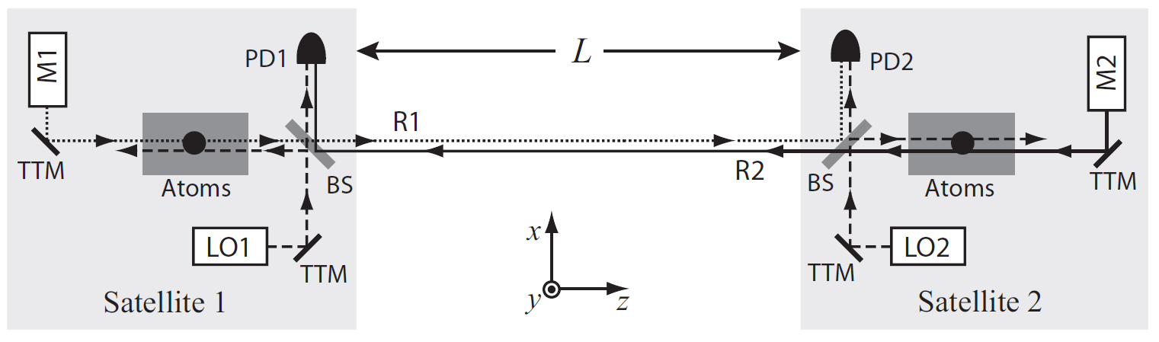


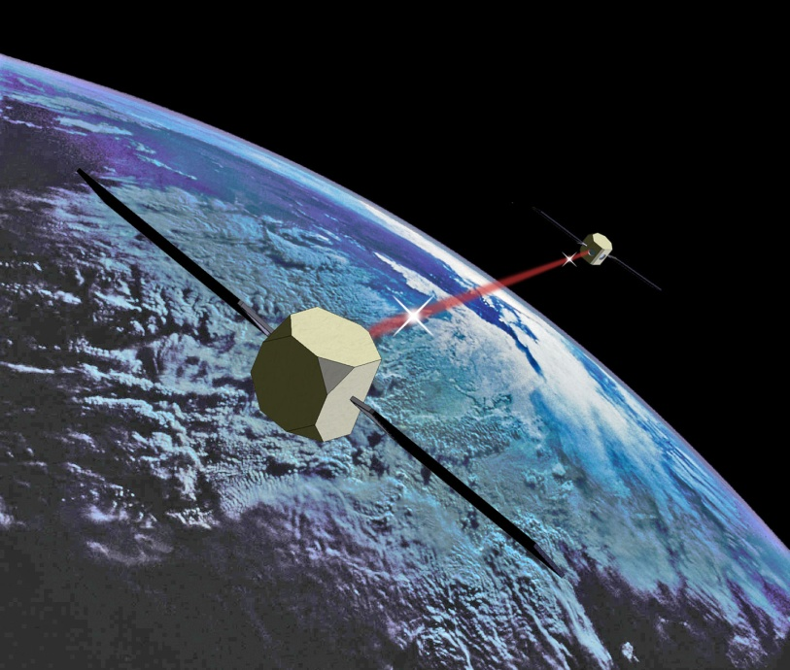
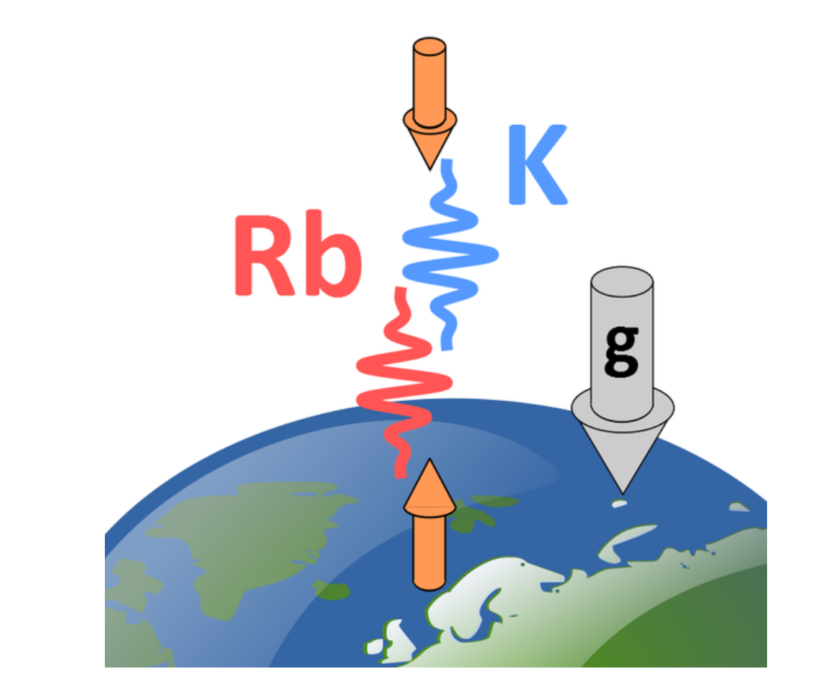
ATOM Interferometry to Explore Fundamental Physics
A UK Atom Interferometer
Observatory and Network
Atomic Experiment for Dark Matter
and Gravity Exploration
Oliver Buchmueller, Imperial College London
STE-QUEST: An M-class Cold Atom mission to probe gravity, dark matter and quantum mechanics

Slide 2
Science Case

Slide 3
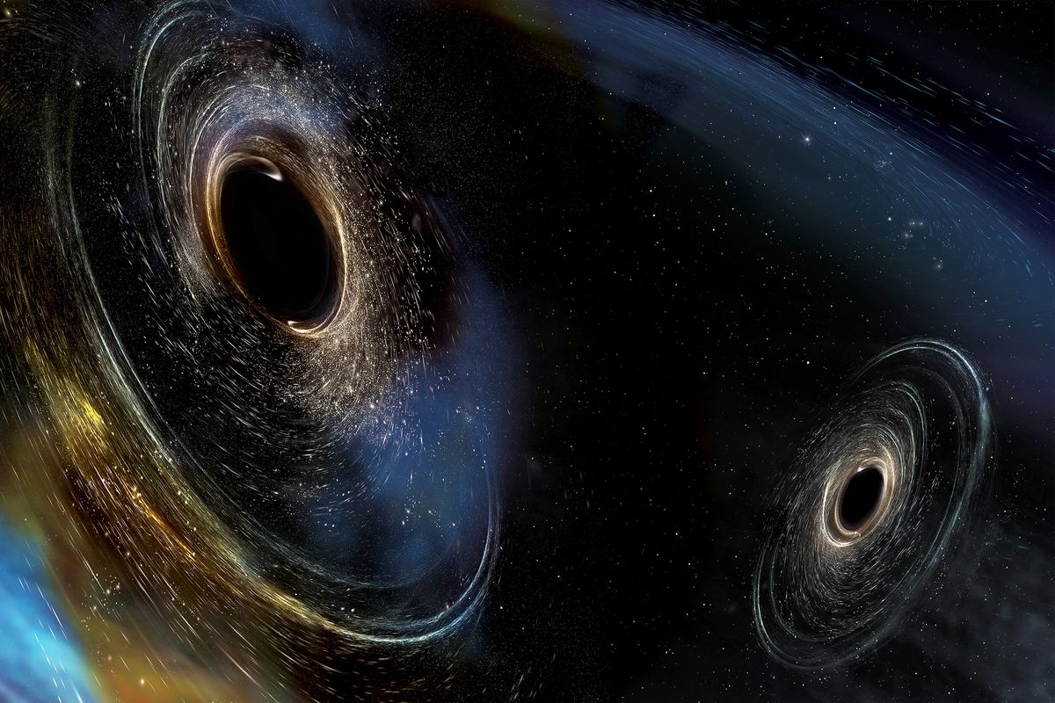
Example of Open Questions in Fundamental Physics
What is dark matter made of?
What is dark energy made of?
Why is there more matter than antimatter in the universe?
How heavy are the neutrinos? What was their role in the formation of the universe?
Is there a quantum theory of gravity that can describe the universe we live in?
What is the number of dimensions in a fundamental theory of nature?
… and many more

Slide 4
Cold Atoms in Space Community Roadmap

Slide 5
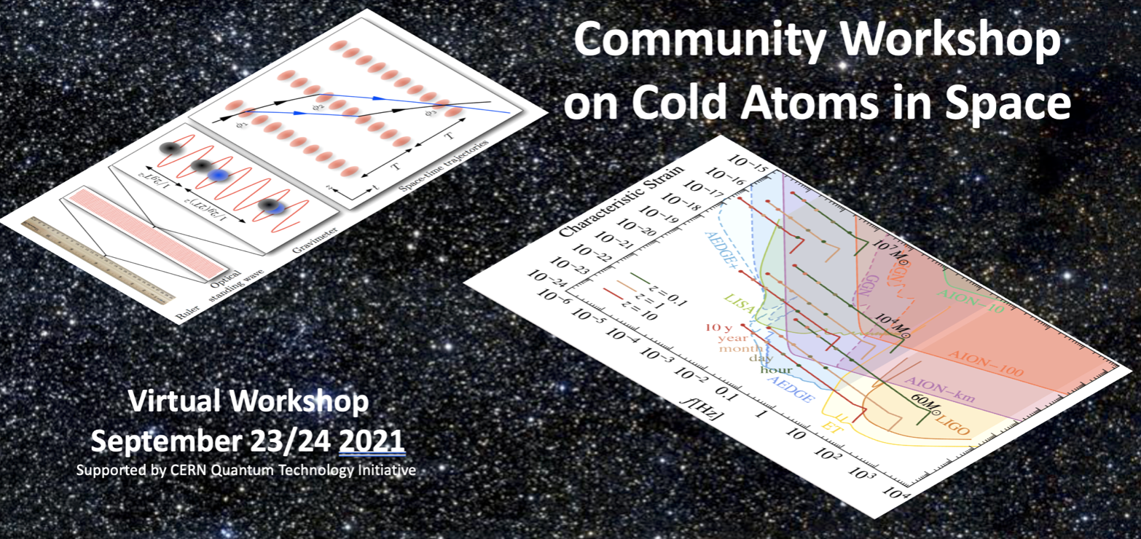

Slide 6
Angelo Bassi, University of Trieste, Italy
Kai Bongs, University of Birmingham, UK
Philippe Bouyer, CNRS, Institut d’Optique, France
Oliver Buchmueller, Imperial College London, UK
Luigi Cacciapuoti, European Space Agency
Marilù Chiofalo, University of Pisa and INFN Pisa, Italy
Albert De Roeck, CERN, Geneva, Switzerland, and University of Antwerp, Belgium
Michael Doser, CERN, Geneva, Switzerland
John Ellis, King’s College London, UK
Rene Forsberg, DTU Space, Denmark
Thomas Lévèque, Centre National d’Etudes Spatiales, France
Christian Lisdat, Physikalisch-Technische Bundesanstalt, Germany
Federica Migliaccio, DICA, Politecnico di Milano, Italy
Ernst Rasel, Leibniz Universität Hannover, Germany
Stephan Schiller, Heinrich-Heine-Universität Düsseldorf, Germany
Christian Schubert, Leibniz Universität Hannover, Germany
Carla Signorini, INFN Pisa, Italy
Guglielmo Tino, Università di Firenze and LENS, Italy
Wolf von Klitzing, IESL-FORTH, Greece
Peter Wolf, CNRS, Observatoire de Paris-PSL, Paris, France

Slide 7
Proposed Road-map

Slide 8
Proposed Road-map

Slide 9
The Conceptional Idea

Slide 10
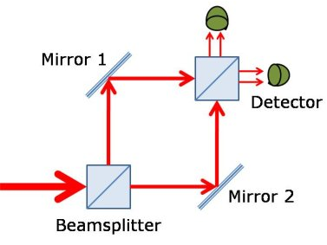
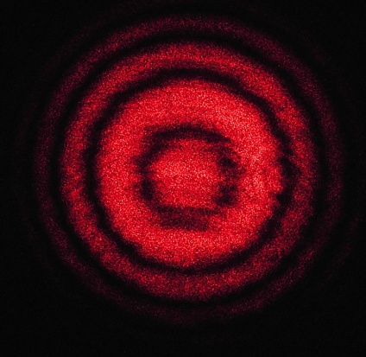
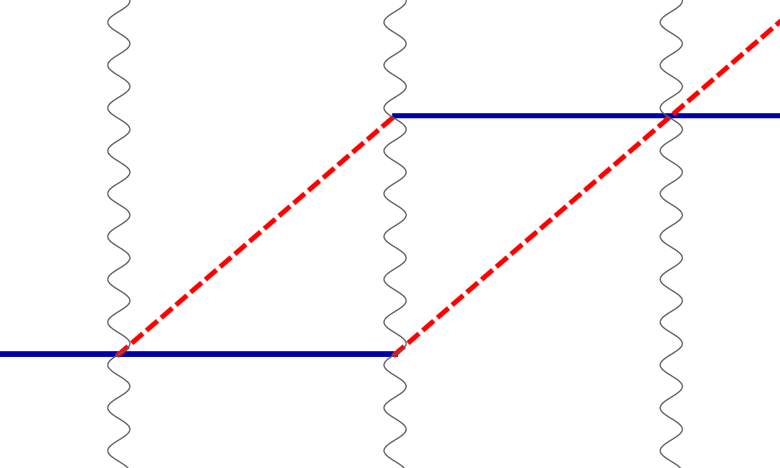
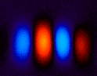
Light vs. Cold Atoms: Atom Interferometry
Light interferometer
Light
Light fringes
Atom interferometer
Beamsplitter
Atom fringes
Atom
Beamsplitter
Mirror
http://scienceblogs.com/principles/2013/10/22/quantum-erasure/
http://www.cobolt.se/interferometry.html

Slide 11




Simple Example: Two Atomic Clocks
Atom clock
Atom clock
Phase evolved by atom after time T
Time

Slide 12
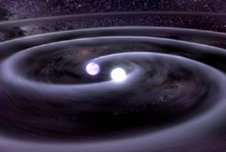


Simple Example: Two Atomic Clocks
GW changes light travel time
Time
Atom clock
Atom clock

Slide 13


Phase Noise from the Laser
The phase of the laser is imprinted onto the atom.
Laser phase noise, mechanical platform noise, etc.
Laser phase is common to both atoms – rejected in a differential measurement.

Slide 14
Cold Atoms in Space Community Roadmap

Slide 16
Angelo Bassi, University of Trieste, Italy
Kai Bongs, University of Birmingham, UK
Philippe Bouyer, CNRS, Institut d’Optique, France
Oliver Buchmueller, Imperial College London, UK
Luigi Cacciapuoti, European Space Agency
Marilù Chiofalo, University of Pisa and INFN Pisa, Italy
Albert De Roeck, CERN, Geneva, Switzerland, and University of Antwerp, Belgium
Michael Doser, CERN, Geneva, Switzerland
John Ellis, King’s College London, UK
Rene Forsberg, DTU Space, Denmark
Thomas Lévèque, Centre National d’Etudes Spatiales, France
Christian Lisdat, Physikalisch-Technische Bundesanstalt, Germany
Federica Migliaccio, DICA, Politecnico di Milano, Italy
Ernst Rasel, Leibniz Universität Hannover, Germany
Stephan Schiller, Heinrich-Heine-Universität Düsseldorf, Germany
Christian Schubert, Leibniz Universität Hannover, Germany
Carla Signorini, INFN Pisa, Italy
Guglielmo Tino, Università di Firenze and LENS, Italy
Wolf von Klitzing, IESL-FORTH, Greece
Peter Wolf, CNRS, Observatoire de Paris-PSL, Paris, France

Slide 17
Proposed Road-map

Slide 18
Proposed Road-map

Slide 19
TERRESTRIAL PROGRAMME

Slide 20
Proposed Road-map

Slide 21
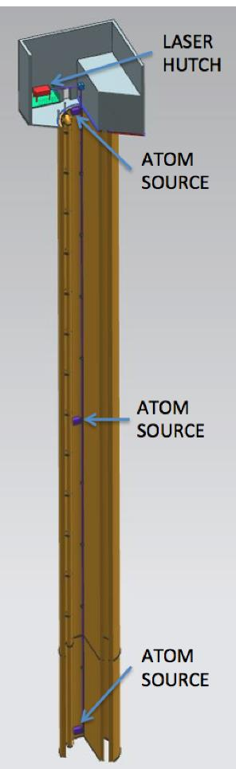
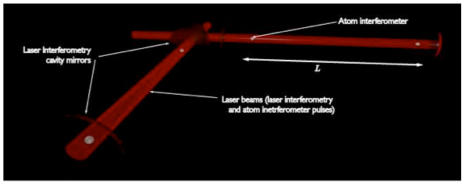
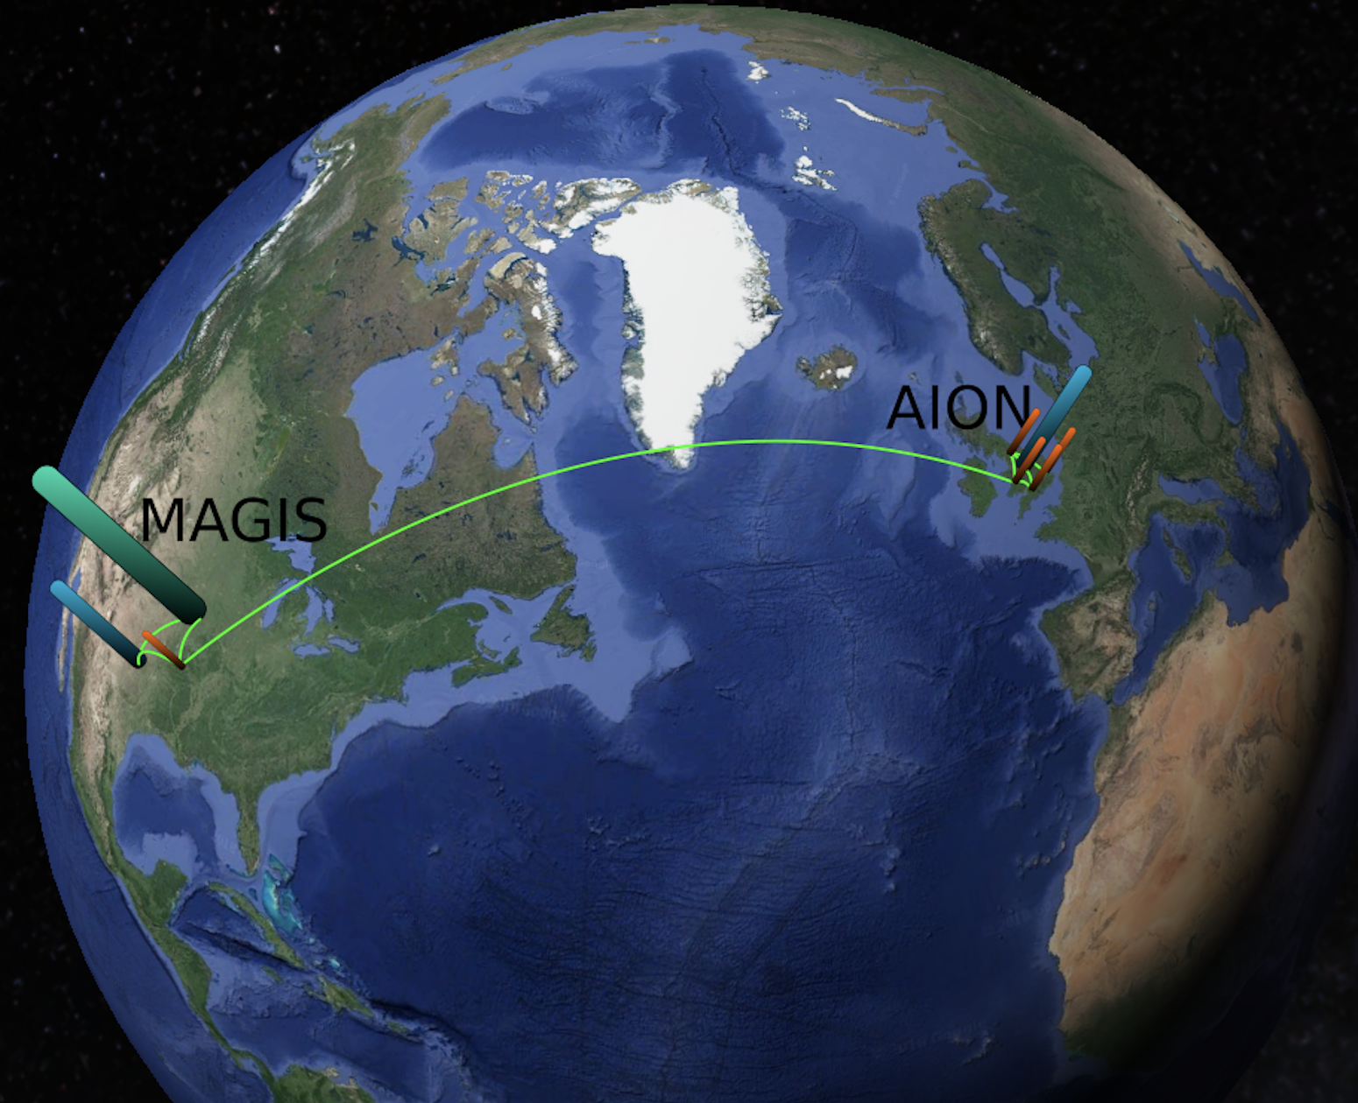
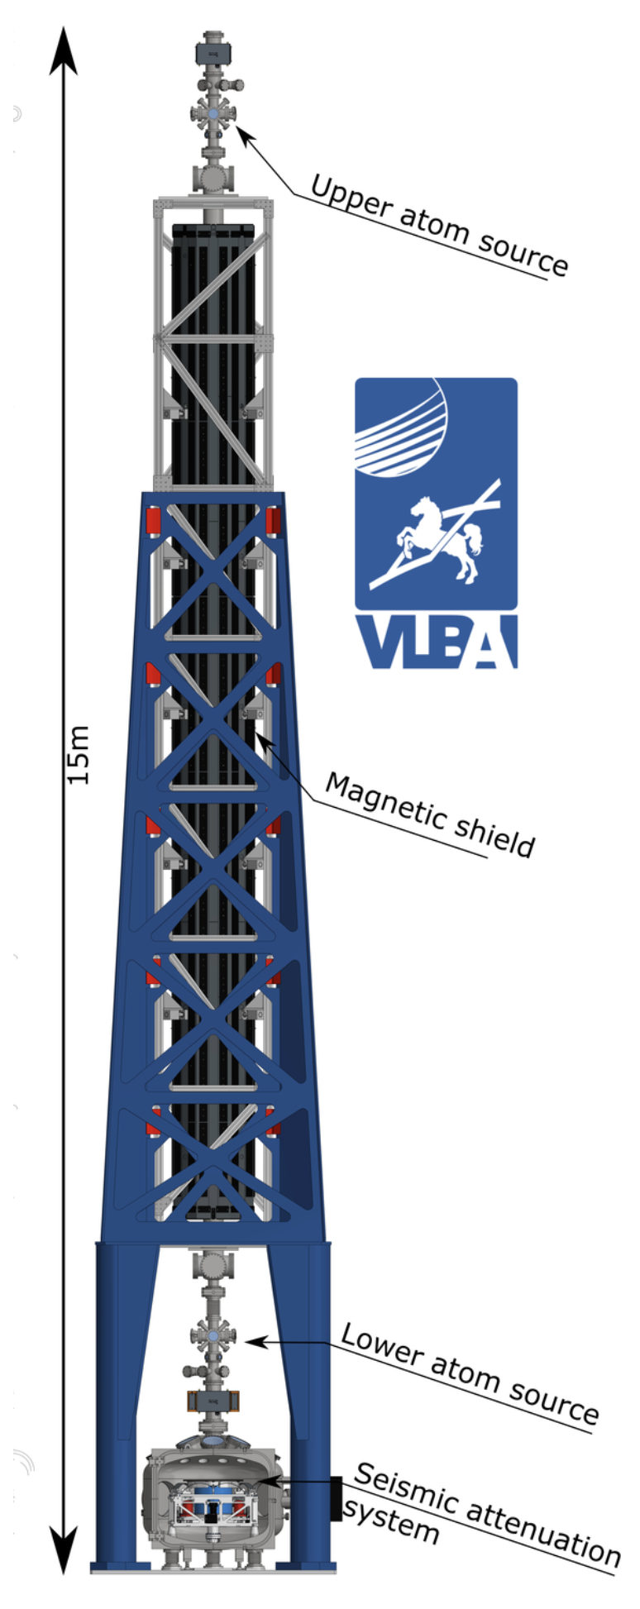
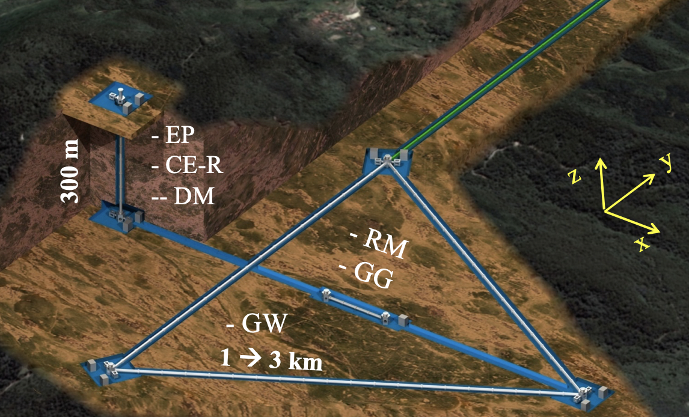
Ground Based Large Scale O(100m) Projects
MIGA: Terrestrial detector using atom interferometer at O(100m)
(France)
AION: Terrestrial shaft detector using atom interferometer at 10m – O(100m) planned
(UK)
VLBAI: Terrestrial tower using atom interferometer O(10m)
(Germany)
ZIGA: Terrestrial detector for large scale atomic interferometers, gyros and clocks at O(100m)
(China)
MAGIS: Terrestrial shaft detector using atom interferometer at O(100m)
(US)
Planned network operation

Slide 22
Ground Based Large Scale O(100m) Projects
VLBAI
MIGA: Terrestrial detector using atom interferometer at O(100m)
(France)
AION: Terrestrial shaft detector using atom interferometer at 10m – O(100m) planned
(UK)
VLBAI: Terrestrial tower using atom interferometer O(10m)
(Germany)
Example of large-scale CA projects that act as demonstrators for
GW mid-frequency band and DM detectors.
All these projects are represented in the AEDGE consortium and now are also part of the Cold Atoms in Space Community.
Each project requires an investment of O(10M) currency units.
All projects (AION, MAGIS, MIGA, VLBAI, ZIGA)
are funded by national funding agencies and foundations.
Timeline 2020 to 2025ish
ZIGA: Terrestrial detector for large scale atomic interferometers, gyros and clocks at O(100m)
(China)
MAGIS: Terrestrial shaft detector using atom interferometer at O(100m)
(US)
Planned network operation

Slide 23
AION Experiment

Slide 24
The AION Programme consists of 4 Stages
Stage 1: to build and commission the 10 m detector, develop existing technology and the infrastructure for the 100 m.
Stage 2: to build, commission and exploit the 100 m detector and carry out a design study for the km-scale detector.
  AION was selected in 2018 by STFC as a high-priority medium-scale project.
  AION will work in equal partnership with MAGIS in the US to form a “LIGO/Virgo-style” network & collaboration, providing a pathway for UK leadership.
Stage 1 is now funded with about £10M by the QTFP Programme and other sources and Stage 2 could be placed at national facility in Boulby or Daresbury (UK), possibly also at CERN (France/Switzerland).
Stage 3: to build a kilometre-scale terrestrial detector.
Stage 4: long-term objective a pair of satellite detectors (thousands of kilometres scale) [AEDGE proposal to ESA Voyage2050 call]
  AION has established science leadership in AEDGE, bringing together collaborators from European and Chinese groups (e.g. MIGA, MAGIA, ELGAR, ZAIGA).
Stage 3 and 4 will likely require funding on international level (ESA, EU, etc) and AION has already started to build the foundation for it.
L ~ 10m
L ~ 100m
L ~ 1km

Slide 25
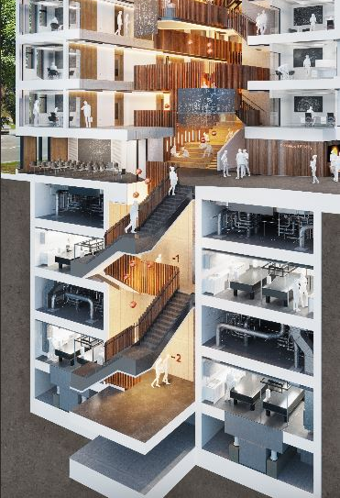
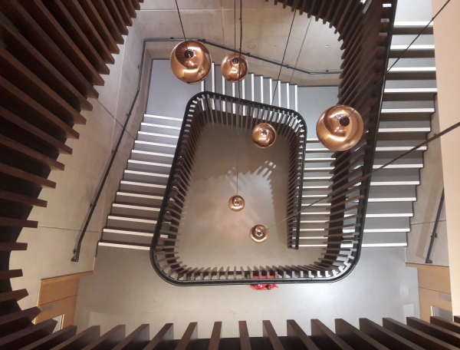
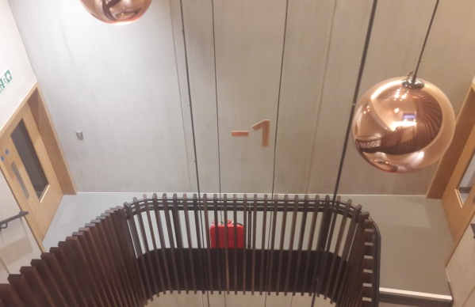
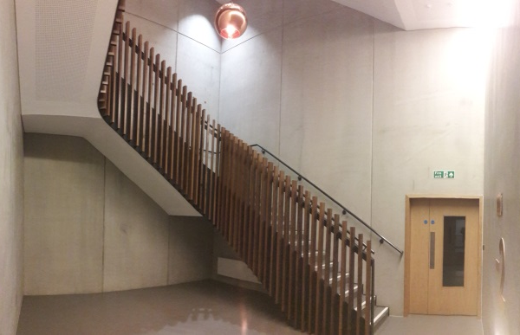
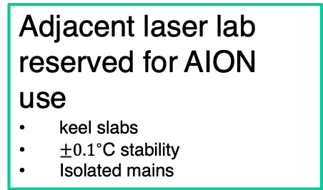
Beecroft building, Oxford Physics
Ultralow vibration
All plant isolated
Thick concrete walls
Adjacent laser lab reserved for AION use
keel slabs
$±{0.1}^{∘}$C stability
Isolated mains
Ground level
AION
12 m
Vertical space
12m basement to ground floor
14.7m floor to ceiling
Aircon infrastructure
Stairwell is not a fire escape route.
Laser lab
Bakeout room and cleanroom nearby
Void
Keel slab

Slide 26
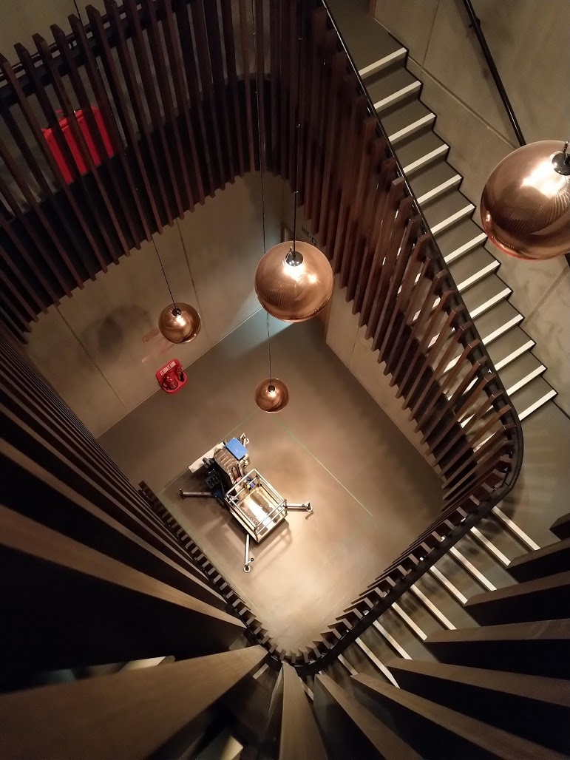
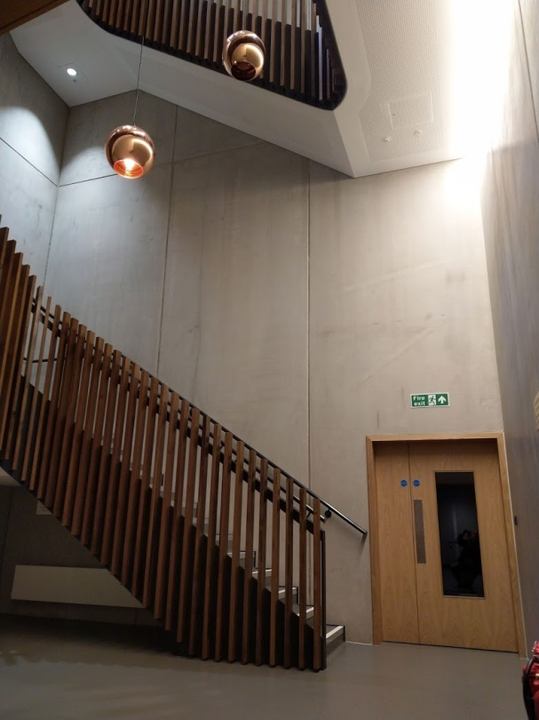
AION-10 site: Beecroft building, Oxford Physics
Beecroft building – brand new, low-vibration laser lab and concrete stairwell
14.7m
Detailed planning of support structure by RAL (Engineering), Oxford Physics Technical Services and Liverpool Univ.
Experienced Project Manager: Roy Preece
Good site for long-term operation and wide accessibility (also ‘visibility’ and outreach).
Ground level
AI-10
10.0m
7.7m
5.0m
Feed through to laser lab

Slide 27
AION-10 site: Beecroft building, Oxford Physics
Beecroft building – brand new, low-vibration laser lab and concrete stairwell
Detailed planning of support structure by RAL (Engineering), Oxford Physics Technical Services and Liverpool Univ.
Experienced Project Manager: Roy Preece
Good site for long-term operation and wide accessibility (also ‘visibility’ and outreach).
For the first 30 months of the project, we will focus on the perquisites for the 10m detector:
Establish the Cold Atom infrastructure (e.g. build UltraCold Sr Laser Labs) and expertise
Develop full design for 10m detector, ready for physics exploitation
Partner AION with the MAGIS experiment in the US
14.7m
Ground level
AI-10
10.0m
7.7m
5.0m
Feed through to laser lab

Slide 28
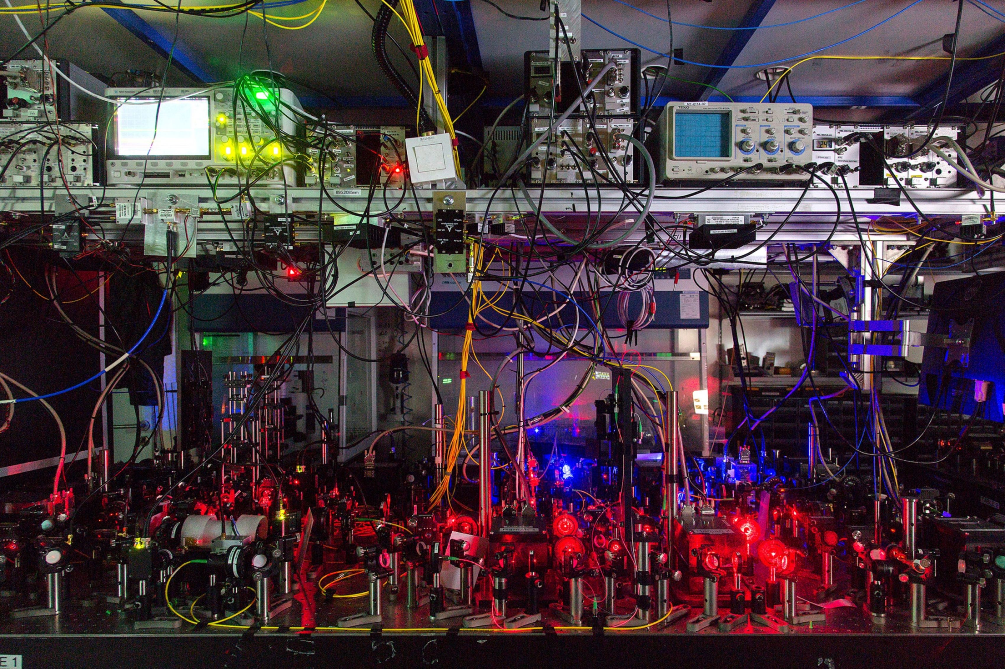
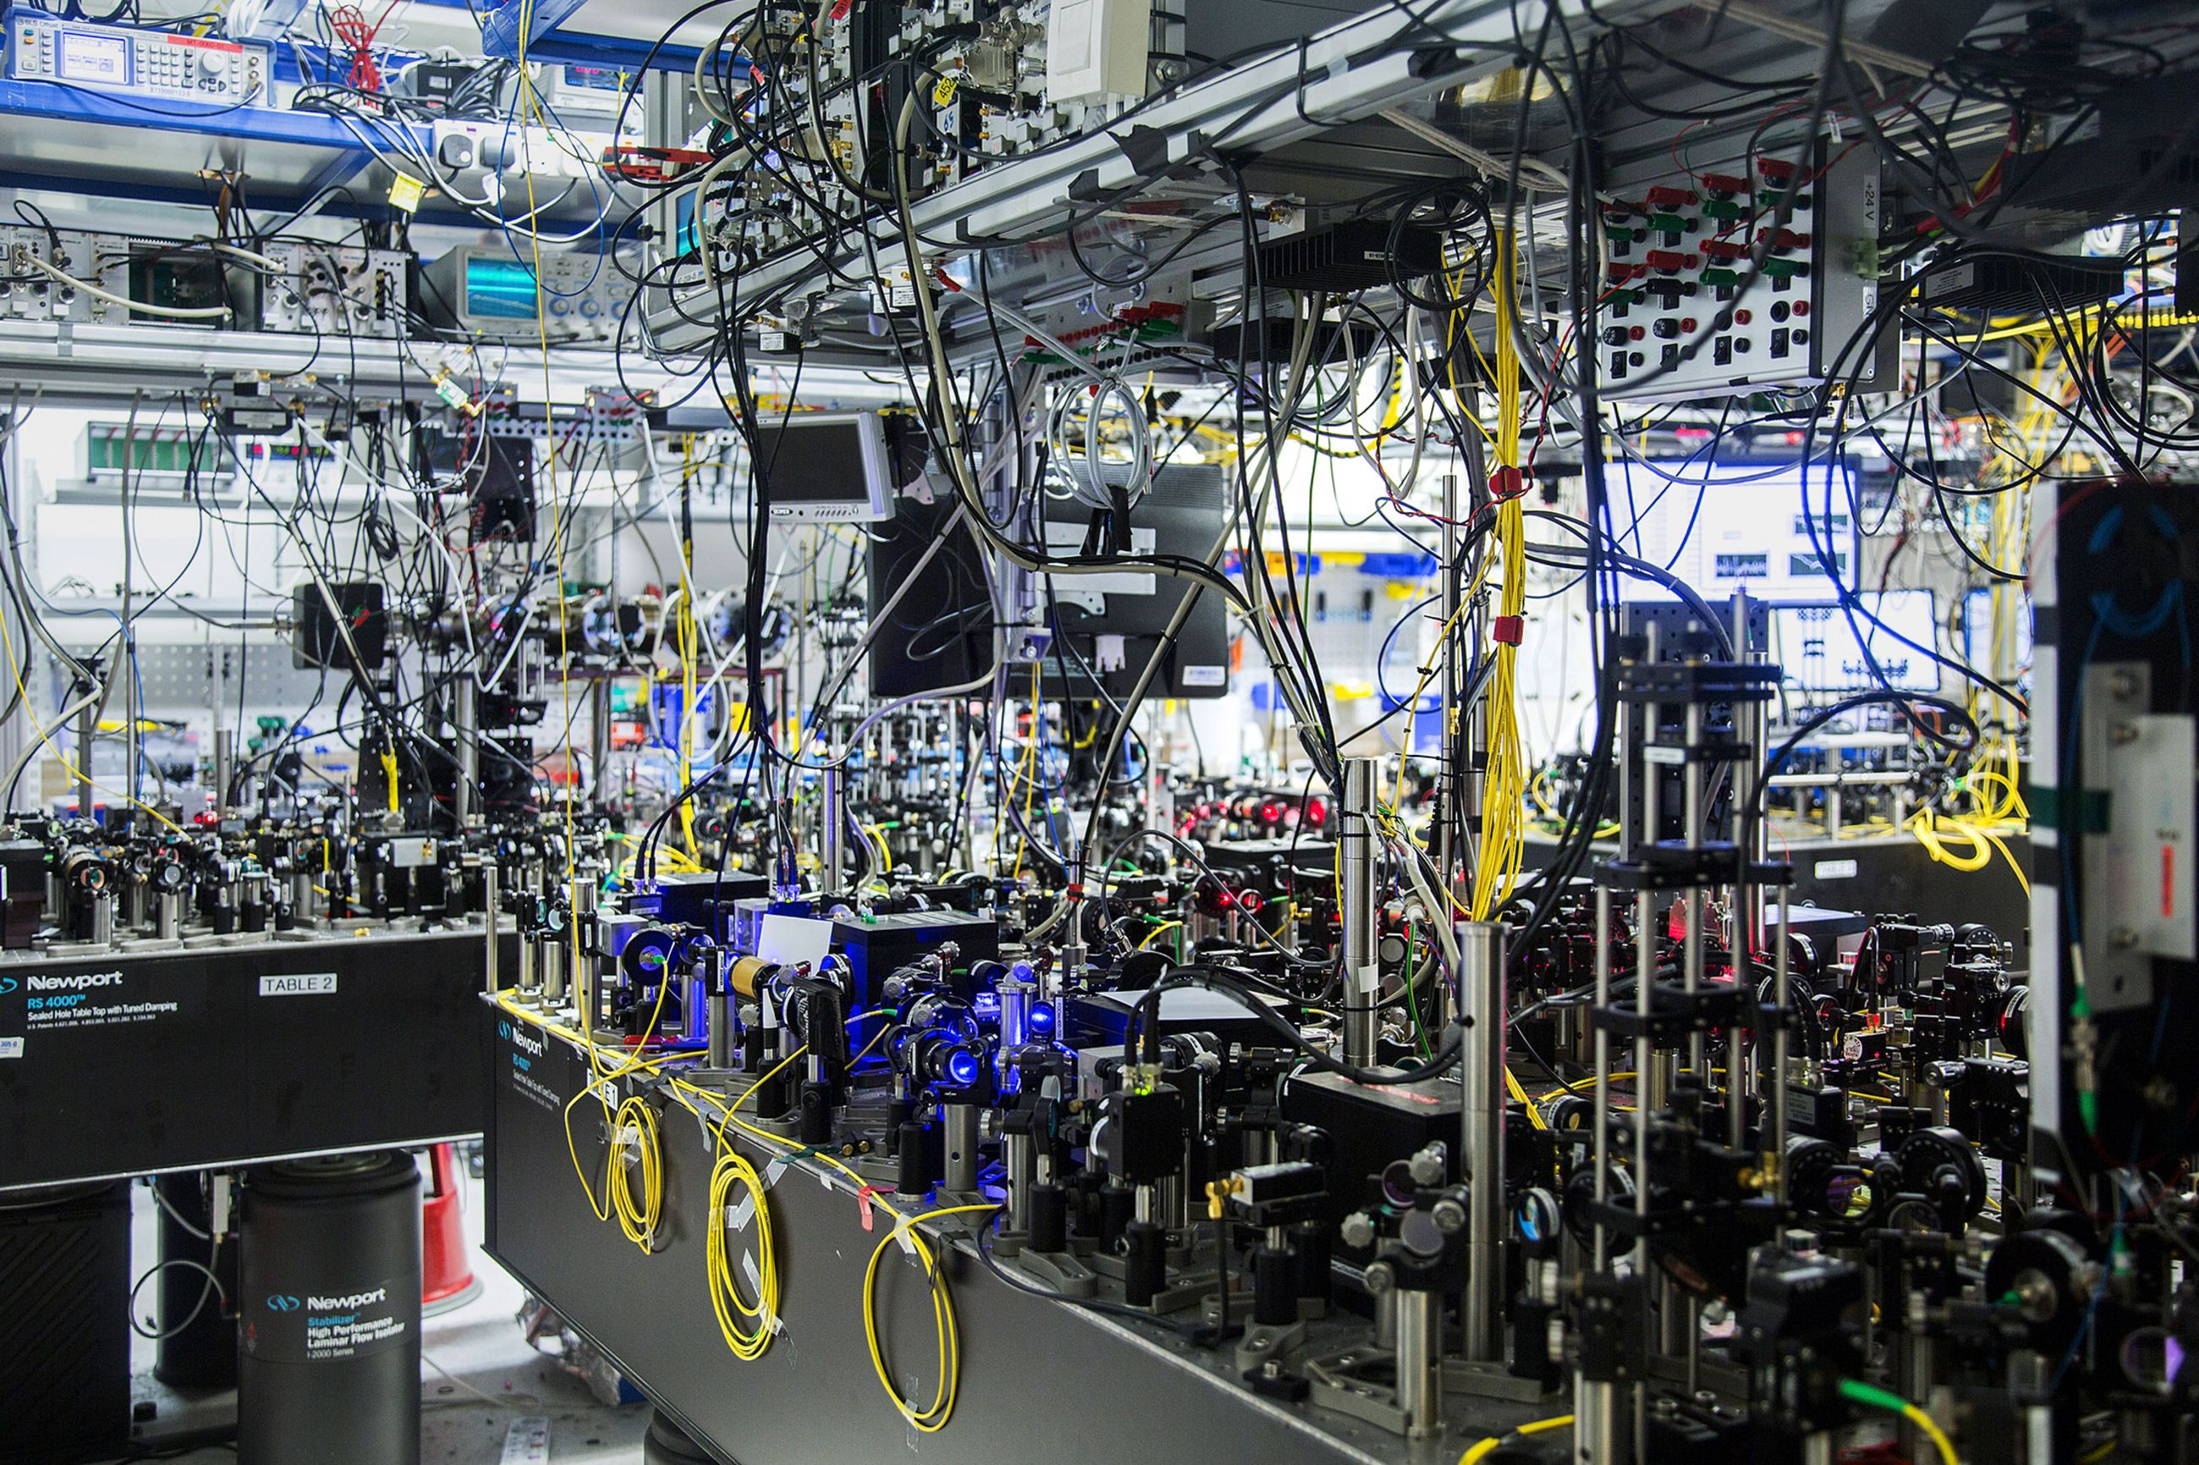
AION: Ultra-Cold Strontium Laboratories in UK
To push the state-of-the-art single photon Sr Atom Interferometry, the AION project builds dedicated Ultra-Cold Strontium Laboratories in:
Birmingham, Cambridge, Imperial College, Oxford, and RAL
The laboratories are expected to be fully operational in fall 2022.

Slide 29
Example: New Ultra-Cold Strontium Laboratory at Imperial College
In the context of the AION project, Imperial College is building a brand new Ultra-Cold Strontium Laboratory on about 100m² of high-quality real state in the Blackett Laboratory in central London.
This Laboratory will extent significant the already very strong Ultra-Cold Atom facilities at Imperial, exploiting strong synergies with existing laboratory space in the same building.
The new Laboratory will be operated by world leading experts in Ultra-Cold Strontium Atomic Clocks, and complements the already established expertise in Rb Atom Interferometry and Magneto-optical trapping and sympathetic cooling of molecules.
The new Laboratory isready for full operation since the end of 2021.

Slide 30
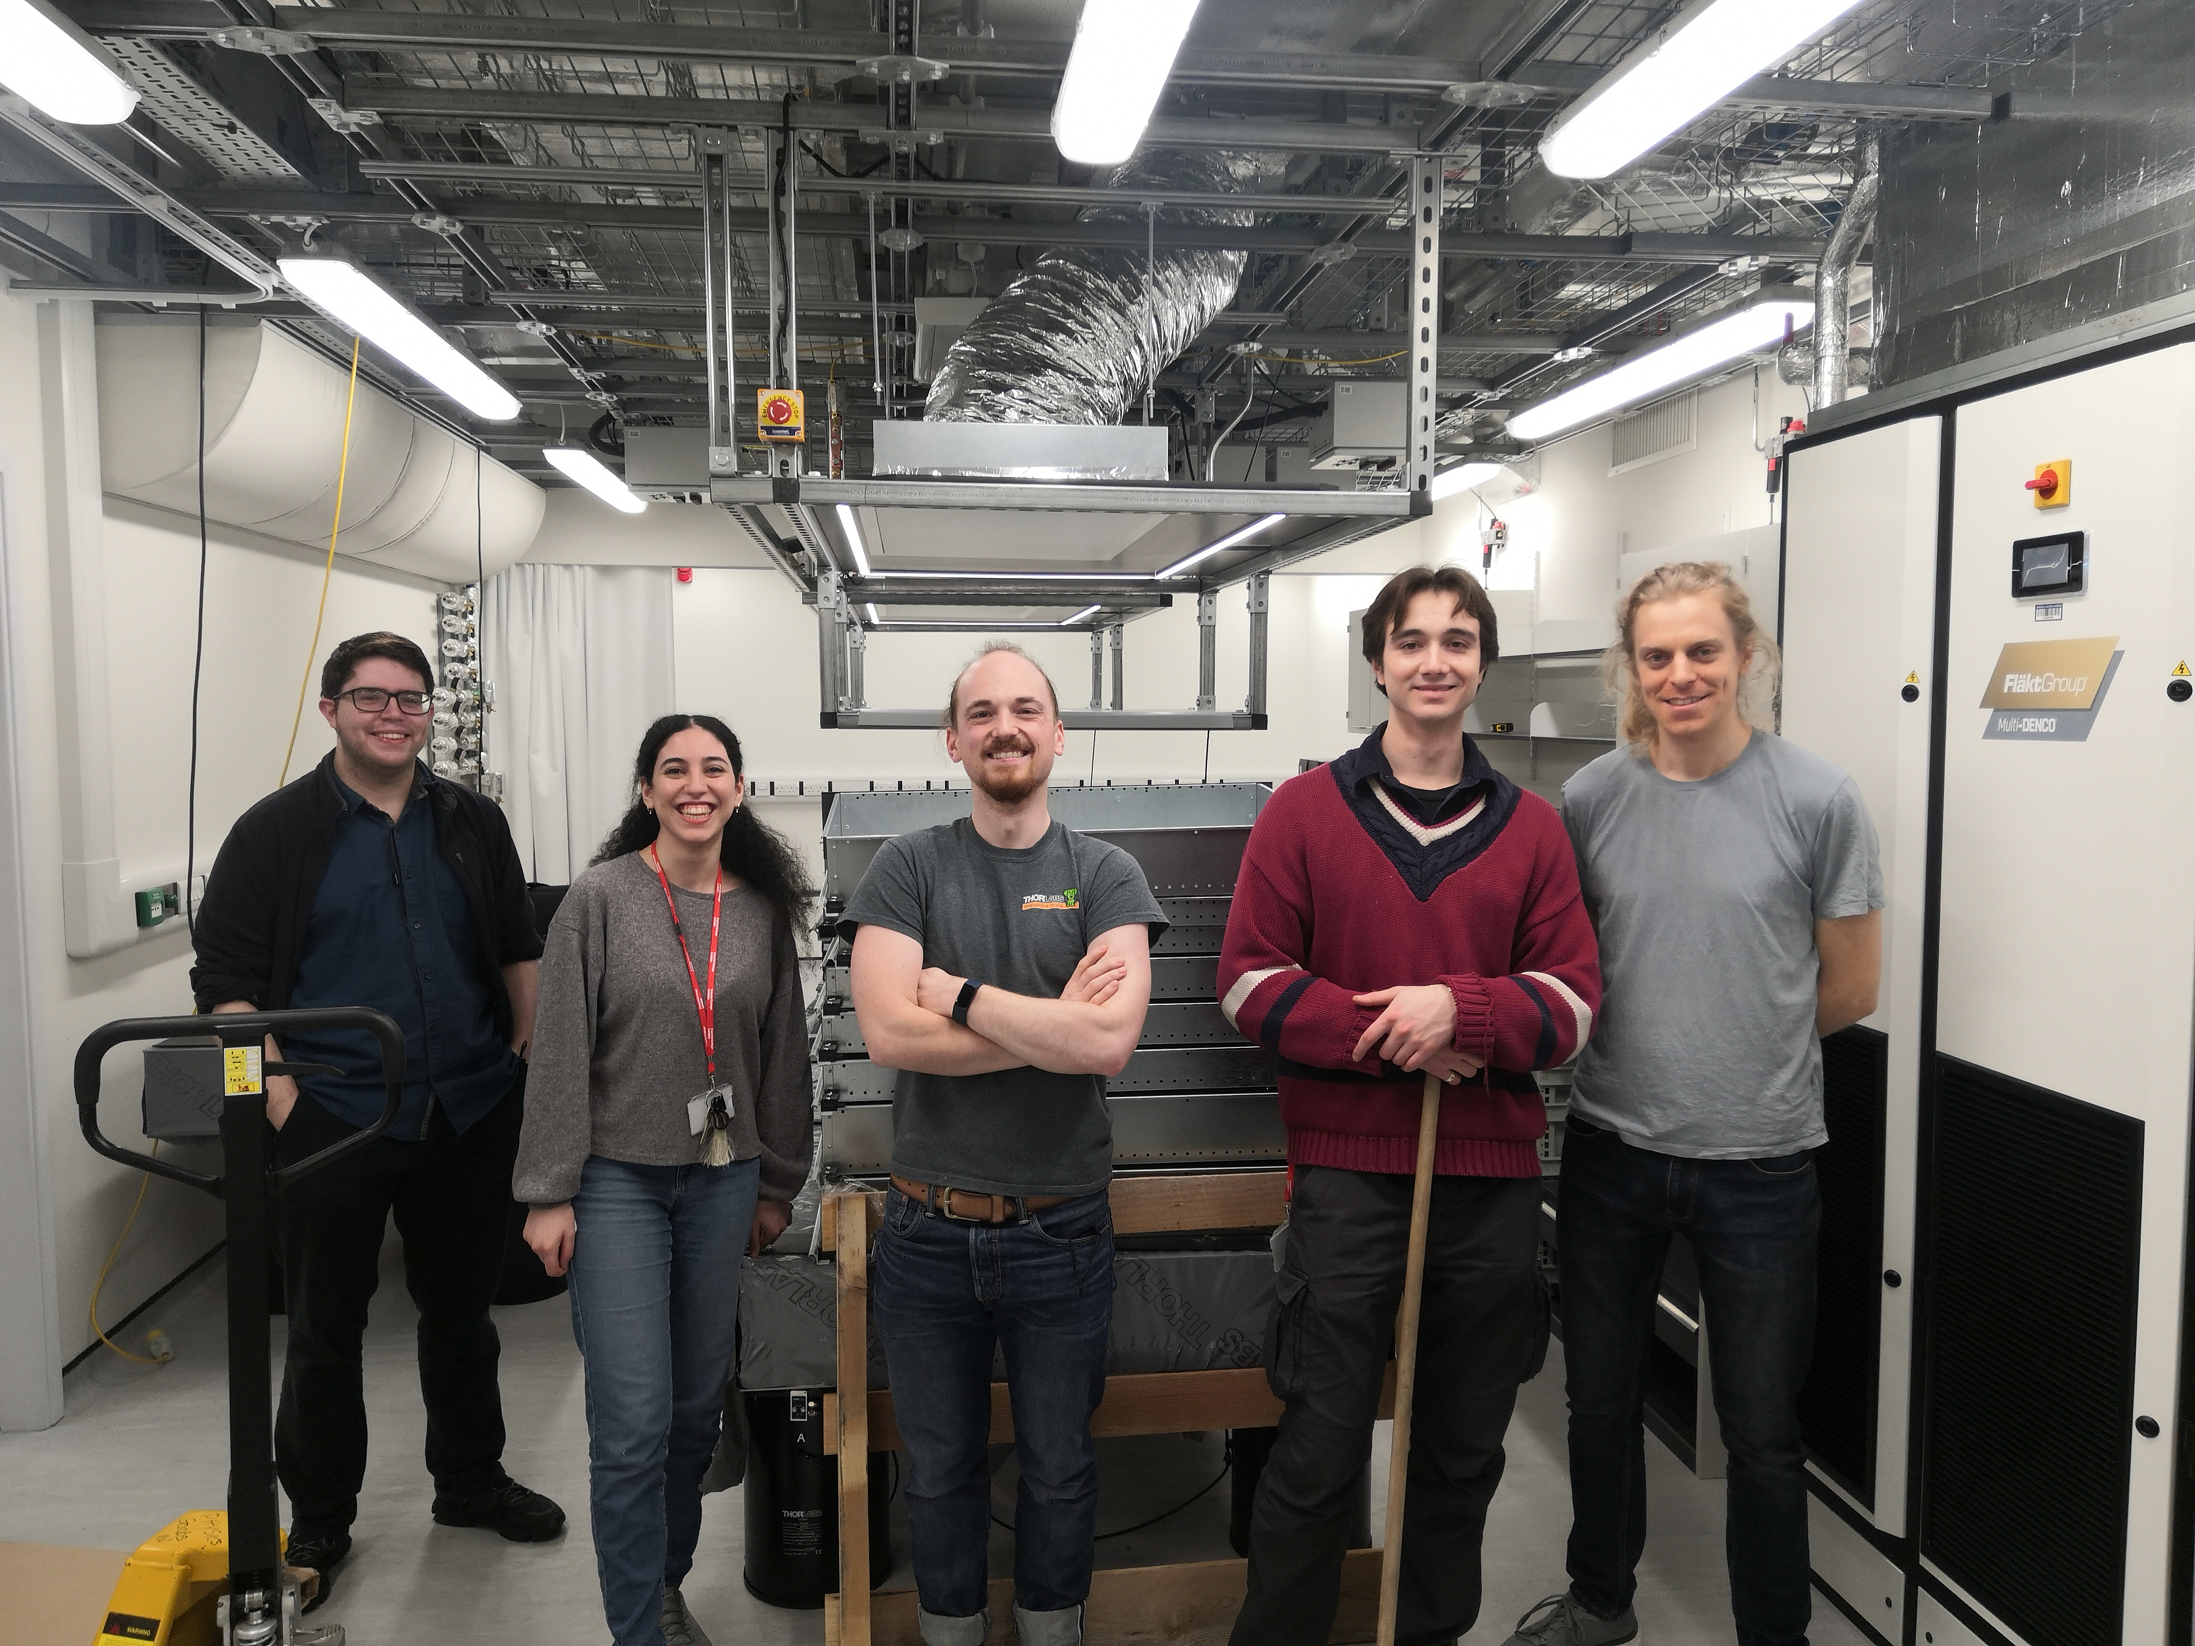
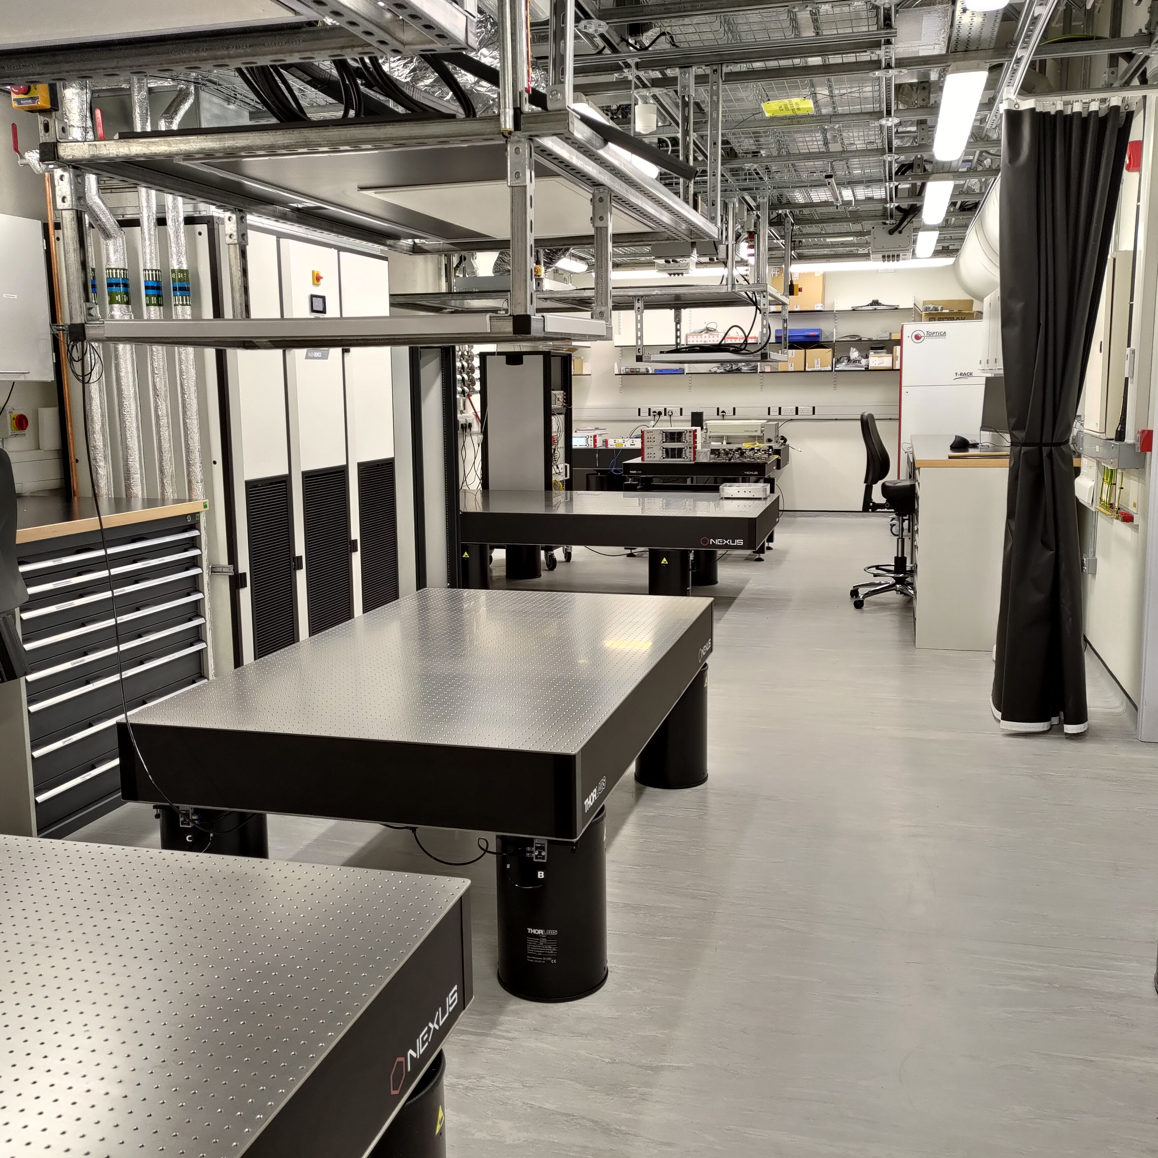
Picture AION Lab

Slide 31
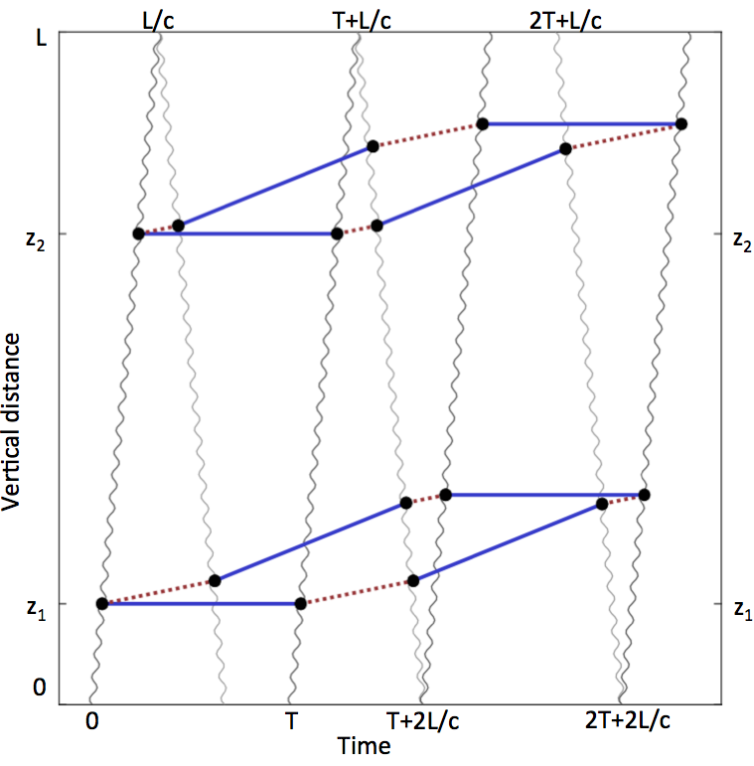
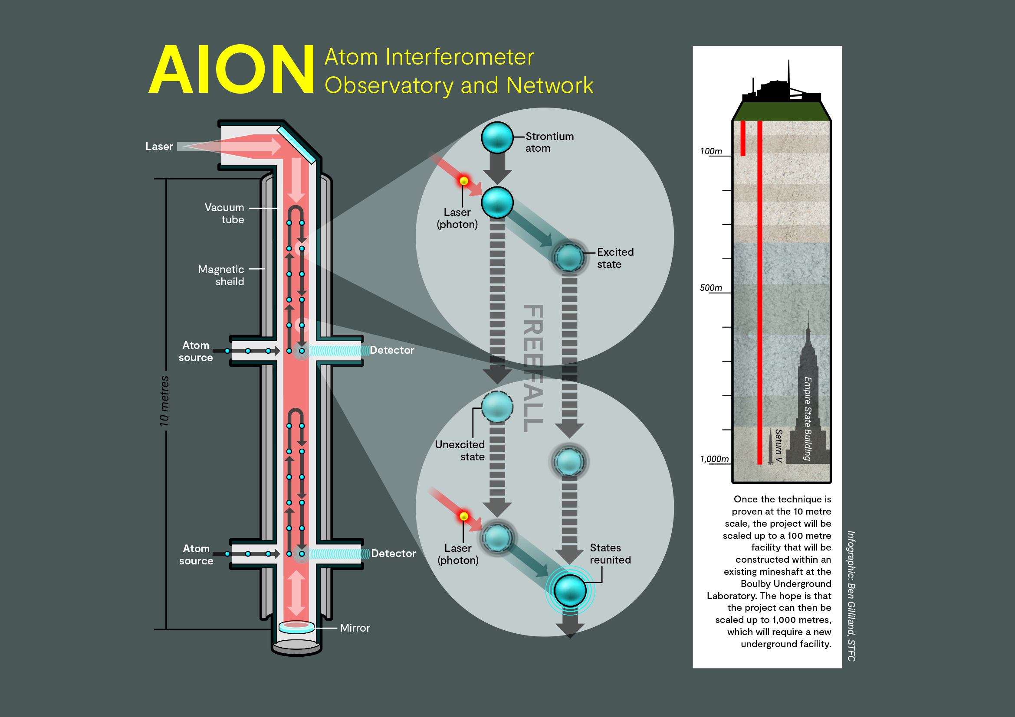
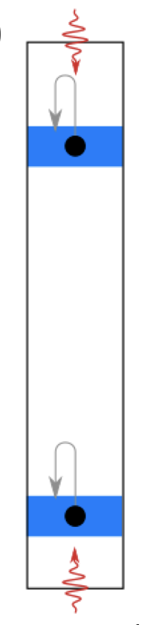
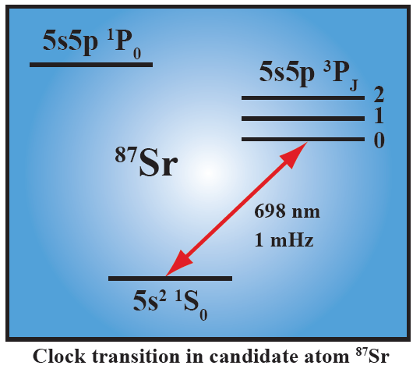
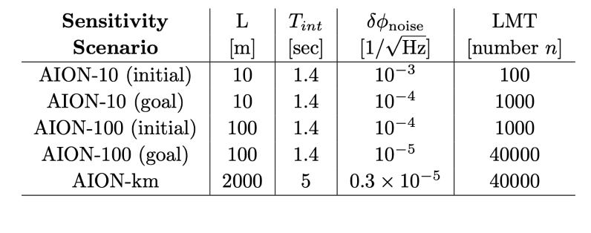
AION: A Different Kind of Atom Interferometer
Hybrid “clock accelerometer”
Clock: measure light travel time ➜ remove laser noise with single baseline
For ultimate sensitivity we need to push
each basic parameter by ~O(10).
The project aims to demonstrate in funding period e.g.
LMT: ~1000 hbar*k
Squeezing ~ 20dB for > 1e6 Atoms
Used for sensitivity projections

Slide 32
AION: A Different Kind of Atom Interferometer
Hybrid “clock accelerometer”
To support this R&D work, we build and commissioning five Ultra-High Vacuum (UHV) system, often referred to as side-arm, and the five Laser Stabilisation (LS) Systems. These systems are critical components of the AION Ultra-Cold Strontium (UC-Sr) laboratories in Cambridge, Oxford, Birmingham, Imperial and RAL.
These UC-Sr Labs are one of our main deliverables in the funded 30month of the project.
Clock: measure light travel time ➜ remove laser noise with single baseline
For ultimate sensitivity we need to push
each basic parameter by ~O(10).
The project aims to demonstrate in funding period e.g.
LMT: ~1000 hbar*k
Squeezing ~ 20dB for > 1e6 Atoms
Used for sensitivity projections

Slide 33
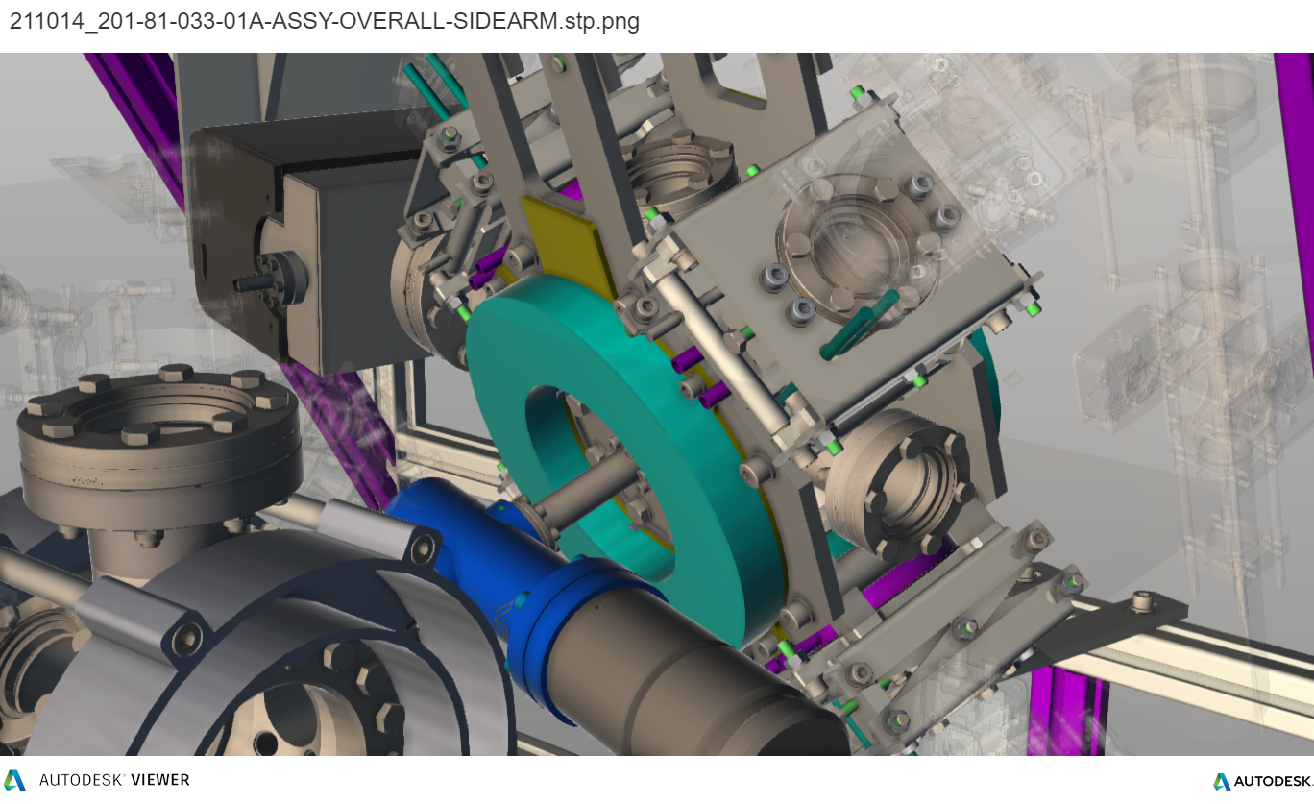
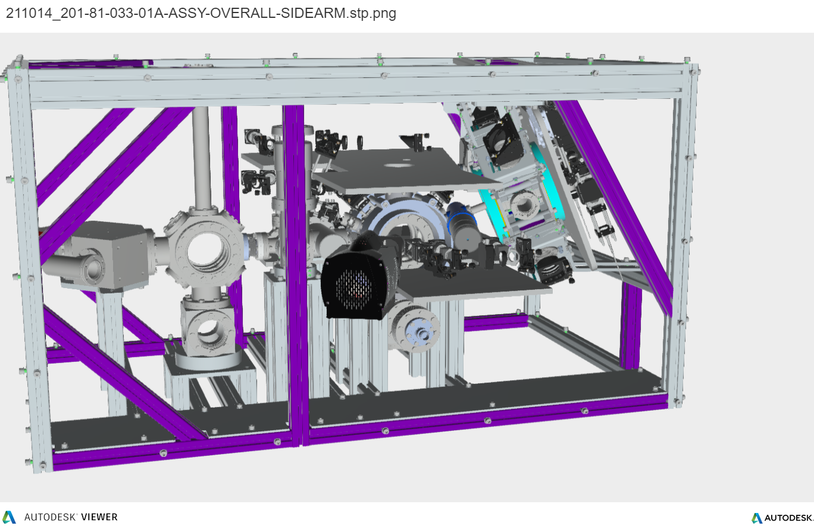
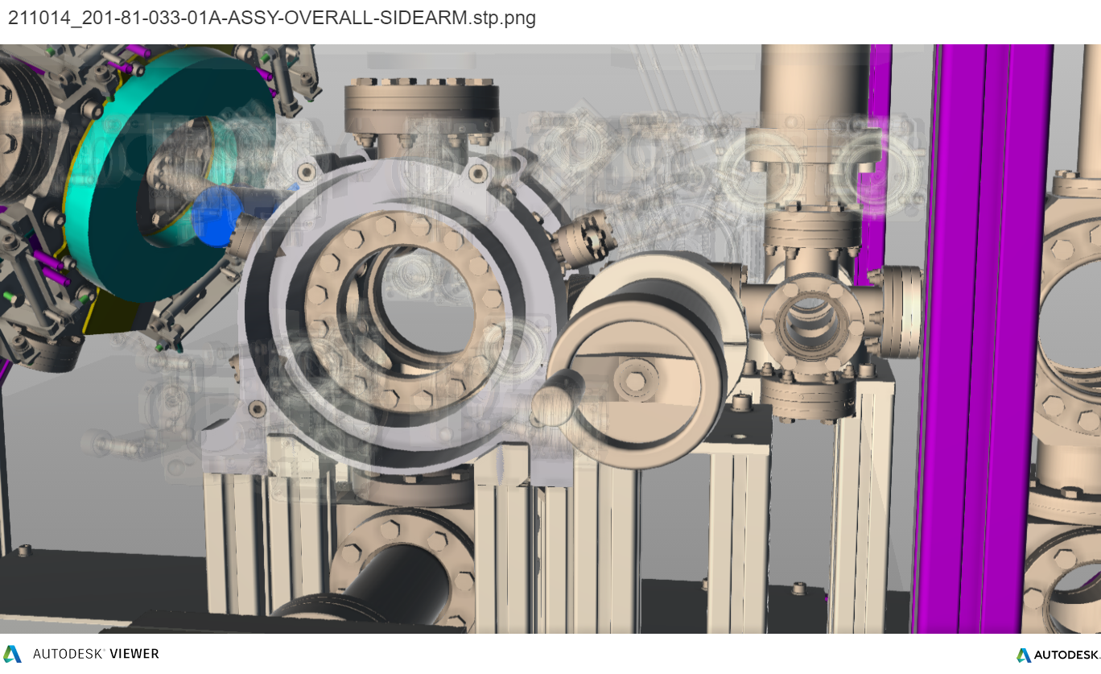
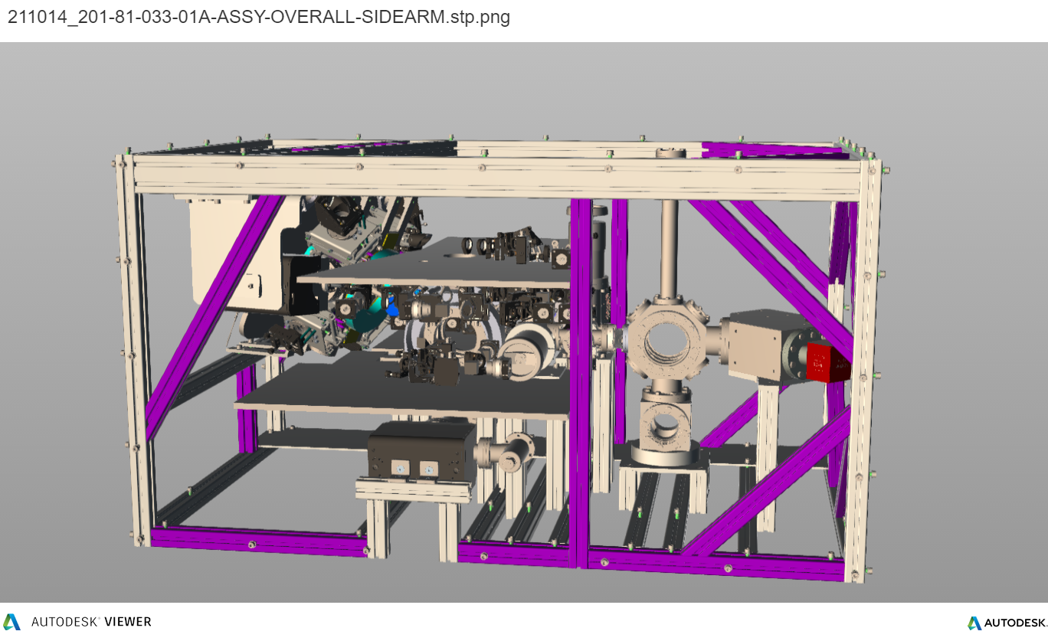
UHV System (Side-Arm) Design & Build
UHV CAD Design
Five Systems with different specs will be required

Slide 34
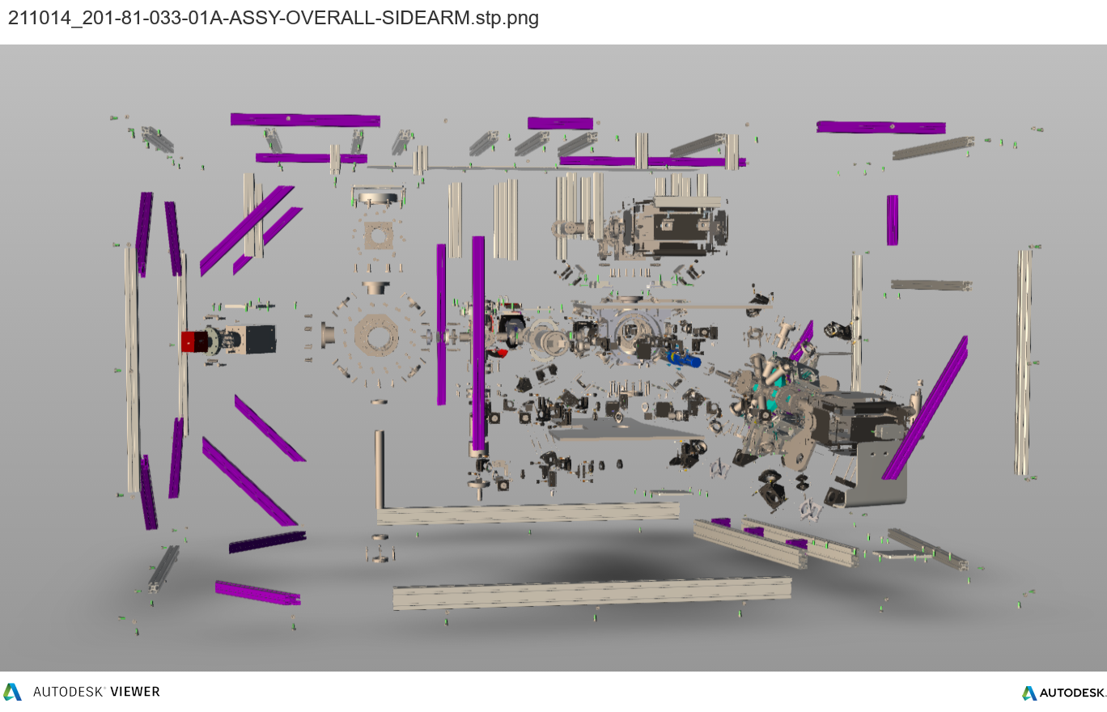
UHV System (Side-Arm) Design & Build
UHV CAD Design
Five Systems with different specs will be required

Slide 35
UHV System (Side-Arm) Design & Build
UHV CAD Design
Five Systems with different specs will be required
The first two UHV Systems are currently under construction at
the Daresbury Laboratory are delivery to Cambridge and Oxford
is expected for April

Slide 36
AION: A Different Kind of Atom Interferometer
Hybrid “clock accelerometer”
Clock: measure light travel time ➜ remove laser noise with single baseline
For ultimate sensitivity we need to push
each basic parameter by ~O(10).
The project aims to demonstrate in funding period e.g.
LMT: ~1000 hbar*k
Squeezing ~ 20dB for > 1e6 Atoms
Used for sensitivity projections

Slide 37
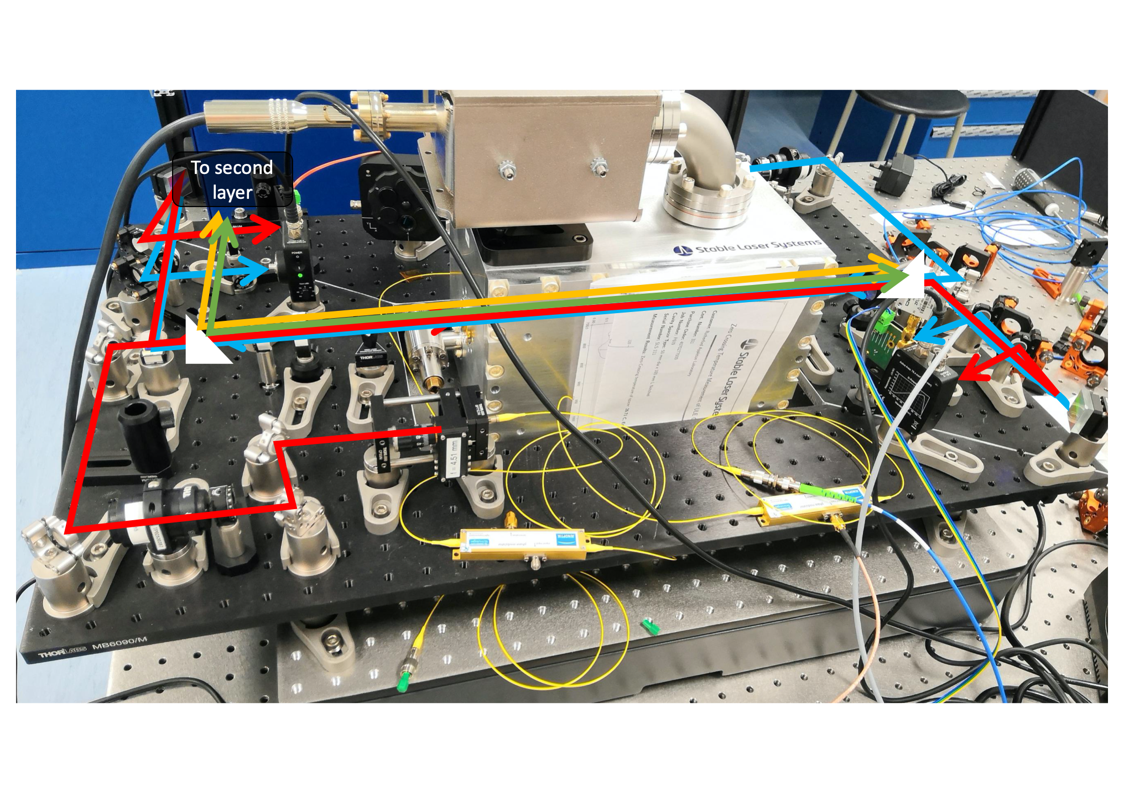
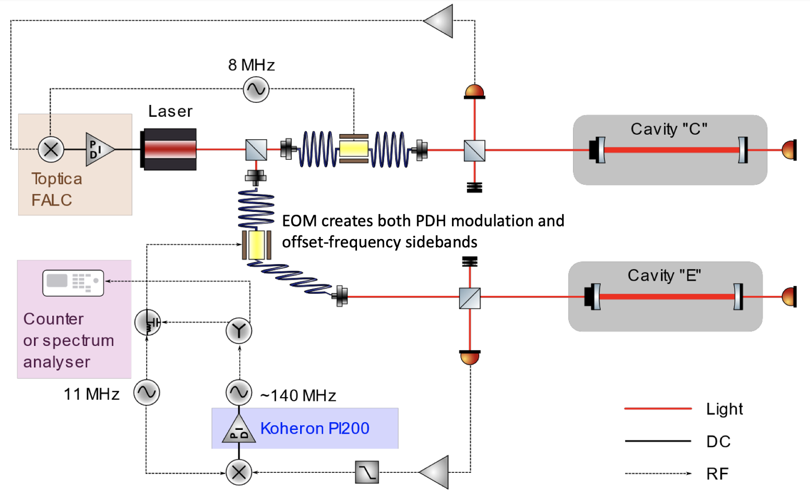
Laser Stabilisation Work in RAL (WP3)
The work at the LS system has been progressing very well, and three LS systems have been built at RAL so far.
Components for the remaining two cavities have already been procured and delivered, and shipment of completed cavities is planned for the end of the year.

Slide 38
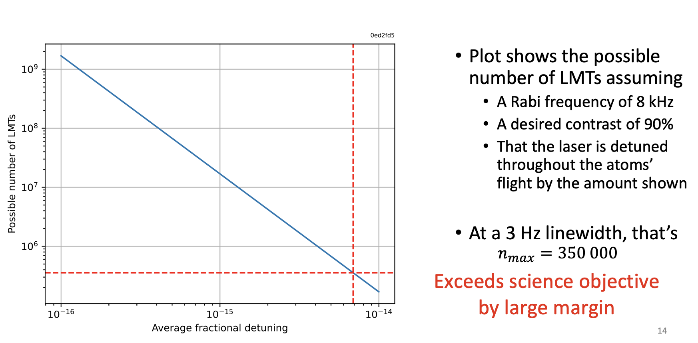
Laser Stabilisation Work in RAL (WP3) – First Tests

Slide 39
Proposed Road-map

Slide 40
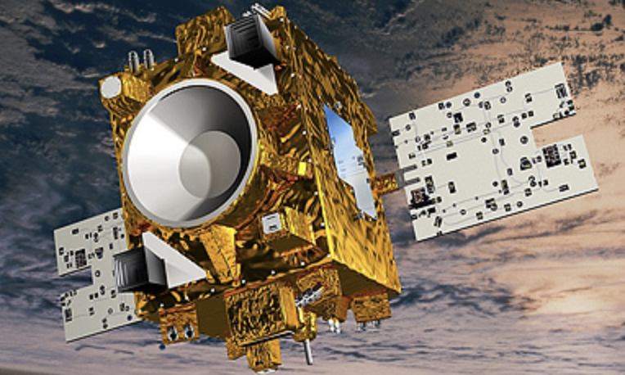
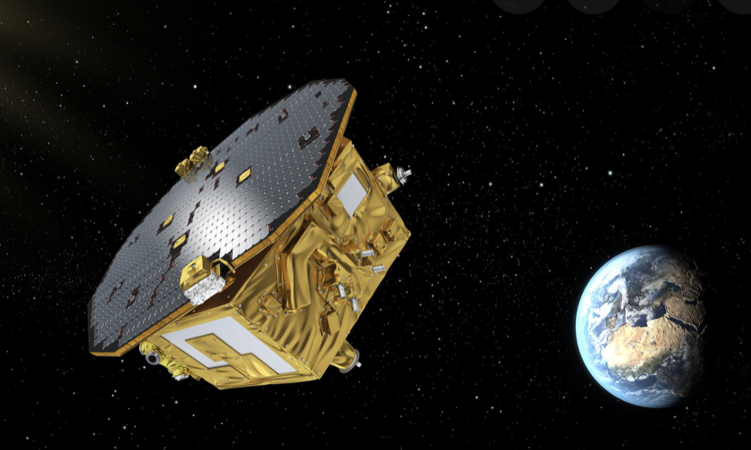
Going into Space
Space offers long free fall times and a quiet, well controlled environment as convincingly demonstrated by the MICROSCOPE and LISA-Pathfinder missions.
Ground experiments are ultimately limited by short free fall times, local gravity gradients and possible uncertainties in the positioning of the test masses. Not the case in space as demonstrated by MICROSCOPE.
Europe has a clear lead in the field (MICROSCOPE, LISA-Pathfinder, ACES/PHARAO).
Space-accelerometers (classical or cold-atoms) offer rich technological heritage for applied fields like gravity field recovery (e.g. GRACE, GOCE, GRACE-FO), navigation, planetary and lunar exploration.
MICROSCOPE Mission (Launch 2016)
LISA-Pathfinder Mission (Launch 2015)

Slide 41
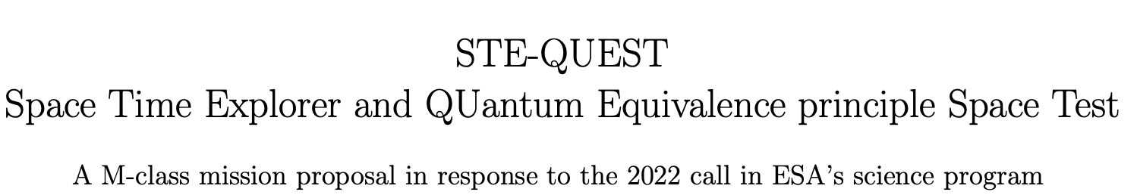
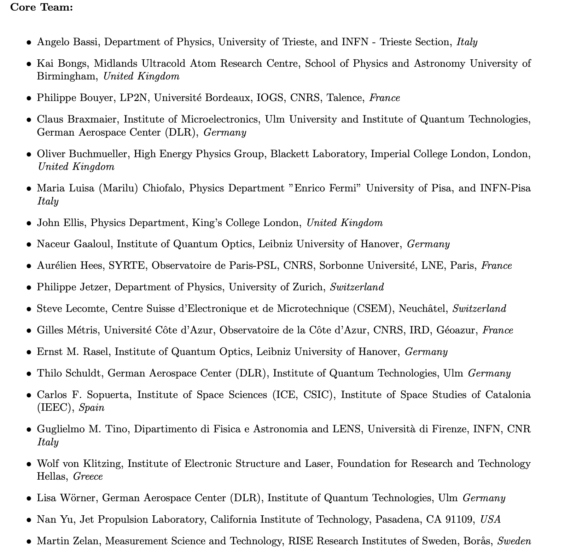
STE-QUEST (M-Class Mission Proposal)
Strong UK representation
in STE-QUEST Core Team.
All are also core
members of AION

Slide 42
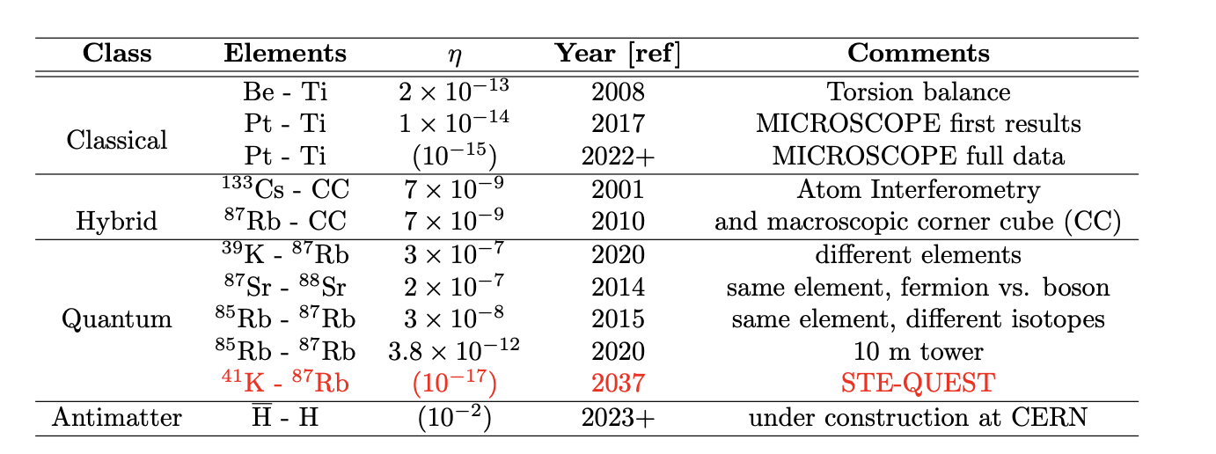

STE-QUEST: An M-class Cold Atom mission to probe gravity, dark matter and quantum mechanics
Science Goals: Equivalent Principal at 1E-17, Ultra-Light Dark Matter, Test of Quantum Mechanics
Based on STE-QUEST proposals (M3, M4).
Double atom interferometer with Rb and K “test masses” in non-classical states (quantum superpositions).
Optimized for UFF test. Assume 700 km circular orbit.
Apply recent results on controlling gravity gradient shifts by offsetting laser frequencies, thus relaxing atom positioning requirements by factor >100.
Reaches 1E-17 target after 18 months of operation.
⁸⁷Rb
⁴¹K

Slide 43
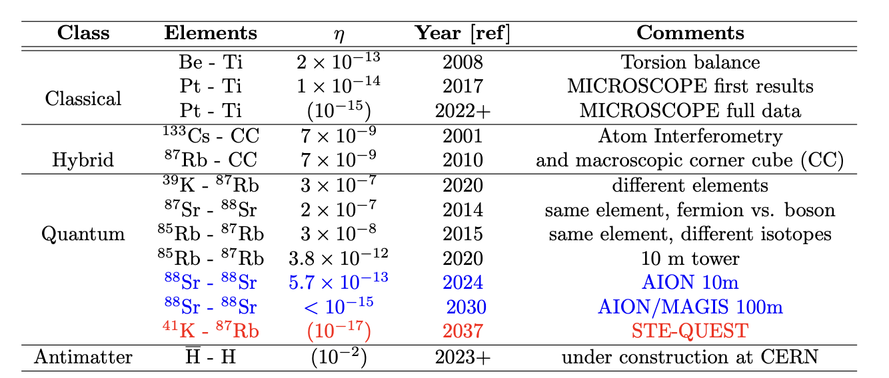
STE-QUEST: An M-class Cold Atom mission to probe gravity, dark matter and quantum mechanics
Science Goals: Equivalent Principal at 1E-17, Ultra-Light Dark Matter, Test of Quantum Mechanics
Based on STE-QUEST proposals (M3, M4).
Double atom interferometer with Rb and K “test masses” in non-classical states (quantum superpositions).
Optimized for UFF test. Assume 700 km circular orbit.
Apply recent results on controlling gravity gradient shifts by offsetting laser frequencies, thus relaxing atom positioning requirements by factor >100.
Reaches 1E-17 target after 18 months of operation.
⁸⁷Rb
⁴¹K

Slide 44
STE-QUEST: An M-class Cold Atom mission to probe gravity, dark matter and quantum mechanics
Science Goals: Equivalent Principal at 1E-17, Ultra-Light Dark Matter, Test of Quantum Mechanics
Based on STE-QUEST proposals (M3, M4).
Double atom interferometer with Rb and K “test masses” in non-classical states (quantum superpositions).
Optimized for UFF test. Assume 700 km circular orbit.
Apply recent results on controlling gravity gradient shifts by offsetting laser frequencies, thus relaxing atom positioning requirements by factor >100.
Reaches 1E-17 target after 18 months of operation.
State-of-the-art conventional sensors
(electrostatic accelerometers)
e.g. used for Earth Observation
are limited by around eta ~1E-11
(acceleration sensitivity)
⁸⁷Rb
⁴¹K

Slide 45
STE-QUEST Workshop on May 17/18
STE-QUEST: An M-class Cold Atom mission to probe gravity, dark matter and quantum mechanics
is now open at:
https://indico.cern.ch/event/1138902/registrations/
The workshop will take place as a virtual event on zoom on May 17/18.
https://indico.cern.ch/event/1138902/
This workshop follows our Community Workshop & Roadmap for Cold Atoms in Space and is the next step in our community building process to define, develop and promote important milestones of our Community Roadmap, specifically the STE-QUEST M-class mission proposal now being considered by ESA.
This event will bring together the cold atom, astrophysics, cosmology, and fundamental physics communities to discuss the science opportunities of this M-class mission proposal. Further information about the workshop scope is listed below.
Registering on the link provided above will enable you to attend the virtual workshop event and to keep informed about the continuing development of a full mission proposal that will follow it.

Slide 46
Proposed Road-map

Slide 47
AEDGE Mission

Slide 48
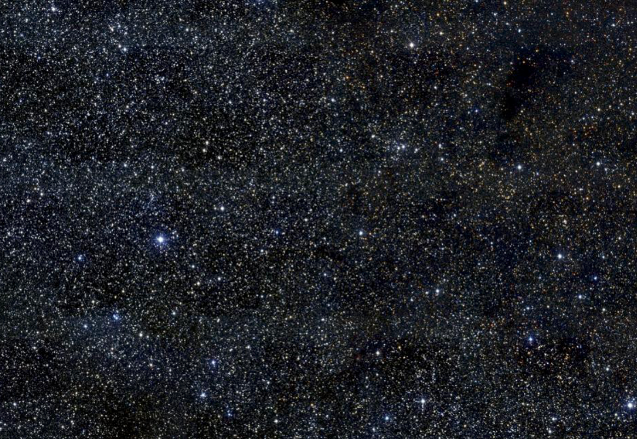
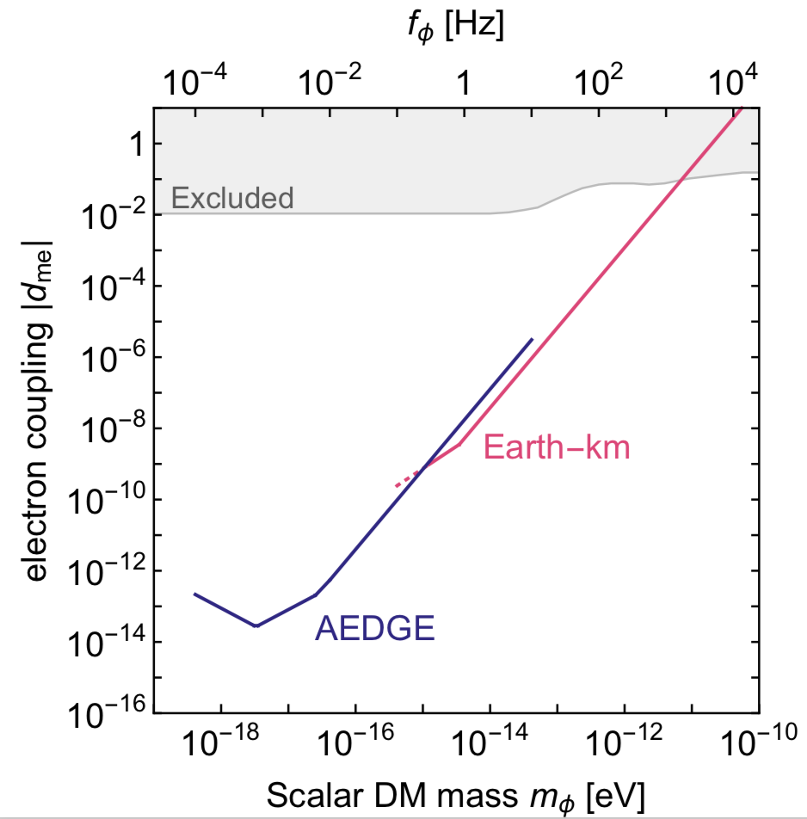
AEDGE:
Atomic Experiment for Dark Matter
and Gravity Exploration
Informal Workshop
CERN, July 22/23 2019
Organizers:
Kai Bongs(CA), Philippe Bouyer(CA), Oliver Buchmueller(PP),
Albert De Roeck(PP), John Ellis(PP, Theory), Peter Graham (CA, Theory),
Jason Hogan (CA), Wolf von Klitzing(CA), Guglielmo Tino(CA), and AtomQT
PP=Particle Physics
CA=Cold Atoms

Slide 49
AEDGE:
Atomic Experiment for Dark Matter
and Gravity Exploration
With more than 130 participants
the workshop was very well attended!
The full agenda can be accessed via:
https://indico.cern.ch/event/830432/timetable/
The main scope was to review the
landscape of Cold Atom experiments on ground AND in space to eventually establish a roadmap for technology readiness for space.
Informal Workshop
CERN, July 22/23 2019
Organizers:
Kai Bongs(CA), Philippe Bouyer(CA), Oliver Buchmueller(PP),
Albert De Roeck(PP), John Ellis(PP, Theory), Peter Graham (CA, Theory),
Jason Hogan (CA), Wolf von Klitzing(CA), Guglielmo Tino(CA), and AtomQT
PP=Particle Physics
CA=Cold Atoms

Slide 50
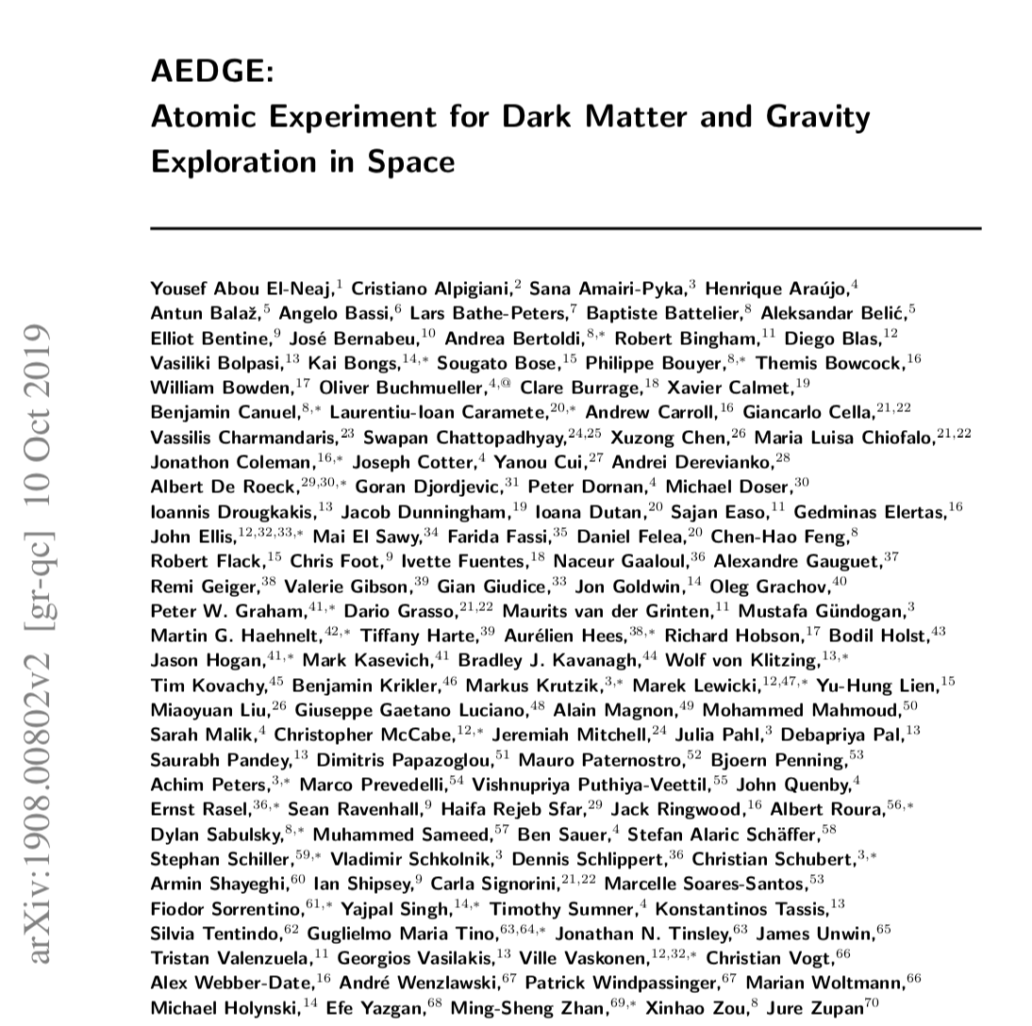
AEDGE Mission Concept
132 Authors, from 70 institutions,
based in 23 different counties!
The authors represent several science communities ranging from Cold Atoms, & Gravitational Waves, over Cosmology and Astrophysics to fundamental Particle Physics.
https://arxiv.org/abs/1908.00802
The paper is now published in EPJ Quantum Technology

Slide 51
Potential Mission Design
Using two cold-atom interferometers that perform a relative measurement of
differential phase shift, a potential mission profile would be using a pair of satellites
separated by a very long baseline L.
Assumed basic parameters:
Pair of satellites in medium earth orbit (MEO)
Satellite separation L = 4.4 x 10⁷ m
A detailed mission outline is provided in: MAGIS collaboration, P. W. Graham et al arXiv:1711.02225
Note: as Laser noise is
common-mode suppressed
only two satellites are required

Slide 52
The Science Case

Slide 53
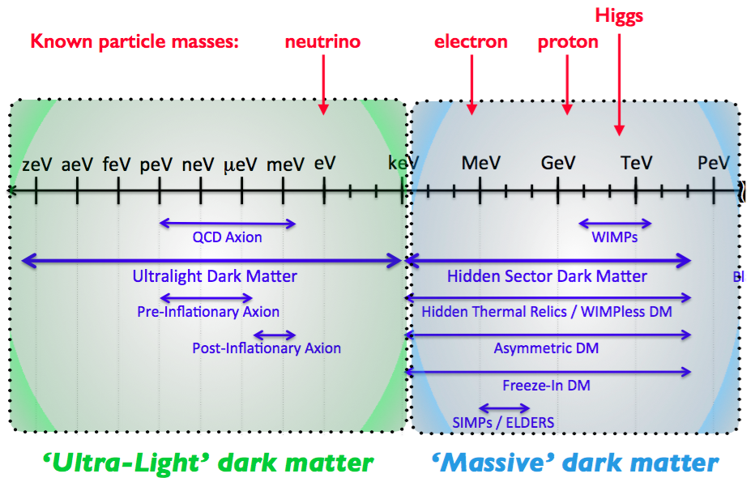
Search for Ultra-Light Dark Matter

Slide 54
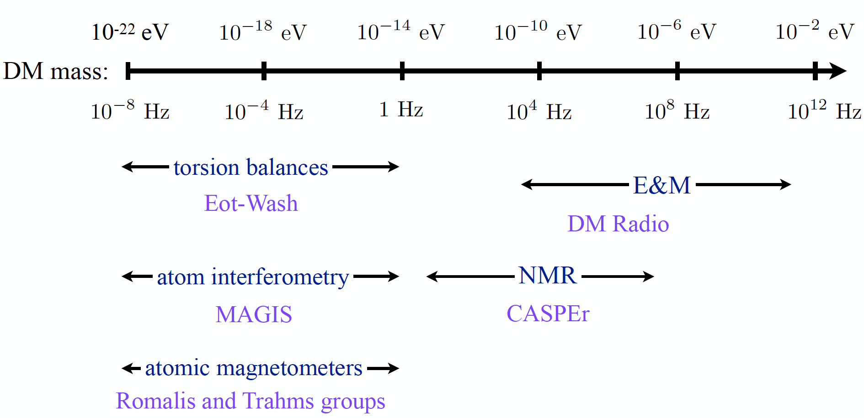
The Landscape of Ultra-Light Dark Matter Detection
Vey light dark matter and gravitational wave detection similar when detecting
coherent effects of entire field, not single particles.
Example: Ultra-Light Dark Matter:
Diagram taken from P. Graham’s
talk at HEP Front 2018

Slide 55
The Landscape of Ultra-Light Dark Matter Detection
Vey light dark matter and gravitational wave detection similar when detecting
coherent effects of entire field, not single particles.
Example: Ultra-Light Dark Matter:
MAGIS/AION
Diagram taken from P. Graham’s
talk at HEP Front 2018

Slide 56
The Landscape of Ultra-Light Dark Matter Detection
Vey light dark matter and gravitational wave detection similar when detecting
coherent effects of entire field, not single particles.
Example: Ultra-Light Dark Matter:
MAGIS/AION
Diagram taken from P. Graham’s
talk at HEP Front 2018

Slide 57



Ultra-Light Spin-0 Dark Matter
Ultra-light spin 0 particles are expected to form a coherently oscillating classical field
as with an energy density of

Slide 58

Ultralight scalar dark matter
Ultralight dilaton DM acts as a background field (e.g., mass ~10⁻¹⁵ eV)
+ …
Electron
coupling
Photon
coupling
e.g., QCD
DM scalar field
DM mass density
DM coupling causes time-varying atomic energy levels:
DM induced oscillation
Dark matter coupling
Time
Courtesy of Jason Hogan!

Slide 59



Search for Ultra-Light Dark Matter
Linear couplings to gauge fields and matter fermions
Orders of
magnitude
improvement
over current
sensitivities
AION Collaboration (Badurina, …, JE et al): arXiv:1911.11755; Badurina, Buchmueller, JE, Lewicki, McCabe & Vaskonen: arXiv:2108.02468

Slide 60
Search for Ultra-Light Dark Matter
Linear couplings to gauge fields and matter fermions
CA will be probing new territory in ULD scalar scenarios.
With different configurations of the Atom Interferometer
it will be also possible to search for
Axions (pseudo-scalar) and Vector DM candidates!
[studies are ongoing]
A Space based versions (e.g. STE-QUEST, AEDGE), would cover an enormous region of parameter space with unprecedented discovery potential!
Vector DM
Orders of
magnitude
improvement
over current
sensitivities
Bedurina, McCabe
AION Collaboration (Badurina, …, JE et al): arXiv:1911.11755; Badurina, Buchmueller, JE, Lewicki, McCabe & Vaskonen: arXiv:2108.02468

Slide 61
Unexplored Mid-frequency Gravitational Waves

Slide 62
Pathway to the GW Mid-(Frequency)

Slide 63
Pathway to the GW Mid-(Frequency)
Mid-band science
Detect sources BEFORE they reach the high frequency band [LIGO, ET]
Optimal for sky localization: predict when and where events will occur (for multi-messenger astronomy)
Search for Ultra-light dark matter in a similar frequency [i.e. mass] range
Mid-Band currently
NOT covered

Slide 64
AION: Pathway to the GW Mid-(Frequency)
Mid-band science
Detect sources BEFORE they reach the high frequency band [LIGO, ET]
Optimal for sky localization: predict when and where events will occur (for multi-messenger astronomy)
Search for Ultra-light dark matter in a similar frequency [i.e. mass] range
AION:
Terrestrial detectors can start filling this gap

Slide 65



Sky position determination
Sky localization precision:
Images: R. Hurt/Caltech-JPL; 2007 Thomson Higher Education
Mid-band advantages
- Small wavelength λ
- Long source lifetime (~months) maximizes effective R
λ
R
Courtesy of Jason Hogan!
Ultimate sensitivity for terrestrial based detectors is achieved by operating 2 (or more)
Detectors in synchronisation mode

Slide 66
Ultimate Goal: Establish International Network
Illustrative Example:
Network could be further extended
or arranged differently

Slide 67
AION: Pathway to the GW Mid-(Frequency)
Mid-band science
Detect sources BEFORE they reach the high frequency band [LIGO, ET]
Optimal for sky localization: predict when and where events will occur (for multi-messenger astronomy)
Search for Ultra-light dark matter in a similar frequency [i.e. mass] range
AION:
Terrestrial detectors can start filling this gap

Slide 68
AION & AEDGE: Pathway to the GW Mid-(Frequency)
Mid-band science
Detect sources BEFORE they reach the high frequency band [LIGO, ET]
Optimal for sky localization: predict when and where events will occur (for multi-messenger astronomy)
Search for Ultra-light dark matter in a similar frequency [i.e. mass] range
AEDGE
Ultimate coverage with a space based detector

Slide 69

Vision for 2045+
Probe formation of SMBHs: Synergies with other GW experiments (LIGO, LISA), test GR
AION Collaboration (Badurina, …, JE et al): arXiv:1911.11755
Badurina, Buchmueller, JE, Lewicki, McCabe & Vaskonen: arXiv:2108.02468

Slide 70


The GW Experimental Landscape: 2045ish+
Sensitivity Scenario | L [m] | T_{int} [s] | Φ [1/√Hz] | LMP [#]
AION-100-today | 100 | 1.4 | 10⁻³ | 100
AION-100-ultimate | 100 | 1.4 | 10⁻⁵ | 40000
AION-km | 2000 | 5 | 0.3 x 10⁻⁵ | 40000
AION-space | 4.4x10⁷ | 300 | 10⁻⁵ | <1000
List of basic parameters: Lengths of the detector L, interrogation time of the atom interferometer T_{int} , phase noise φ, and number of momentum transfers LMP. The choice of these parameters predominately defines the sensitivity of the projection scenarios.

Slide 71

The GW Experimental Landscape: 2030ish

Slide 72
Other Fundamental Physics
Ultra-high-precision atom interferometry may also be sensitive to other aspects of fundamental physics beyond dark matter and GWs, though studies of such possibilities are still at exploratory stages.
Examples may include:
The possibility of detecting the astrophysical neutrinos
Probes of long-range fifth forces.
Constraining possible variations in fundamental constants.
Probing dark energy.
Probes of basic physical principles such as foundations of quantum mechanics and Lorentz invariance.

Slide 73
Proposed Road-map

Slide 74
Summary
The first stage of the UK Atom Interferometer Observatory and Network (AION) project was recently funded in the UK with about £9.6M
AION opens a new window on gravitational physics, astrophysics & cosmology using ultra-cold atom interferometers, leveraging UK investment in quantum technologies, providing new opportunities for UK science communities.
To push the state-of-the-art single photon atom interferometry, the AION project builds dedicated ultra-cold strontium laboratories in Birmingham, Cambridge, Imperial College, Oxford, and RAL
AION: An Atom Interferometer Observatory and Network, JCAP05(2020) 011,[1911.11755].
The Atomic Experiment for Dark Matter and Gravity Exploration (AEDGE) mission proposal was summitted in the Voyage2050 White Paper call.
AEDGE propose to use ultra-cold atom technology to explore gravitational physics, astrophysics & cosmology and to search for ultra-light dark matter. The underlying technology concept is identical to the one AION pursues.
AEDGE is supported by an international consortium of almost 200 scientists from 70 institutions, based in 23 different counties.
The AEDGE consortium includes leading members of the AION (UK), MAGIS (US), MIGA (France), and ZIGA (China) large-scale terrestrial ultra-cold atom interferometry projects. Each project is funded by national agencies with about 10M dollar (or more).
AEDGE: Atomic Experiment for Dark Matter And Gravity Exploration in Space, arXiv:1908.00802, EPJ Quantum Technol. 7, 6 (2020).
The Community Workshop on Cold Atoms in Space and its Road-Map
The purpose of this community workshop was to discuss options for a quantum technology development programme coordinated at the Europe-wide level and to develop a community roadmap and milestones to demonstrate the readiness of cold atom technologies in space, as proposed in the Voyage 2050 recommendations, and in synergy with EU programmes.
This event brought together the cold atom, astrophysics, cosmology, fundamental physics, and earth observation communities to shape this development programme.
Writeup: Cold Atoms in Space: Community Workshop Summary and Proposed Road-Map, arXiv:2201.07789, submitted to EPJ Quantum Technology

Slide 75
Backup

Slide 76


Why Space?
One important argument in favour of Space (vs Earth) is interrogation time T of the atoms in free fall conditions.
To better understand this, it is useful to look at the short-term sensitivity to acceleration of an Atom Interferometer:
On Earth, many interferometry experiments are limited by their free-fall interrogation times T, achieved through launching or dropping atom clouds at some limited distance above the floor. In space this limitation is removed, leading to potentially large improvements in performance.
Example:
Taking AION-10 goal as reference, we are planning to demonstrate that AION-10 can reach on earth with
an interrogation time T ~1s a dg of about 5.7x1E-13 in 2024. In space, we estimate we could reach T~20sec and, thus, reach 3.9x1E-14 (factor ~15 better).

Slide 77
Community Workshop For Cold ATOMs in space

Slide 79
Angelo Bassi, University of Trieste, Italy
Kai Bongs, University of Birmingham, UK
Philippe Bouyer, CNRS, Institut d’Optique, France
Oliver Buchmueller, Imperial College London, UK
Luigi Cacciapuoti, European Space Agency
Marilù Chiofalo, University of Pisa and INFN Pisa, Italy
Albert De Roeck, CERN, Geneva, Switzerland, and University of Antwerp, Belgium
Michael Doser, CERN, Geneva, Switzerland
John Ellis, King’s College London, UK
Rene Forsberg, DTU Space, Denmark
Thomas Lévèque, Centre National d’Etudes Spatiales, France
Christian Lisdat, Physikalisch-Technische Bundesanstalt, Germany
Federica Migliaccio, DICA, Politecnico di Milano, Italy
Ernst Rasel, Leibniz Universität Hannover, Germany
Stephan Schiller, Heinrich-Heine-Universität Düsseldorf, Germany
Christian Schubert, Leibniz Universität Hannover, Germany
Carla Signorini, INFN Pisa, Italy
Guglielmo Tino, Università di Firenze and LENS, Italy
Wolf von Klitzing, IESL-FORTH, Greece
Peter Wolf, CNRS, Observatoire de Paris-PSL, Paris, France

Slide 80

Large missions:
Moons of the Giant Planets
Exoplanets
New Physical Probes of the Early Universe: Fundamental physics and astrophysics
Possible Medium missions:
… QM & GR (cold atoms?)
Technology development recommendations for Cold Atom Interferometry
for gravitational wave detectors in new wavebands …, detectors for dark matter candidates, sensitive clock tests of general relativity, tests of wave function collapse .…
must reach high technical readiness level, be superior to classical technologies
start with atomic clocks, on free-flyer or ISS?
What M-mission to propose?

Slide 81
“Per audacia ad astra”
A coordinated three-fold response of the community to the Voyage 2050 recommendations:
A letter to ESA’s Director of Science, Guenther Hasinger:
  to raise awareness in ESA that the community is prepared to organise itself and to work actively with ESA, as it shapes a roadmap for a Cold Atom technology in space development programme
A community workshop in September:
  This event brought together the cold atom, astrophysics, cosmology, fundamental physics, and earth observation communities to formulate a road-map for the development programme,.
A Workshop Summary and Road-map Document
  As input input to ESA and national space agencies on how to structure a Cold atoms in Space programme and what priorities could be established.

Slide 82
Participant Analysis
321 people from 36 countries have registered for the Workshop and/or to follow the Community Roadmap process

Slide 83
Participant Analysis
321 people from 36 countries have registered for the Workshop and/or to follow the Community Roadmap process

Slide 84



Workshop Agenda
Community Workshop for Cold Atoms in space

Slide 85
Workshop Agenda
Community Workshop for Cold Atoms in space
Closely related to FP
Interest from space agencies
Other interesting space
applications of cold atoms

Slide 86


Community Workshop Summary & Road-map
https://arxiv.org/abs/2201.07789
This document has been signed by more than 250 scientists, representing the cold atom, astrophysics, cosmology, fundamental physics, geodesy and earth observation communities.

Slide 87
Proposed Road-map

Slide 88
Proposed Road-map

Slide 89
STE-QUEST (M-Class Mission Proposal)

Slide 90
Applications in other fields, such as quantum computing.

Slide 91

Quantum Computing & AION
Image: JILA (Colorado), Kaufman lab

Slide 92


Quantum Computing & AION
Existing AION cold Sr system (80%)
+
New tweezer array (20%)
=
Quantum computer
K. Barnes et al, https://arxiv.org/abs/2108.04790 (2021)
– Atom Computing

Slide 93



Quantum Computing & AION
1 qubit = 1 Sr atom
Quantum logic gates (the hard bit!): Rydbergs
A. W. Young et al, Nature 588, 408-413 (2020)
– JILA Colorado, Kaufman lab
S. Madjarov et al. Nature Physics 16, 857-861 (2020)
– Caltec, Endres lab
99.9(2)% gate fidelity

Slide 94

Quantum Computing & AION
Trapped-ion or superconducting qubits developed over ~ 20 years
Tweezer array qubits started to emerge in the last ~ 10 years
Startups in neutral atom computing
https://atom-computing.com/ - $60M funding round, 2022
https://pasqal.io/about
https://coldquanta.com/core-technology/hilbert/
https://www.quera.com/
https://mobile.twitter.com/computingq
Why are we well placed to do this at Imperial?
Atomic clocks → single qubit operations
Squeezing → cavities to exchange atom vs photon qubits
AION → robust, highly engineered Sr systems
Atoms in tweezers – some recent academic results:
S. Ebadi et al, Nature 595, 227-232 (2021) – Harvard, Lukin lab
A. W. Young et al, Nature 588, 408-413 (2020) – JILA, Kaufman lab
S. Madjarov et al. Nature Physics 16, 857-861 (2020) – Caltec, Endres lab
P. Scholl et al, Nature 595, 233-238 (2021) – CNRS, Bronwaes lab

Slide 95
Summary
The first stage of the UK Atom Interferometer Observatory and Network (AION) project was recently funded in the UK with about £9.6M
AION opens a new window on gravitational physics, astrophysics & cosmology using ultra-cold atom interferometers, leveraging UK investment in quantum technologies, providing new opportunities for UK science communities.
To push the state-of-the-art single photon atom interferometry, the AION project builds dedicated ultra-cold strontium laboratories in Birmingham, Cambridge, Imperial College, Oxford, and RAL
AION: An Atom Interferometer Observatory and Network, JCAP05(2020) 011,[1911.11755].
The Atomic Experiment for Dark Matter and Gravity Exploration (AEDGE) mission proposal was summitted in the Voyage2050 White Paper call.
AEDGE propose to use ultra-cold atom technology to explore gravitational physics, astrophysics & cosmology and to search for ultra-light dark matter. The underlying technology concept is identical to the one AION pursues.
AEDGE is supported by an international consortium of almost 200 scientists from 70 institutions, based in 23 different counties.
The AEDGE consortium includes leading members of the AION (UK), MAGIS (US), MIGA (France), and ZIGA (China) large-scale terrestrial ultra-cold atom interferometry projects. Each project is funded by national agencies with about 10M dollar (or more).
AEDGE: Atomic Experiment for Dark Matter And Gravity Exploration in Space, arXiv:1908.00802, EPJ Quantum Technol. 7, 6 (2020).
The Community Workshop on Cold Atoms in Space and its Road-Map
The purpose of this community workshop was to discuss options for a quantum technology development programme coordinated at the Europe-wide level and to develop a community roadmap and milestones to demonstrate the readiness of cold atom technologies in space, as proposed in the Voyage 2050 recommendations, and in synergy with EU programmes.
This event brought together the cold atom, astrophysics, cosmology, fundamental physics, and earth observation communities to shape this development programme.
Writeup: Cold Atoms in Space: Community Workshop Summary and Proposed Road-Map, arXiv:2201.07789, submitted to EPJ Quantum Technology

Slide 96
Roadmap

Slide 97

use for next-generation SI time standard worldwide?
Atomic Clock Progress

Slide 98

ACES atomic clock mission: scheduled launch to ISS 2025
Atomic Clock Progress

Slide 99


Earth Observation: using classical electrostatic accelerometers & gradiometers
Earth Observation Progress

Slide 100

Frequency Sensitivity advantage of cold atom gravity gradiometers at low frequency, no drift
Earth Observation Progress

Slide 101

Sensitivity to Water Height crucial for monitoring climate change
Earth Observation Progress

Slide 102

Requirements & Objectives
Earth Observation Progress

Slide 103

Tests of Weak Equivalence Principle (Universality of Free Fall)
Fundamental Physics Part

Slide 104

Basic Differential Measurement
Laser 1
Laser 2
Atom
Source
Atom
Source

Slide 105
Basic Differential Measurement
Laser 2: π pulse [high p]
Laser 1: π/2 pulse [split]
Laser 1
Laser 2
Atom
Source
Atom
Source

Slide 106
Basic Differential Measurement
“Mirror”
3π pulse
[low-high/low-high]
[Doppler shift to select]
Laser 2: π pulse [high p]
Laser 1: π/2 pulse [split]
Laser 1
Laser 2
Atom
Source
Atom
Source

Slide 107
Basic Differential Measurement
Laser 1: π/2 pulse [split]
Laser 2: π pulse [low p]
“Mirror”
3π pulse
[low-high/low-high]
[Doppler shift to select]
Laser 2: π pulse [high p]
Laser 1: π/2 pulse [split]
Laser 1
Laser 2
Atom
Source
Atom
Source

Slide 108
Basic Differential Measurement
Laser 1: π/2 pulse [split]
Laser 2: π pulse [low p]
“Mirror”
3π pulse
[low-high/low-high]
[Doppler shift to select]
Laser 2: π pulse [high p]
Laser 1: π/2 pulse [split]
Laser 1
Laser 2
Each AI spends time L/c
in excited state but at different
periods in the sequence
Atom
Source
Atom
Source

Slide 109




Team roles and linkages in AION and MAGIS
MAGIS-100
Joint work includes:-
Jon Coleman (Liverpool) is a founding member of the MAGIS project: Design and fabrication of key parts by Liverpool Physics.
Hardware deliverables to MAGIS: Cameras (Oxf.), Electronics (Cam.)
Assisting in construction, commissioning and data-taking at Fermilab site.
Participation in date analysis and first results.
Kavli-funded PDRA (Cam.)
Cambridge: transport + launching atoms, MAGIS
UoB: LMT pulse sequences, Sr technology transfer
King’s + Imperial Colleges: Theory and publication office
UoB, Cambridge, Imperial: modelling system parameters
Imperial: (clock) laser stabilisation, squeezing
10m
RAL: Vacuum + support structure. Design AION-100
Liverpool: internal optics for MAGIS + AION
Impact
Technology transfer
UK laser company: Unique systems for Q Tech. with Sr
Oxford: site, cold-atom source, laser lab, construction

Slide 110
Experimental Landscape

Slide 111
Ground Based Large Scale O(100m) Projects
MIGA: Terrestrial detector using atom interferometer at O(100m)
(France)
MAGIS: Terrestrial shaft detector using atom interferometer at O(100m)
(US)
AION: Terrestrial shaft detector using atom interferometer at 10m – O(100m) planned
(UK)
ZIGA: Terrestrial detector for large scale atomic interferometers, gyros and clocks at O(100M)
(China)
Planned network operation

Slide 112
State-of-the-art design spEsifications

Slide 113
The Physics case

Slide 114
Dark Matter Physics @AION
Based on DM workshop at KCL:
https://indico.cern.ch/event/797031/timetable/
and AION workshop at Imperial:
https://indico.cern.ch/event/802946/
Using Material from. M. Bauer, J. Hogan, J. March-Russel, C. McCabe, and Y. Stadnik

Slide 115
Ultralight scalar dark matter
Ultralight dilaton DM acts as a background field (e.g., mass ~10⁻¹⁵ eV)
+ …
Electron
coupling
Photon
coupling
e.g., QCD
DM scalar field
DM mass density
DM coupling causes time-varying atomic energy levels:
DM induced oscillation
Dark matter coupling
Time
Courtesy of Jason Hogan!

Slide 116
Ultra-Light Scalar Dark Matter
DM induced oscillation
Dark matter coupling
time
Coupling
to electron
The AION staged programme will have unprecedented sensitivity to DM with scalar couplings to matter, which cause time variation of fundamental constants such as the electron mass.
Based on: Arvanitaki et al., PRD 97, 075020 (2018).
Linear scalar DM interactions
Quadratic scalar DM interactions
Coupling
to photon
Coupling
Higgs-portal

Slide 117

Ultra-Light Scalar Dark Matter
DM induced oscillation
Dark matter coupling
time
Coupling
to electron
The AION staged programme will have unprecedented sensitivity to DM with scalar couplings to matter, which cause time variation of fundamental constants such as the electron mass.
Based on: Arvanitaki et al., PRD 97, 075020 (2018).
Linear scalar DM interactions
Quadratic scalar DM interactions
Coupling
to photon
Coupling
Higgs-portal

Slide 118
Ultra-Light Scalar Dark Matter
DM induced oscillation
Dark matter coupling
time
Coupling
to electron
The AION staged programme will have unprecedented sensitivity to DM with scalar couplings to matter, which cause time variation of fundamental constants such as the electron mass.
Based on: Arvanitaki et al., PRD 97, 075020 (2018).
Linear scalar DM interactions
Quadratic scalar DM interactions
AION will be probing new territory in ULD scalar scenarios.
With different configurations of the Atom Interferometer
it will be also possible to search for
Axions (pseudo-scalar) and Vector DM candidates!
[studies are ongoing]
Coupling
to photon
Coupling
Higgs-portal

Slide 119
GW Physics @ AION
References:
On the Maximal Strength of a First-Order Electroweak Phase Transition and its Gravitational Wave Signal, 1809.08242
Cosmic Archaeology with Gravitational Waves from Cosmic Strings, 1711.03104
Probing the pre-BBN universe with gravitational waves from cosmic strings, 1808.08968
Formation and Evolution of Primordial Black Hole Binaries in the Early Universe, 1812.01930
Primordial Black Holes from Thermal Inflation, 1903.09598

Slide 120

AION: Pathway to the GW Mid-(Frequency) Band
Experimental GW Landscape

Slide 121
AION: Pathway to the GW Mid-(Frequency) Band
Experimental GW Landscape
Mid-Band currently
NOT covered
Mid-band
decihertz to hertz
Mid-band science
Detect sources BEFORE they reach the high frequency band [LIGO, ET]
Optimal for sky localization: predict when and where events will occur (for multi-messenger astronomy)
Search for Ultra-light dark matter in a similar frequency [i.e. mass] range

Slide 122
Gravitational Wave Detection with Atom Interferometry
high-frequency
region
low-frequency
region
mid-frequency
region

Slide 123
Sky position determination
Sky localization precision:
Images: R. Hurt/Caltech-JPL; 2007 Thomson Higher Education
Mid-band advantages
- Small wavelength λ
- Long source lifetime (~months) maximizes effective R
λ
R
Courtesy of Jason Hogan!
Ultimate sensitivity for terrestrial based detectors is achieved by operating 2 (or more)
Detectors in synchronisation mode

Slide 124
Ultimate Goal: Establish International Network
Illustrative Example:
Network could be further extended
or arranged differently

Slide 125
GW Detection & Fundamental Physics - Example
First-Order Electroweak Phase Transition and its Gravitational Wave Signal
arXiv:1809.08242
John Ellis, Marek Lewicki,
José Miguel No
What is is the GW signal
of electroweak phase
transition in various
theories beyond
the Standard Model.
Plots provided by Marek Lewicki
Translate strain into dimensionless energy density Ω_{GW}h² in GWs against frequency

Slide 126
The GW Experimental Landscape: 2030ish

Slide 127
The GW Experimental Landscape: 2030ish

Slide 128
The GW Experimental Landscape: 2030ish
Sensitivity Scenario | L [m] | T_{int} [s] | Φ [1/√Hz] | LMP [#]
AION-100-today | 100 | 1.4 | 10⁻³ | 100
AION-100-ultimate | 100 | 1.4 | 10⁻⁵ | 40000
AION-km | 2000 | 5 | 0.3 x 10⁻⁵ | 40000
AION-space | 4.4x10⁷ | 300 | 10⁻⁵ | <1000
List of basic parameters: Lengths of the detector L, interrogation time of the atom interferometer T_{int} , phase noise φ, and number of momentum transfers LMP. The choice of these parameters predominately defines the sensitivity of the projection scenarios.

Slide 129
GW Physics: A Few Examples
Astrophysical Sources
  The Black Holes (BH) whose mergers were discovered by LIGO and Virgo have masses up to several tens of solar masses. Many galaxies are known to contain super-massive black holes (SMBHs) with masses in the range between 10⁶ and billions of solar masses.
  It is expected that intermediate-mass black holes (IMBHs) with masses in the range 100 to 10⁵ solar masses must also exist [6]. There is some observational evidence for IMBHs, and they are thought to have played key roles in the assembly of SMBHs.
Cosmological Sources
  Many extensions of the Standard Model (SM) predict first-order phase transitions in the early Universe. Examples include extended electroweak sectors, effective field theories with higher-dimensional operators and hidden sector interactions.
    Extended electroweak model with a massive Z' boson
    Cosmic String Model

Slide 130

Strain Sensitivity & BH Mergers: 2030ish
The AION frequency range is ideal for observations of mergers involving IMBHs,
to which LISA and the LIGO/Virgo/KAGRA/ET experiments are relatively insensitive.

Slide 131


Strain Sensitivity & BH Mergers
Sensitivity of AION-100m for detecting GWs from the mergers of IMBHs at signal-to-noise (SNR) levels ≥ 5, which extends to redshifts of 1.5 for BHs with masses ∼ 10⁴ solar masses.
Comparison of the sensitivities of AION and other experiments with threshold SNR = 8.

Slide 132

Strain Sensitivity & BH Mergers: Future
The AION frequency range is ideal for observations of mergers involving IMBHs,
to which LISA and the LIGO/Virgo/KAGRA/ET experiments are relatively insensitive.

Slide 133


Cosmological GW Sources: Z’ Model
Many extensions of the Standard Model (SM) predict first-order phase transitions in the early Universe.
Example: Extended electroweak model with a massive Z' boson
Example of the GW spectrum in a classical scale-invariant extension of the SM with a massive Z' boson compared with various experimental sensitivities. Right panel: Signal-to-noise ratio (SNR) in the parameter plane of the same model for the AION-1km stage.

Slide 134

Cosmological GW Sources: Cosmic Strings
Other possible cosmological sources of GW signals are cosmic strings. These typically give a very broad frequency spectrum stretching across the ranges to which the LIGO/ET, AION/MAGIS, LISA and SKA experiments are sensitive.
The impact of including the change in the number of degrees of freedom as predicted in the Standard Model and clearly shows that probing the plateau in a wide range of frequencies can give us a significant amount of information not only on strings themselves but also on the evolution of the universe.
This way we could probe both SM processes such as the QCD phase transition and BSM scenarios predicting new degrees of freedom or even more significant cosmological modifications such as early matter domination, which would all leave distinguishable features in the GW background.

Slide 135


Constraints on Graviton Mass
arXiv:2003.13480
Waveforms
arXiv:2003.13480
Current LIGO/Virgo limit:
1.76 × 10⁻²³ eV
Future sensitivity with
LIGO/Virgo-like
event?
Longer observations
With merger of
heavier BHs?
Lower frequencies
LIGO/Virgo: arXiv:2010.14529
GW150914-like
BH-BH binary inspiral
SNR
J Ellis & V Vaskonen: arXiv:2003.13480

Slide 136


Constraints on Graviton Mass
LIGO/Virgo: <1.76 × 10⁻²³ eV
AION 1-km: sensitive to 10⁻²⁴ eV
  with LIGO/Virgo-like event
Sensitive to 2 × 10⁻²⁵ eV
with heavier BHs
AEDGE: 8 × 10⁻²⁷ eV
with BHs 5600 + 4400
solar masses
arXiv:2003.13480
90% upper bound on the graviton mass for observations of BH-BH binary inspirals as functions of the luminosity distance (upper) and binary chirp mass (lower)
for AION 1km
arXiv:2003.13480
AION (and AEDGE) have impressive sensitivity to Graviton Mass
J Ellis & V Vaskonen: arXiv:2003.13480

Slide 137
Other Fundamental Physics
Ultra-high-precision atom interferometry may also be sensitive to other aspects of fundamental physics beyond dark matter and GWs, though studies of such possibilities are still at exploratory stages.
Examples may include:
The possibility of detecting the astrophysical neutrinos
Probes of long-range fifth forces.
Constraining possible variations in fundamental constants.
Probing dark energy.
Probes of basic physical principles such as foundations of quantum mechanics and Lorentz invariance.

Slide 138
AION-10: 10 Meter Side chosen to be Oxford

Slide 139
Beecroft building, Oxford Physics
The Beecroft in Oxford is the proposed site, with a backup at RAL (MICE Hall) in case show-stoppers are encountered.

Slide 140
Beecroft building, Oxford Physics
Ultralow vibration
All plant isolated
Thick concrete walls
Adjacent laser lab reserved for AION use
keel slabs
$±{0.1}^{∘}$C stability
Isolated mains
Ground level
AION
12 m
Vertical space
12m basement to ground floor
14.7m floor to ceiling
Aircon infrastructure
Stairwell is not a fire escape route.
Laser lab
Bakeout room and cleanroom nearby
Void
Keel slab

Slide 141
Beecroft building, Oxford Physics
← Side view
↓ Plan view
14.7m
5.4m
10.0m
AI-10
Bake room
7.7m
AI-10
Laser Lab
Keel slab,
Optical table
5.0m
Core site
Core site

Slide 142
AION-10 site: Beecroft building, Oxford Physics
Beecroft building – brand new, low-vibration laser lab and concrete stairwell
14.7m
Detailed planning of support structure by RAL (Engineering), Oxford Physics Technical Services and Liverpool Univ.
Experienced Project Manager: Roy Preece
Good site for long-term operation and wide accessibility (also ‘visibility’ and outreach).
Ground level
AI-10
10.0m
7.7m
5.0m
Feed through to laser lab

Slide 143



Beecroft building laser lab
Beecroft stairwell: lowest level
Laminar flow
Isolated electrical supply
Cooling water
Keel slab
Core site: feed through fibre and cables
laser lab (interior): optical table enclosure with laminar air flow and temperature-control installed.
Bake-out room next door

Slide 144



Assembly: extruded aluminium support structure
Remove top layer
after hoisting
Scaffolding erected from ground up.
10 m
vacuum pipe;
3.8 m long,
<100 kg.

Slide 145
Atom Interferometer Concept

Slide 146
Simple Example: Two Atomic Clocks
Atom clock
Atom clock
Phase evolved by atom after time T
Time

Slide 147
Simple Example: Two Atomic Clocks
GW changes light travel time
Time
Atom clock
Atom clock

Slide 148
Phase Noise from the Laser
The phase of the laser is imprinted onto the atom.
Laser phase noise, mechanical platform noise, etc.
Laser phase is common to both atoms – rejected in a differential measurement.

