Slide 1
Review of satellite gravity missions for environmental science applications and the user requirements.
Gabriella Fasoli
Gabriella.fasoli@kcl.ac.uk

Slide 2
Research Questions
Applications. What are the key applications within environmental sciences that cold atom sensors could help to address?
Limitations. What are the limitations of current satellite gravity missions that cold atom sensors could help to overcome?
User Requirements. What are the user requirements for a future mission?

Slide 3
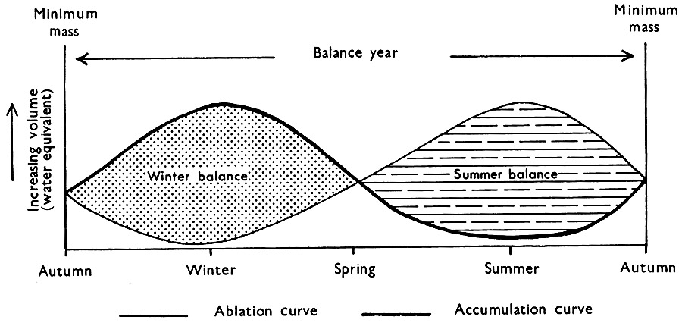
Fields of Application
CRYOSPHERE.
First direct estimates of ice mass change.
Mass balance of the ice sheets and their contribution to sea level change (Chen et al., 2006; Gardner et al., 2013).
(Velicogna et al., 2020)
(Tapley et al., 2019)
(Sugden et al., 1976)

Slide 4
Fields of Application
HYDROLOGY.
Trends in water storage (Frappart et al., 2018).
Water budget closure (Ramillien et al., 2008).
Flood and drought monitoring.
(Tapley et al., 2019)

Slide 5
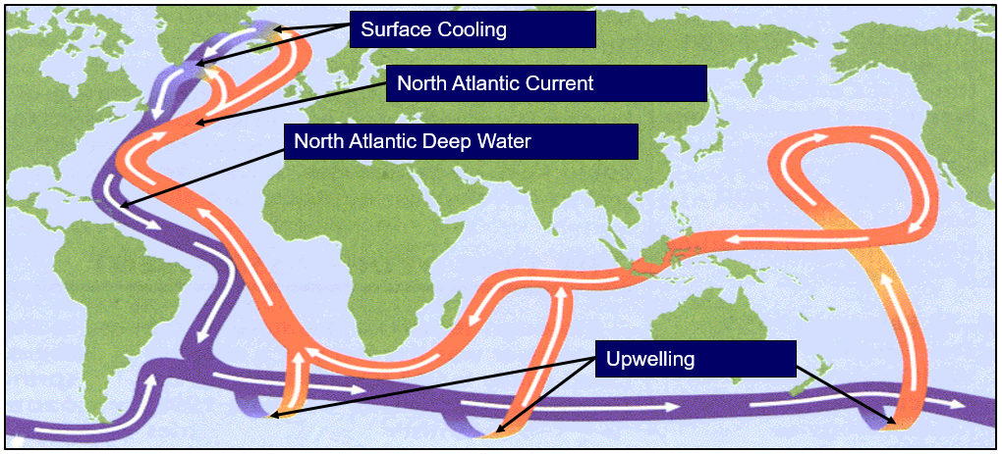
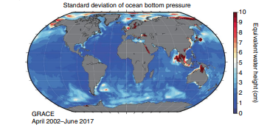
Fields of Application
Ocean bottom pressure.
Ocean circulation, mass and heat transport (Janjić et al., 2012).
Sea level change.
OCEANOGRAPHY.

Slide 6
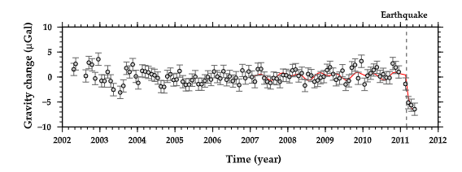
Fields of Application
SOLID EARTH.
Physical properties of and processes in the mantle and crust.
Monitoring tectonic activity
(Han et al., 2011).
Glacial Isostatic Adjustment
(Sasgen et al., 2013).
Tohoku-Oki Earthquake, 2011.
(Matsuo et al., 2011)

Slide 7
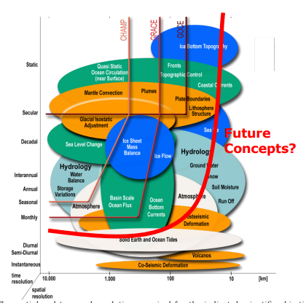
Fields of Application
SOCIETAL.
Early warnings and risk management of extreme events (Jäggi et al., 2019).
Sustainable water resource management for water and food security.
Natural hazards – earthquakes, volcanoes and tsunamis (Chen et al., 2014).
Understanding the climate system.
Sustainable exploitation of natural resources.
Sea level change (Zemp et al., 2019).
(Alonso et al., 2022)

Slide 8
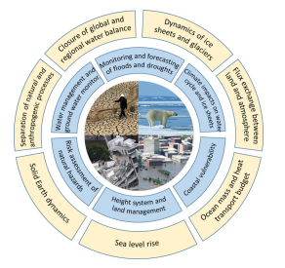
Potential New Applications
Thematic Area
Cryosphere | Detecting cryosphere mass balance on shorter timescales. Quantifying cryosphere contribution to regional and global sea level change. Determination of mass changes of individual ice sheet drainage basins to support modelling and prediction.
Continental Hydrology | Detecting water storage changes in smaller river basins. Closing the terrestrial water balance.
Oceanography | Improve regional sea level change estimates as well as heat and mass transport estimates.
Solid Earth | Detecting mass shifts from magnitude 7 earthquakes. 4D dynamic Earth model for understanding and predicting near-surface motion and deformation.
(Pail et al., 2015)

Slide 9
Limitations of Past Missions
Spatial Resolution. Limited to a few hundred km.
Many processes occur on much smaller spatial scales (Alley et al., 2015).
E.g. Water storage estimates cannot be resolved in basins with an area >200,000km² (Longuevergne et al., 2010).
Leakage effects – target signals are distorted by mass variations in adjacent areas (Arendt et al., 2013; Horwath et al., 2009) .
Monthly Temporal Resolution.
Hampers monitoring of highly dynamic systems.
E.g. extreme hydrological events can be short-lived and therefore not detected by the long revisit frequencies.
Long Data Latency. (1-6 months)
Inhibits use for service type applications such as flood/drought monitoring and forecasting.

Slide 10
Limitations of Past Missions
Timeseries Length. (>20 years)
Insufficient for climatological assessments.
Longer timeseries is required for a more reliable separation of natural and anthropogenic forcings.
Signal Strength.
Ability to measure mass change is dependant on the signal strength.
I.e., It is more likely that a catchment with significant water storage variation will be detected regardless of a small spatial extent.
E.g. Minimum threshold for detecting earthquake deformation is an 8.5 magnitude event (Matsuo et al., 2011).

Slide 11
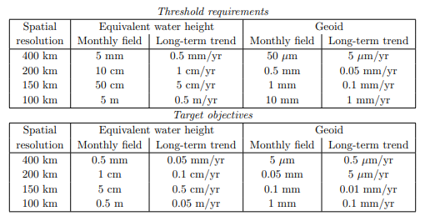
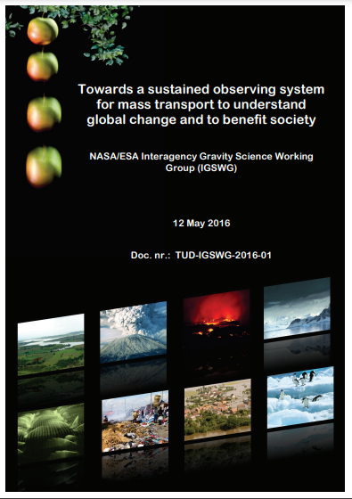
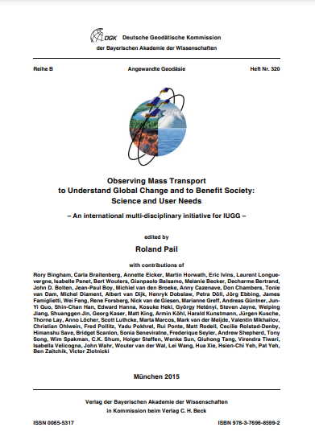
User Requirements
“The required target performance in terms of equivalent water height has been identified as 5 cm for monthly fields and 0.5 cm/year for long-term trends at a spatial resolution of 150 km.” Pail et al., 2015.
Large consensus regarding the need for improved spatial and temporal resolution, long-term continuity, in addition to improved measurement accuracy (Pail et al., 2015). However, due to the diversity of applications of mass change data, user requirements vary substantially (NASA/ESA ISGWG, 2016).
GRACE: 1.5 cm equivalent water height at spatial scale of 550km.

Slide 12
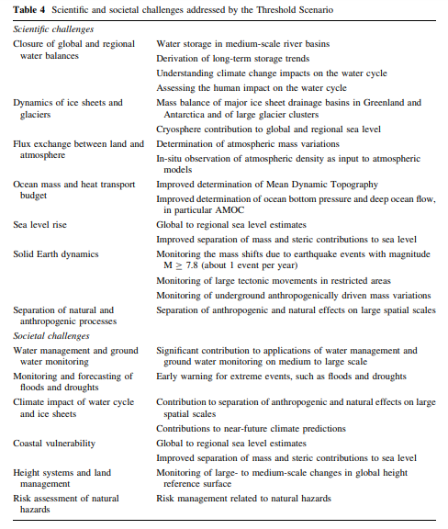
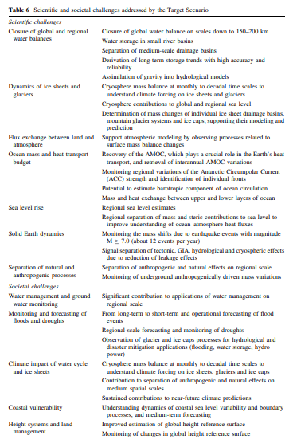
(Pail et al., 2015)

Slide 13
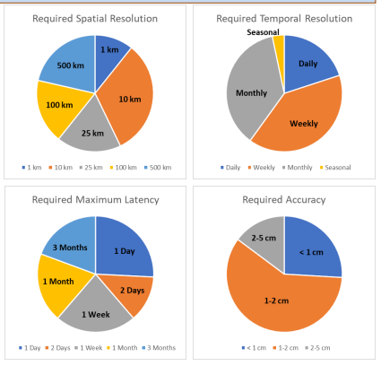
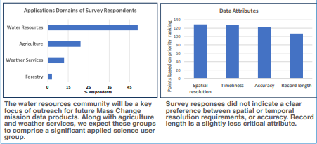
User Requirements
NASA Mass Change Applications Survey.
Survey distributed to known and expected satellite gravimetry data users, and to scientists and decision-makers who may have an interest in applied uses of future mission data and information products.
https://docs.google.com/forms/d/18UQrf-f4hfnrfks72z4wXb139T4iRpXIY8AGANLLhKc/viewform?edit_requested=true
(Srinivasan et al., 2019)

Slide 14
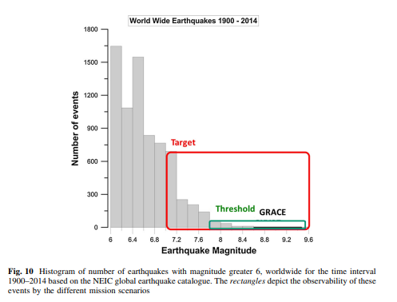
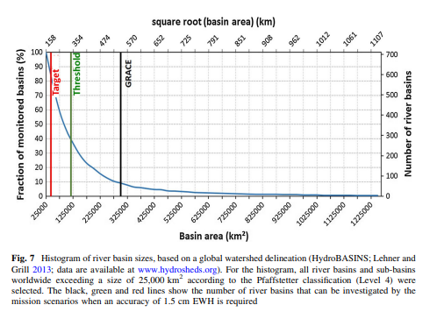
Improvements in number of river basins investigated.
Improvements in number of earthquake events investigated.

