Slide 1
Inter-disciplinary Workshop on Environmental Applications of Quantum Sensors 23 March 2023 Bruce D. Malamud Professor of Natural and Environmental Hazards Department of Geography, King’s College London [Lead, Physical and Environmental Geography Research Group]
Today will:
Introduce topics from the King’s Physical and Environmental Geography Research Group (representative topics of many ‘environmental’ groups within the UK)
Discuss a few thoughts related to natural hazards.

Slide 2
The King’s College London Department of Geography: Research Groups, Hubs and Centres

Slide 3
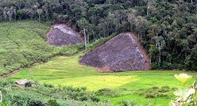
The King’s College London Department of Geography: Research Groups, Hubs and Centres
Research Hubs
Research Groups
Research Centres
Political Ecology & Ecosystem Services research group
Provides a collaborative focus for work on the social (re)production of nature, environmental conservation and resource management.

Slide 4
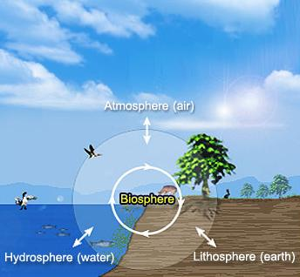
Like many research groups in geography, we seek a broader and deeper understanding of Earth’s interacting processes:
hydrological,
geomorphological,
atmospheric &
ecological.

Slide 5
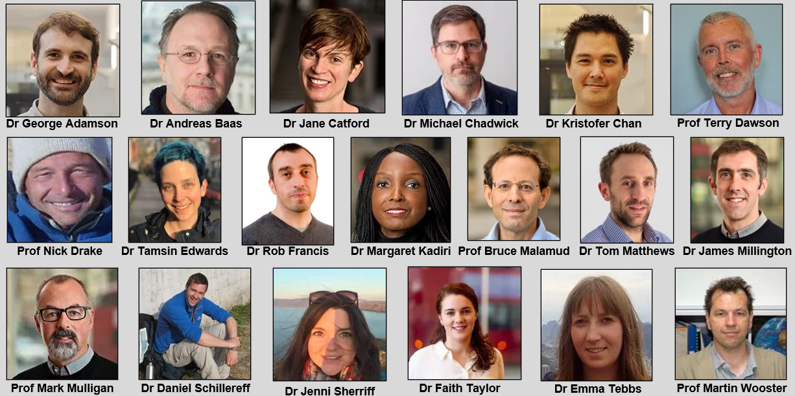
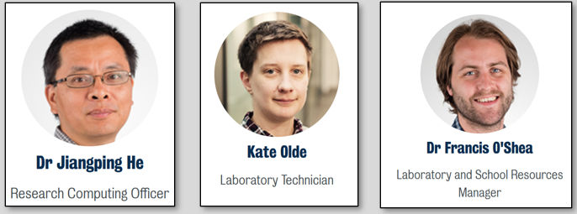
Academics
As well as…
15+ PDRA (Postdoctoral Research Associates)
20+ PhD students (including a number co-supervised with NMS, e.g., CANES)
60+ MSc students (Primarily on MSc Environmental Science for Sustainability and MSc Climate Change)

Slide 6
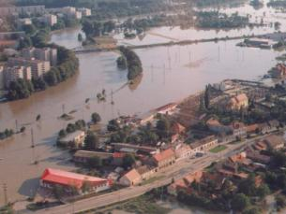
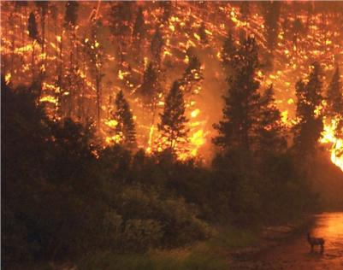
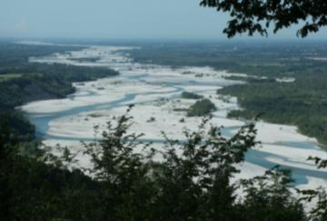
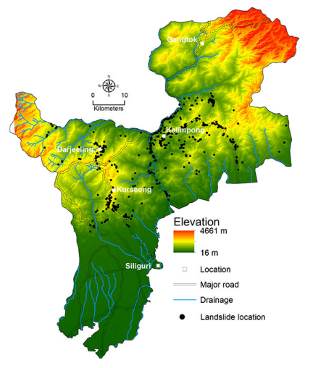
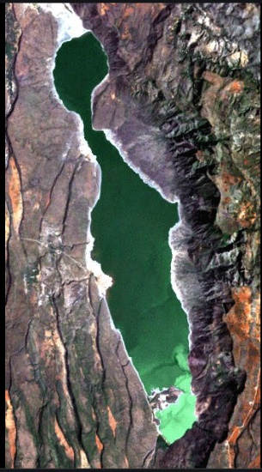
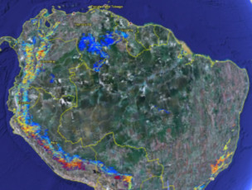
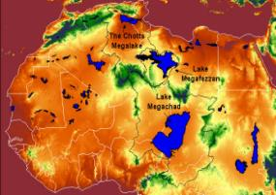
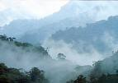
Research in many different ecosystems, countries and spatial/temporal scales. Some of many examples
UK Flooding
UK Extreme Storms
Forest Fires in North America
(Prof Martin Wooster, Dr James Millington, Prof Bruce Malamud)
UK Fresh Water Ecology [Dr Rob Francis]
Volcanoes in Nicaragua
(Prof Martin Wooster)
Cloud forest/deforestation, of conservation importance. (Prof Mark Mulligan)
Green Cooridors through the Sahara (Prof Nick Drake)
Remote sensing of hydrological variable of Tanzania Lake Natron
(Dr Emma Tebbs)
Landslide Early Forecasting in India
(Prof Bruce Malamud & Dr George Adamson)
Antarctic and Greenland ice sheet contributions to sea-level rise
(Dr Tamsin Edwards)
Notes:
Volcanoes in Nicaragua

Slide 7
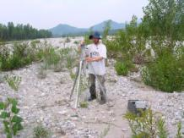
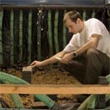
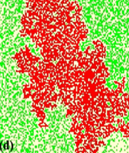
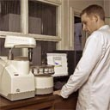
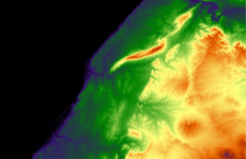
Research links different methods
Field environmental monitoring
Laboratory experimental work
Computer-based simulation modelling
In-situ sensor networks
Remote Sensing
Policy, risk, GIS (links w. other geography research domains)
https://twitter.com/KCLGeoglabs
One of the first Geography research groups in the UK to develop this particular expertise.
Notes:
WE do different components of the earth, atmosphere, hydrosphere, lithsophere, their interaction on land—biosphere, etc.

Slide 8
Give in the following slides some exemplars of research being done (but non-complete). Some you will have seen mentioned in previous workshop talks yesterday/today.
Notes:
WE do different components of the earth, atmosphere, hydrosphere, lithsophere, their interaction on land—biosphere, etc.

Slide 9
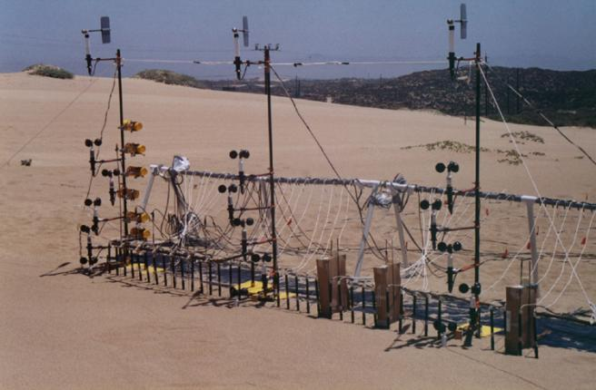
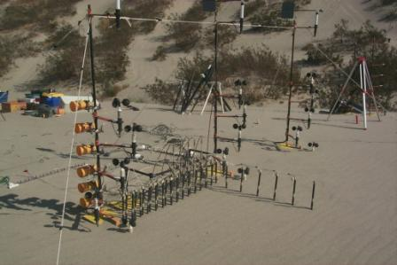
Monitoring sand transport in California
(Dr Andreas Baas)
Notes:
Andreas Baas: Sand transport and monitoring it.

Slide 10
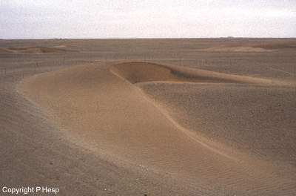
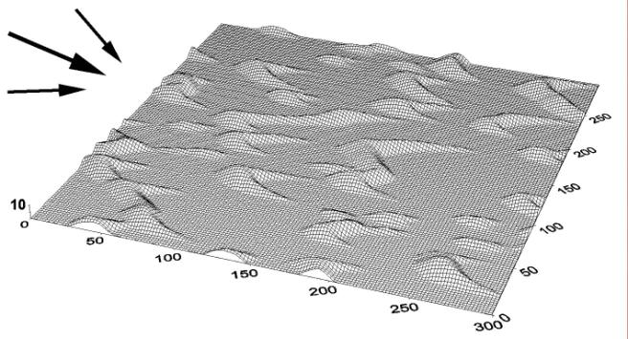
Modelling and monitoring
sand dune evolution
(Dr Andreas Baas)
Notes:
Andreas: Modelling.

Slide 11
Aeolian geomorphology (sand transport by wind) Queries/Comments related to workshop
Dr Andreas Baas
Possible applications depend on scale (especially spatial resolutions achievable).
On a scale of 10s of km, would be interesting to map mass changes of sand seas (deserts), but​ any significant changes play out over decades, and probably beyond the life of the mission.
On monthly/annual time-scales, a potential application would be mapping mass changes in the near-shore zone, related to shifting coastal sediments throughout the seasons, but would likely require spatial resolution of 0.1 km or less.
Is this kind of resolution feasible? Or is 10s of km the best resolution?

Slide 12
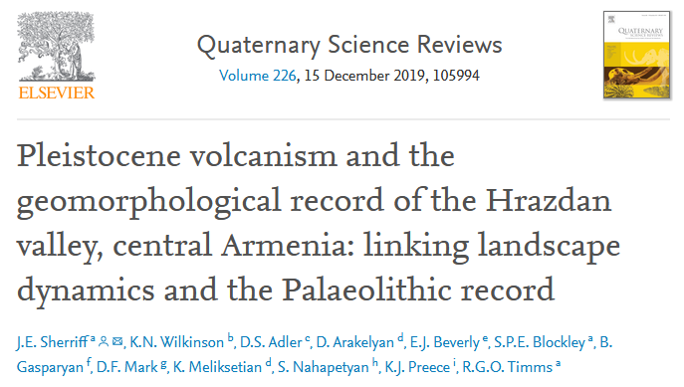
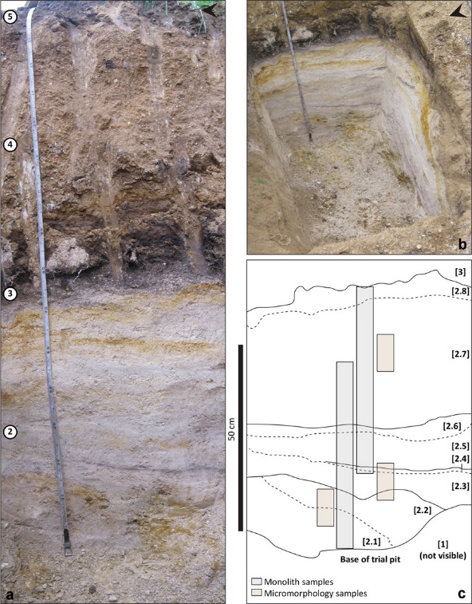
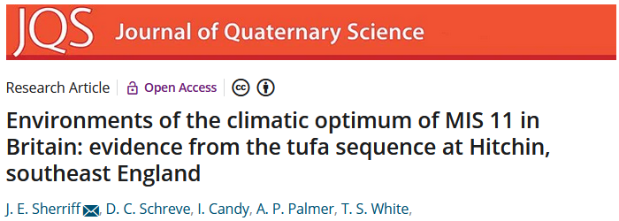
Quaternary landscape evolution, climate change, and hominin dispersals in Eurasia. (Dr Jenni Sherriff)
Queries/Comments related to workshop
Possible applications depend on spatial scale of mapping (especially spatial resolutions achievable, and over different region extents).
Distinguish sub-terranean stratigraphy and depositional environments.
[Kai Bong’s talk yesterday and their recent paper in Nature on “Quantum sensing for gravity cartography”—how large a spatial scale can this be done, and can it be implemented from remote sensing]
Notes:
Flood risk. Hypothetical urban model, which explores the friction of the buildings on the flood waters

Slide 13
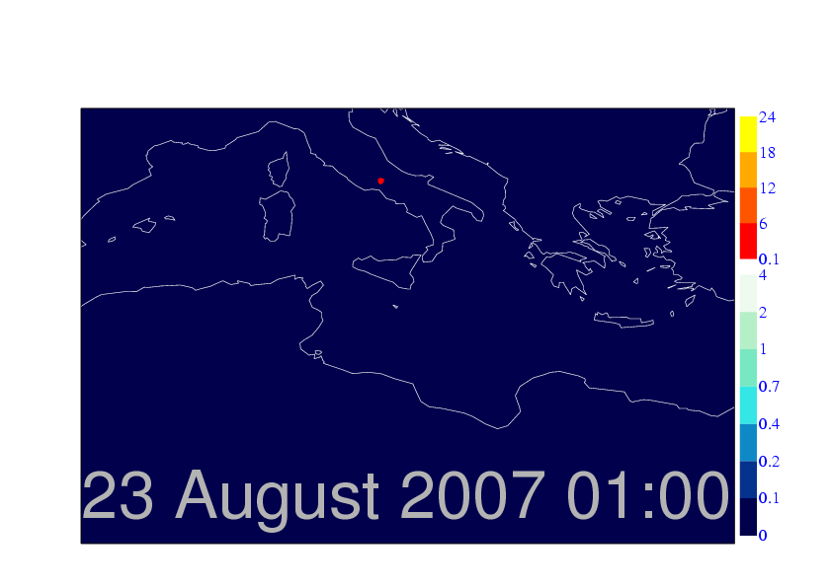
Modelling smoke plumes from Forest Fires (Professor Martin Wooster)
2007 Greek Fires
J. Kaiser (ECMWF)
Kaiser, ECMWF
Notes:
This is modelled
(?) scale

Slide 14
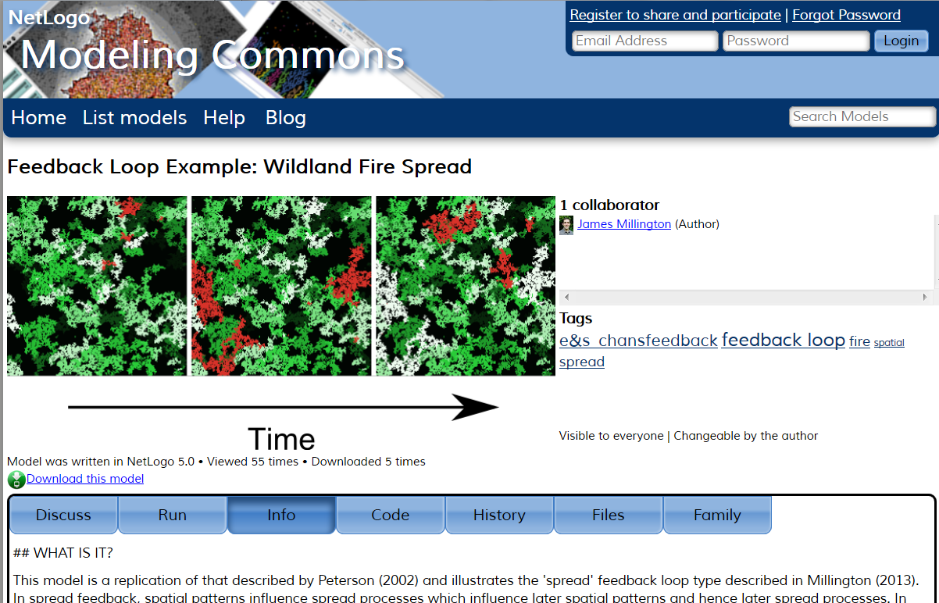
Ecological memory demonstrated by a model of forest fire (Dr James Millington)
Notes:
Flood risk. Hypothetical urban model, which explores the friction of the buildings on the flood waters

Slide 15
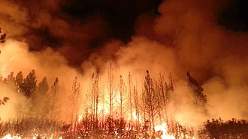
Landscape ecology and wildfire dynamics
Queries/Comments related to workshop
Dr James Millington
Could cold atoms sensors be sensitive enough (and at what scales) to detect change in
'terrestrial mass change’ due to removal of biomass by burning?
water content of vegetation?
changes in vegetation biomass?

Slide 16
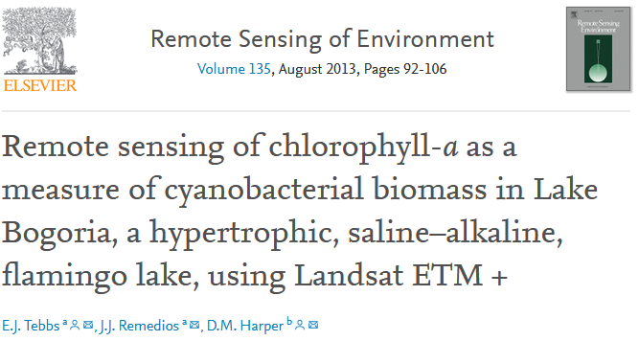
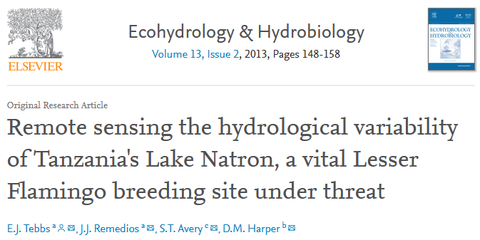
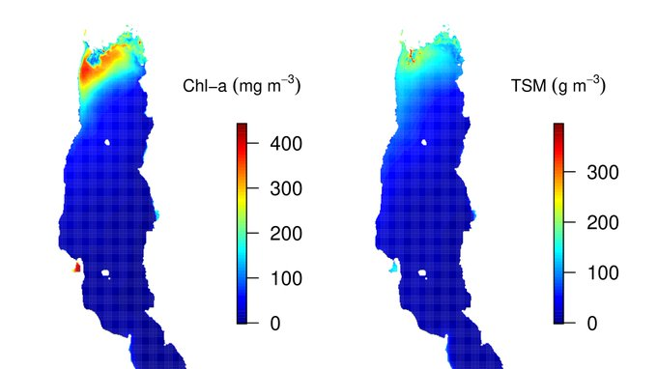
Applications of Earth observation technology to biodiversity conservation and sustainable development (Dr Emma Tebbs)
Notes:
Flood risk. Hypothetical urban model, which explores the friction of the buildings on the flood waters

Slide 17
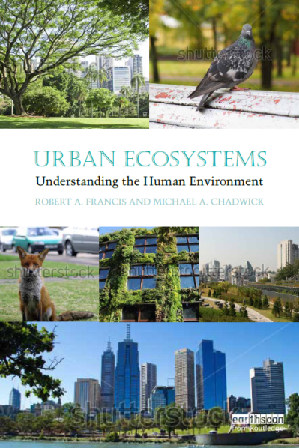
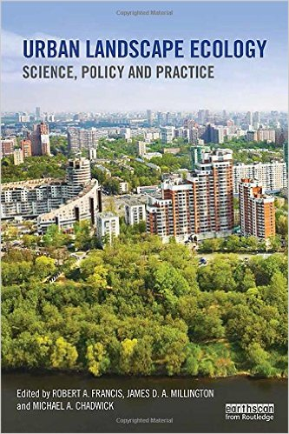
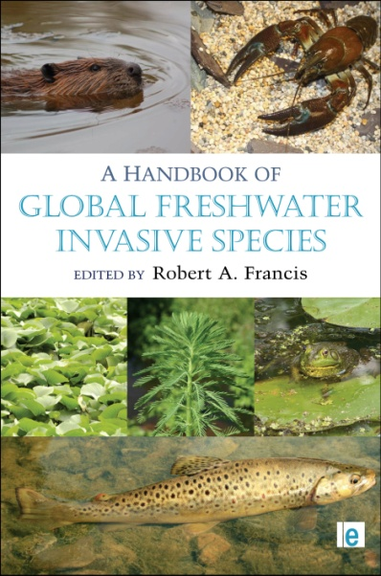
Urban Ecosystems and Biodiversity; Invasive Alien Species (Dr Rob Francis, Dr Mike Chadwick)
Notes:
Tagliemento, Helen does ‘her’ research here.

Slide 18
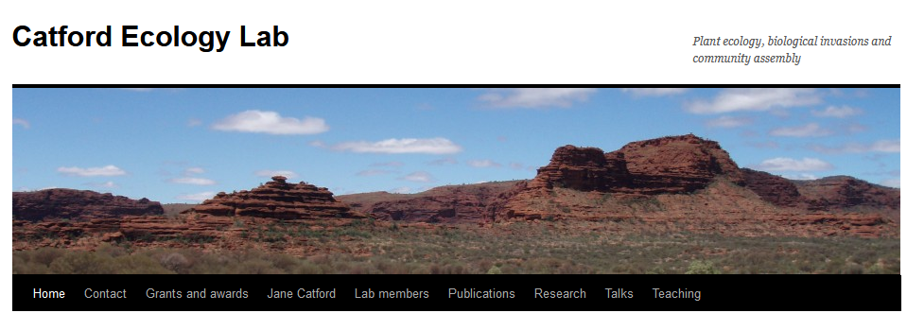
Plant Community Ecology (Dr Jane Catford)
https://janecatford.com/
Biological invasions
Environmental change
Biodiversity
Notes:
Tagliemento, Helen does ‘her’ research here.

Slide 19
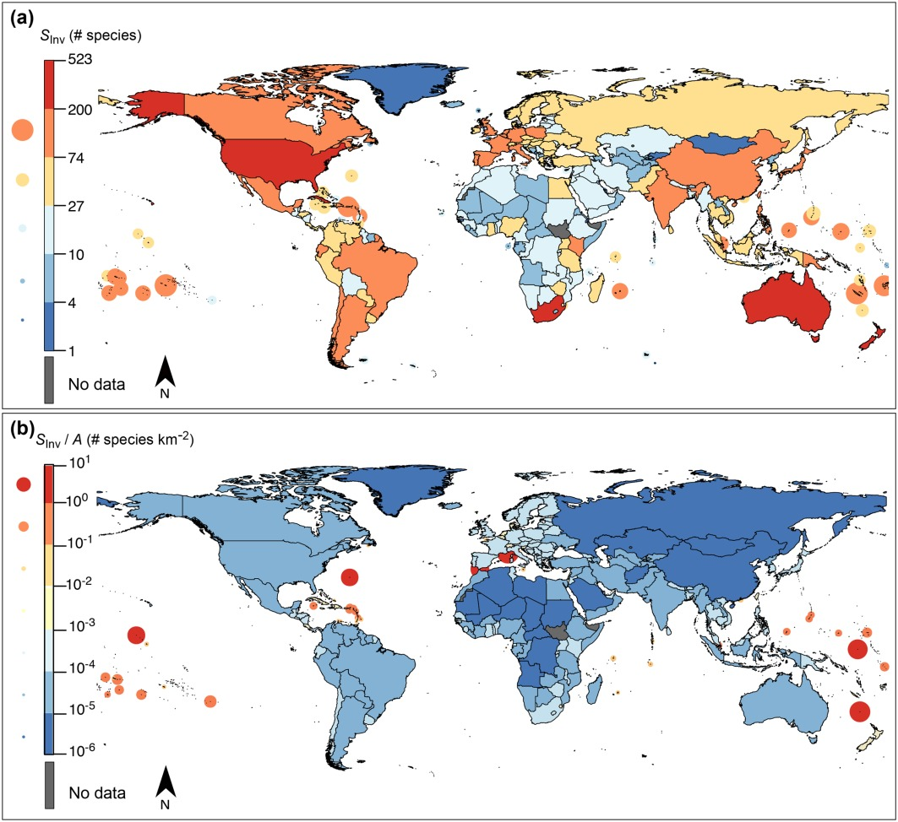
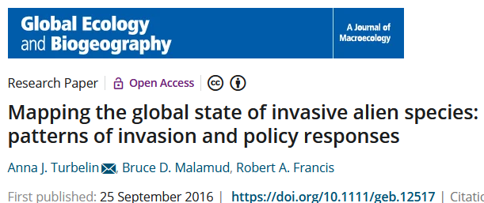
Invasive Alien Species
Queries/Comments related to workshop
[Again related to biomass]
Could quantum sensors be sensitive enough to distinguish and monitor the mass from monthly/yearly/decadal shifts of biomass (and then potentially pull out different signatures) for invasive species shifts.
What spatial/temporal resolutions?

Slide 20
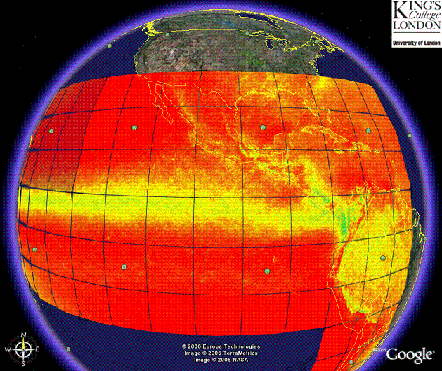
Monitoring and Modelling of Global Data (Prof Mark Mulligan)
Global Gridded 1 km TRMM Rainfall Climatology and Derivatives.
Notes:
Tagliemento, Helen does ‘her’ research here.

Slide 21
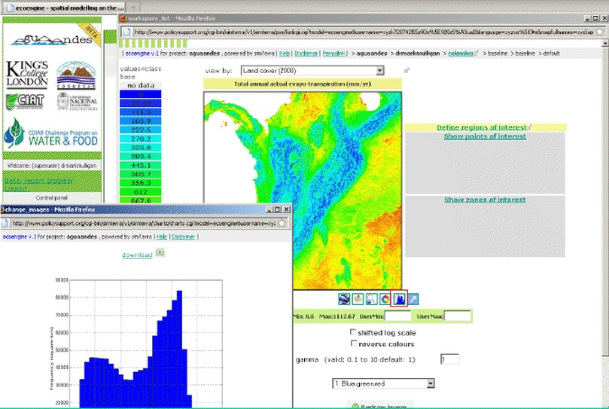
Monitoring and Modelling of Global Data (Prof Mark Mulligan)
http://www.policysupport.org/
Policy
Support Systems
Notes:
Tagliemento, Helen does ‘her’ research here.

Slide 22
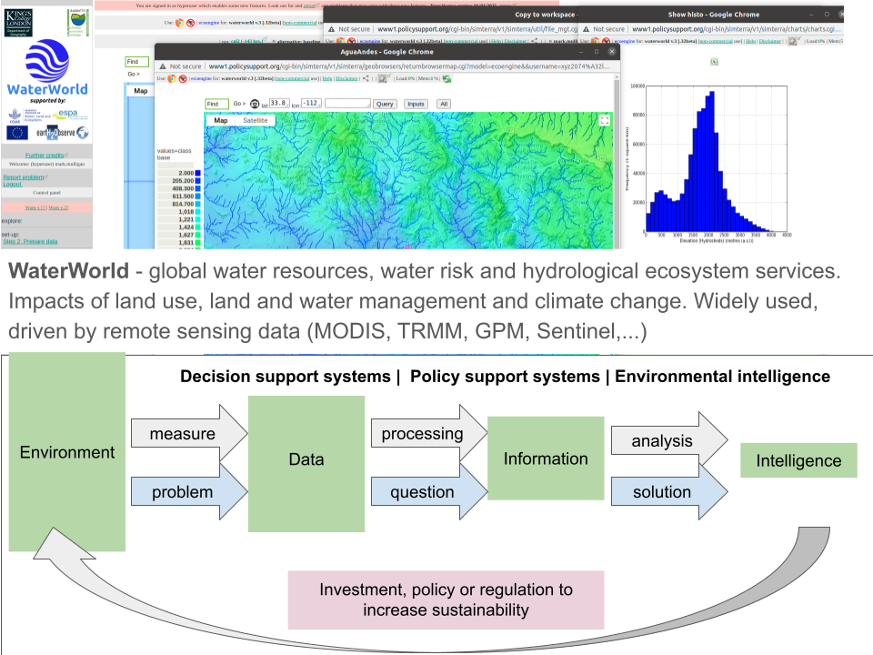
Professor Mark Mulligan
Hydrological modelling
Queries/Comments related to workshop
Could improved gravity field measurements contribute to improved hydrological modelling and feed into decision-support tools?
At what spatial/temporal scales.
http://www.policysupport.org/

Slide 23
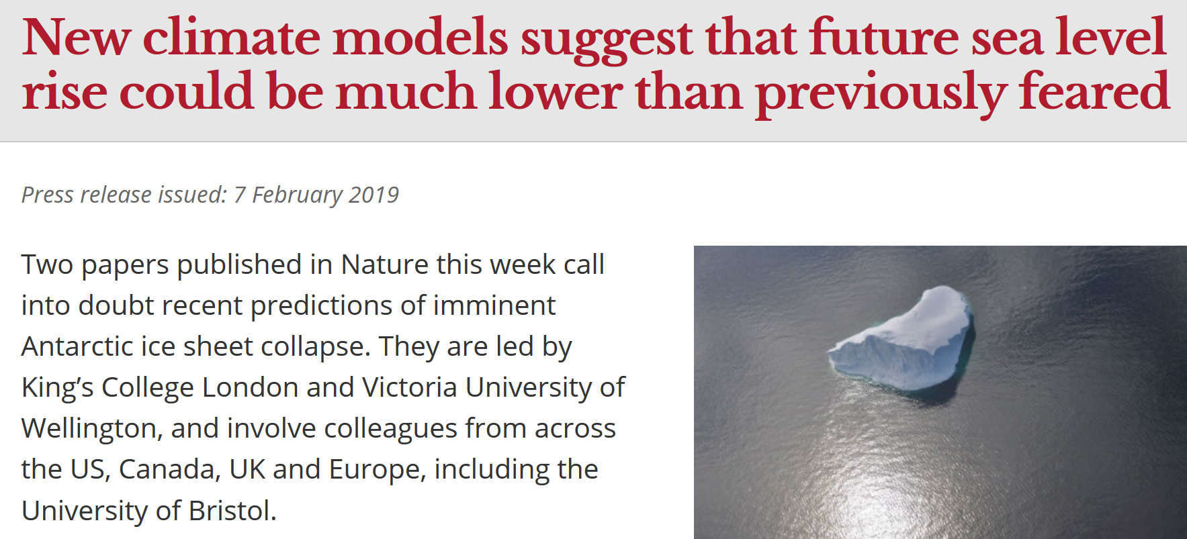
Climate Modelling: Antarctic and Greenland ice sheet contributions to sea-level rise (Dr Tamsin Edwards)
Notes:
Tagliemento, Helen does ‘her’ research here.

Slide 24
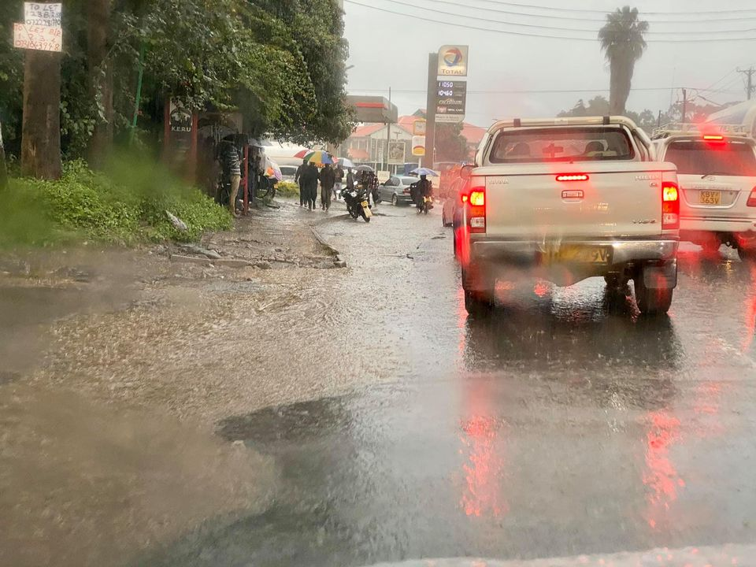
Bruce D Malamud Professor of Natural and Environmental Hazards Department of Geography, King’s College London
My single hazard research focuses on:
Landslides, Wildfires, Floods, Earthquakes, Tornadoes
Work across a range of scales
Statistics, Time Series and Spatial Analysis (e.g., clustering of values in time and space)
Focus on Urban Risk (Dynamic hazard, vulnerability, exposure)
Blended Sources of Evidence
Interactions of Physical with Social Dynamics.
My current research is in:
Nairobi, Istanbul, Quito, Kathmandu [“Tomorrow’s Cities” UK Funded research]
Philippines
UK / France [EDF funded research]
India [LANDSLIP, UK funded research]
I also focus on:
Multi-Hazard Interrelationships (natural hazards, anthropogenic processes)
www.tomorrowscities.org
Nairobi Street Flooding, 2 Dec 2019
Photo: Bruce D Malamud
Taal Volcano, Philippines 7 Feb 2017
Photo: Bruce D Malamud
www.landslip.org

Slide 25
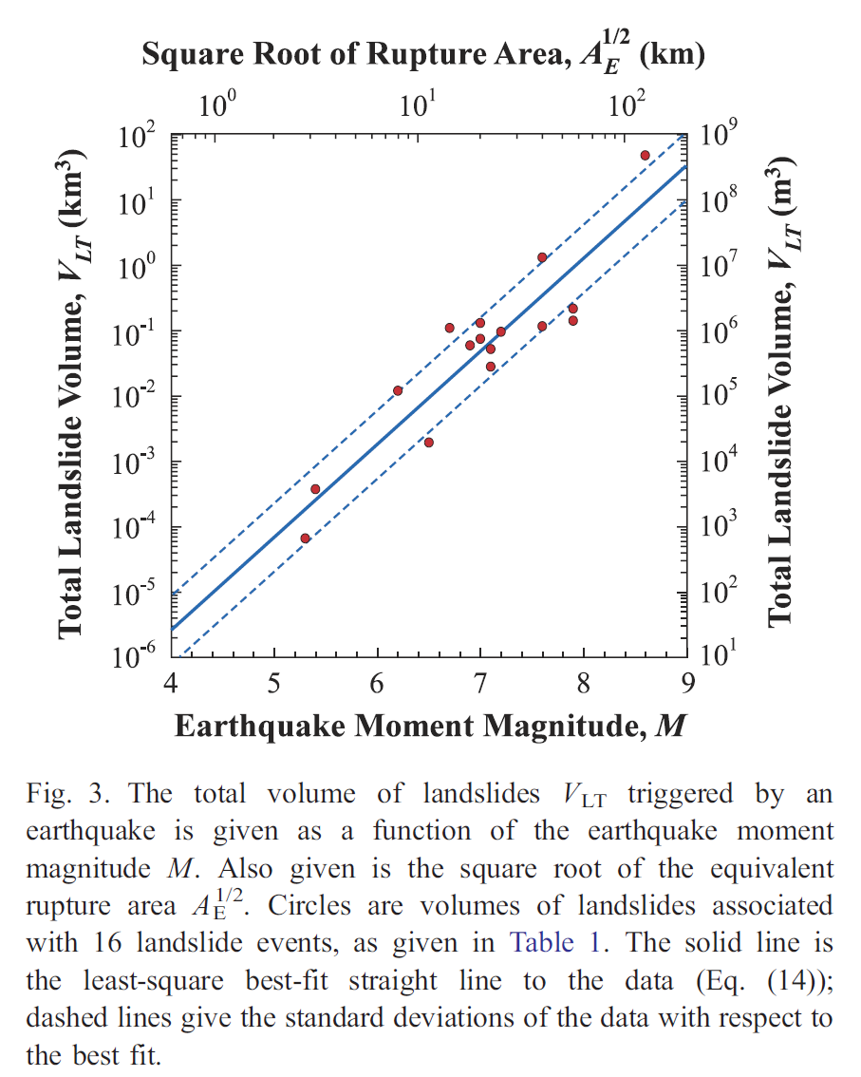
Mass Wasting (Landslides) (Bruce D. Malamud)
Association of earthquake magnitudes with triggered landslides.
Would quantum sensors be able to be one more evidence base for total volume of sediment triggered by a given earthquake leaving/entering a system?
Is there a change of gravity signature?
Queries/Comments related to workshop
Notes:
Tagliemento, Helen does ‘her’ research here.

Slide 26
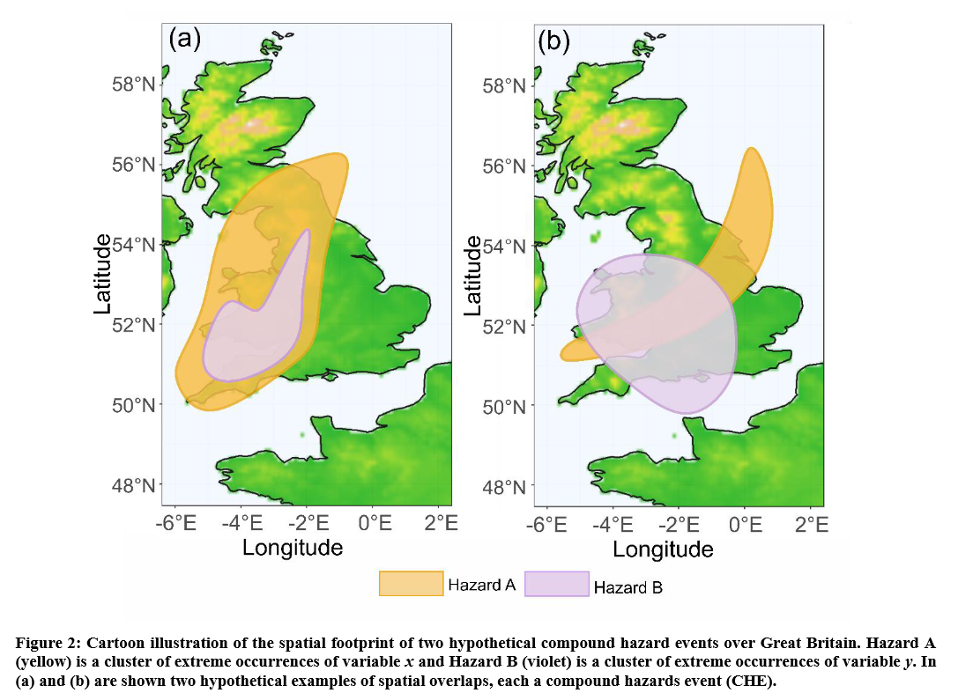
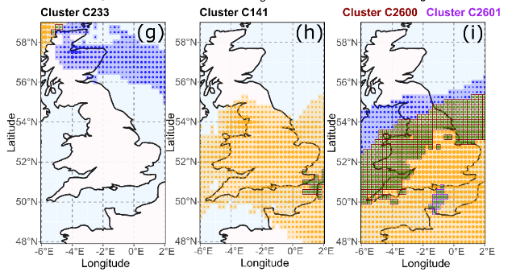
Atmospheric events (clustering in space and time) (Bruce D. Malamud)
Spatial and temporal clustering of atmospheric events (and compound atmospheric events).
Would quantum sensors be able to (eventually, depending on temporal and spatial scales) help us identify single clusters of hazards in time and space.
[Depends on scales]
Queries/Comments related to workshop
Notes:
Tagliemento, Helen does ‘her’ research here.

Slide 27
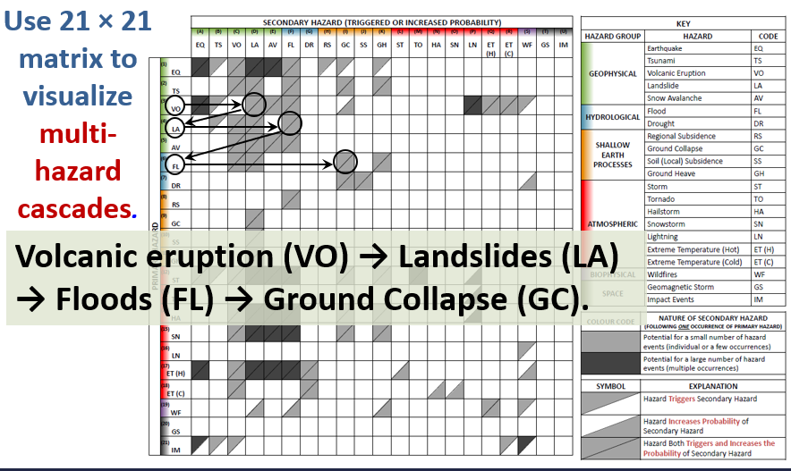
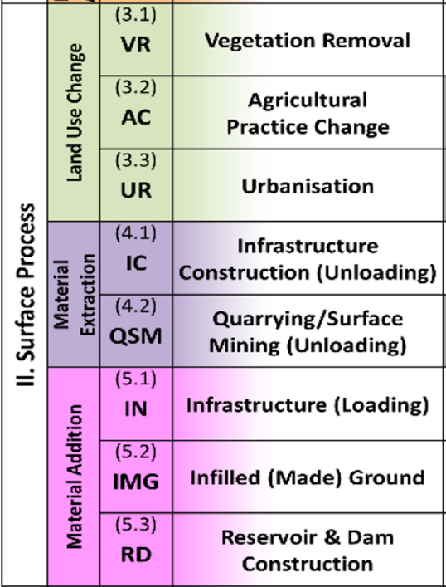
Multi-Hazard Cascades (Bruce D. Malamud)
Anthropogenic Processes that influence hazard cascades
Scales of natural hazards range from local to global, and seconds to decades.
Gill and Malamud (2017) Anthropogenic processes, natural hazards, and interactions in a multi-hazard framework. Earth-Science Reviews.
Notes:
Tagliemento, Helen does ‘her’ research here.

Slide 28
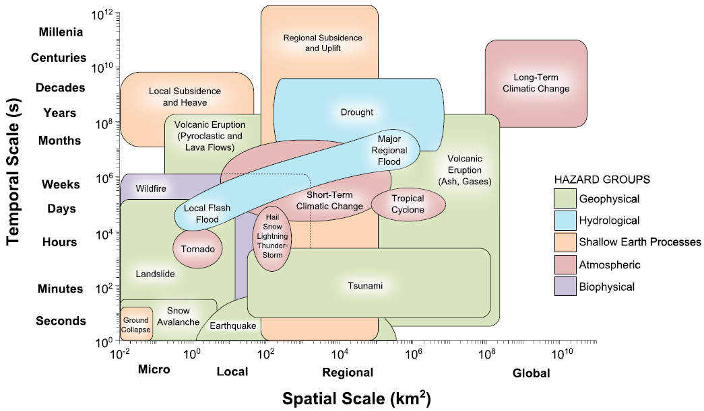
Natural hazards (in space and time)
Temporal Scale (s)
Gill and Malamud (2014) Reviewing and visualizing the interactions of natural hazards. Reviews of Geophysics.
Spatial Scale (km²)
Notes:
Tagliemento, Helen does ‘her’ research here.

Slide 29
Natural Hazards
The natural hazard community broadly interested in understanding different aspects of risk
The hazard—intensity of events, how often, and where.
The exposure—the human assets exposed (e.g., buildings, roads)
The vulnerability—characteristics of humans/buildings.
Where quantum sensors might be helpful?
[The hazard] Better identification of hazard ‘events’ with regards to spatial and temporal footprint or other measures of the intensity.
[The exposure] The change of mass of assets in a region/urban area.
This might be over many years (e.g., urbanization) or sudden events (e.g., earthquake).
Would there be a change in gravity signature that can be distinguished from other types of mass (e.g., water, rock).
Queries/Comments related to workshop
Notes:
Tagliemento, Helen does ‘her’ research here.

