Slide 1


Quantifying uncertainty around land ice contributions to sea level rise with Gaussian process emulation
Ongoing work in the Department of Geography
Fiona Turner
KCL
fiona.turner@kcl.ac.uk
Notes:
Thank organisers for invitation. I’m a post doc in the geography department, and have been asked to give you an overview of what sort of climate research we’re doing, and how this sensor technology can contribute. I work with Tamsin Edwards, who is a reader in climate change in the department.

Slide 2
Source: IPCC AR6 (2021)
Notes:
My research is focused on predicting land ice contribution to global sea level rise. Here we have two plots from AR6, the IPCC’s latest report on the climate, published in August. On the left are projections of sea level rise up to 2100, under what are known as Shared Socioeconomic Pathways, or SSPs. These are scenarios describing varying amounts of greenhouse gas emissions, with SSP1-1.9 being the lowest emissions scenario and SSP5-8.5 being the highest. I’ll discuss them in a little more detail in a moment. We can see under the scenarios we’d expect up to 1m of sea level rise by 2100, but we have this dashed line representing a storyline of high impact events all happening together, leading to a much more extreme rise in sea level. Up to 2300, on the right, they modelled two different scenarios and produced what’s called p-boxes; these are the ranges of ‘likely’ scenarios predicted from the latest research. This was partly because there isn’t as much literature about the climate at 2300, so it’s difficult to reach conclusions such as we have for 2100. There is also a lot more uncertainty when you try to project that far into the future. When including the low likelihood but high impact storyline, the red box, they couldn’t rule out sea level rise greater than 15m. So there’s a huge amount of variety and uncertainty in these predictions; as we move further ahead in time, it becomes harder to predict what effect we will have on sea level. And modelling this uncertainty is what I’m interested in.

Slide 3
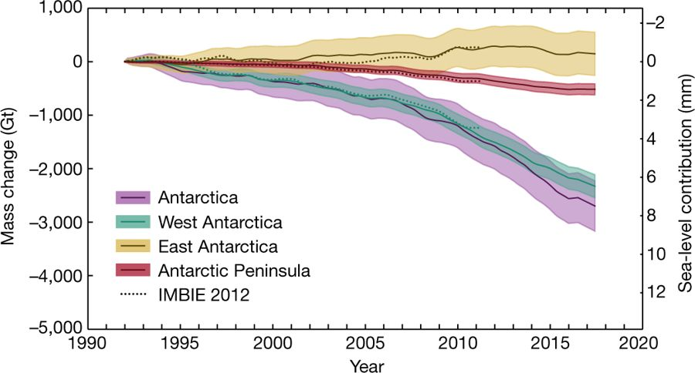
Mass balance of the Antarctic Ice Sheet from 1992 to 2017, The IMBIE Team, Nature, 2018
Notes:
So where is this uncertainty coming from? A large amount of it is in Antarctica. My research is modelling the projected contribution from the worlds ice sheets and glaciers to global sea level rise, but largest and most uncertain contributor is Antarctica, so that’s what I’m going to be focusing on today. This is the observed change in the mass balance of Antarctica from 1992 to 2017. When we’re modelling it, we tend to talk about three areas: West Antarctica, East Antarctica and the Antarctic Peninsula. (Maybe move to next slide to demonstrate these, then come back.) Even with measurements from the recent past, there’s still a lot of uncertainty in how much it has changed. We can see that there has been an overall loss of mass, which in turn means an overall contribution of 8mm to sea level in those 25 years. We can see this is largely coming from the West and the Peninsula, with the East ice sheet largely holding steady and maybe even increasing in size. This is a great example of the difficulty in climate and ice sheet modelling. As the climate warms, we are going to see a lot of ice sheets and glaciers melting. However, a warmer climate is also a wetter climate, as warmer air can hold more moisture. This means you get more precipitation, which in the Antarctic means more snow. The East Antarctic ice sheet is a vast expanse, a lot of it situated in the middle of the continent and shielded by mountains, so that is why it may actually grow a little in the next centuries.

Slide 4
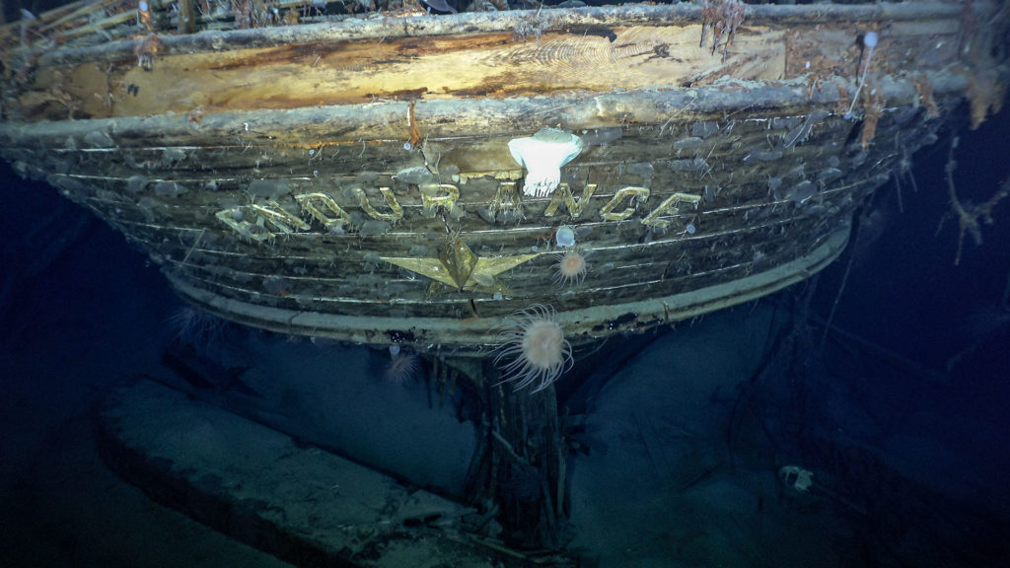
Notes:
One of those is how relatively recent all of our records are. We have a very short record of observations in Antarctica. In other areas of the world, most notably in the northern hemisphere, we have data going back centuries, but there has only been a human presence on the Antarctic continent for just over a century – you may have heard of Ernest Shackleton’s ship, the Endurance, being rediscovered recently after it sank in 1915 whilst an expedition was underway to attempt to cross the continent. These sorts of expeditions are famous for the various records they broke and stories of human endurance, but there were always scientists present on them, and a lot of scientific discoveries were made as part of these adventures. For data fully covering the continent, records only go back to 1979, when satellites were launched to track changes. It’s very difficult to predict how Antarctica is going to change in the future if we don’t fully understand how it has changed in the past.

Slide 5
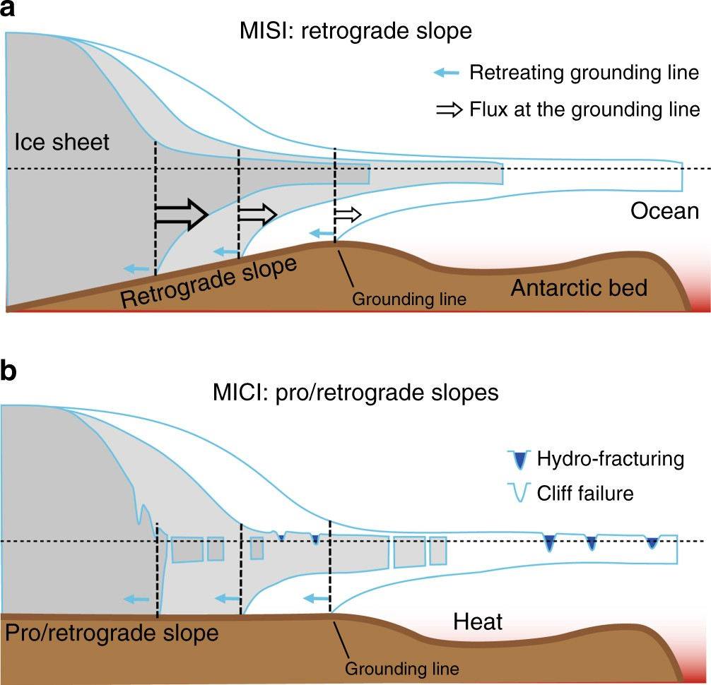
Source: Pattyn et al (2019)
Notes:
On top of this, there are various processes around how ice sheets change that we do not fully understand. Hopefully this slide doesn’t get too technical, but it’s a good example of where climate modelers and scientists can disagree over their work. Two that have the largest potential effect on Antarctica are Marine Ice Sheet Instability, or MISI, and Marine Ice Cliff Instability, or MICI. These are two processes that affect ice shelves; these are the parts of an ice sheet that jut out from the continent and are floating on the ocean. Under MISI, we have warming ocean water underneath the ice shelf slowly melting it. It pushes back what we call the grounding line, which is the point where the ice sheet becomes ice shelf. If the bed rock is sloping backwards, that exacerbates the retreating grounding line, so more ocean water gets underneath the ice shelf and pushes the grounding line back even more, which leads to more melt and so on. This has been observed many times in Antarctica.
MICI, on the other hand, is a lot more controversial. This is the process where icebergs break off from the ice shelf until you are left with an ice cliff so tall that it starts to collapse under its own weight. It then leaves behind an even taller ice cliff, and the collapse continues. This is partly why the AR6 report couldn’t rule out sea level rise of up to 15m at 2300; when MICI is included in ice sheet modeling, you get sudden and huge sea level contributions from Antarctica.

Slide 6
Source: IPCC AR6 (2021)
Notes:
Another area of uncertainty in the future climate are future emissions scenarios. The IPCC works with the SSPs I mentioned earlier, which describe future possible scenarios with differing amounts of greenhouse gases being emitted. This leads to various possible warming scenarios. SSP1-1.9 here represents a world with warming well under 2C, as we are meant to be aiming for under the Paris agreement. Then we have a range of increasing emissions, going up to SSP5-8.5, which represents an increase in gas emissions which could lead to almost 6C of warming. The difficulty here is understanding what scenario we are currently on track to match, as well as understand the uncertainties present in them. You remember the earlier slide with low likelihood, high impact factors in a 5-8.5 world; it is difficult to completely rule them out and important to understand what effect they could have.

Slide 7
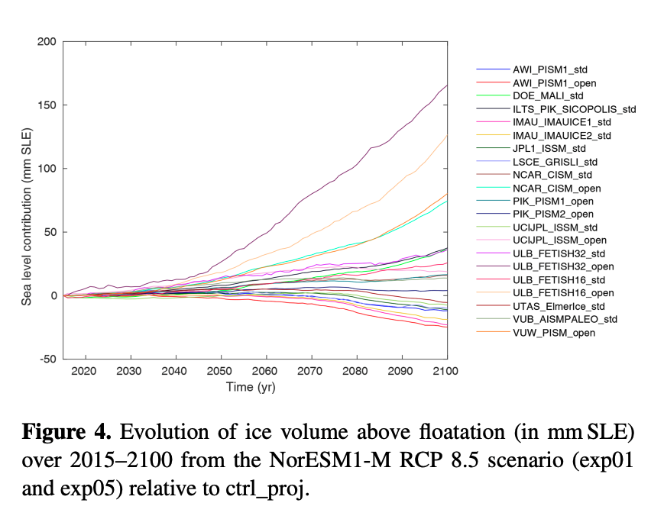
Seroussi et al. (2020)
Notes:
So given all these uncertainties, how do we make our projections? Ice sheet and climate models can disagree a huge amount when we use them to predict future changes. The latest comparison of ice sheet models shows a vast variety of projections; these are all run under the same climate assumptions, and yet we have a range going from around -20mm at 2100 to over 150mm. So what do we do if even our models are contributors to uncertainty?

Slide 8
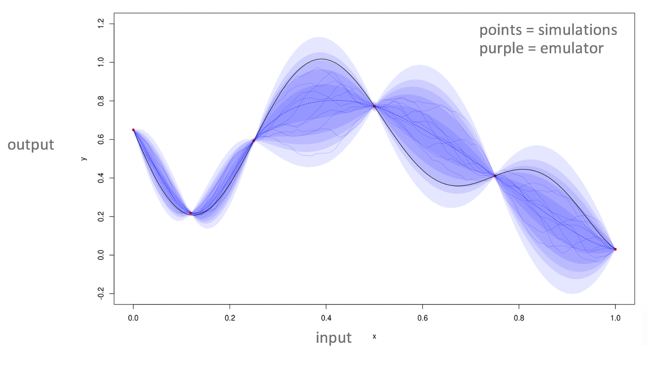
Notes:
I and Tamsin use a method called Gaussian process emulation. This is a method where using a set of simulations, say of an ice sheet model, we can emulate what is happening between these simulations, and build a super cheap and easy to run version of the ice sheet model. So whilst the actual ice sheet models take days to run, we can get results in minutes for our given input and output, and also an estimation of the uncertainty in the model. These red points here are the simulations, and these blue bubbles represent thousands of runs of our emulators, showing what might be happening between our simulations, and showing the uncertainty. This allows us to sample from a variety of ice sheet models very quickly, so we can then model the effect of, say, global temperature to sea level rise.

Slide 9
Notes:
Using this method, Tamsin lead a paper published in Nature last year that I was a co-author on. Ice sheet and glacier models were used, and their uncertainties explored, using emulation, to predict sea level rise in the twenty-first century.

Slide 10
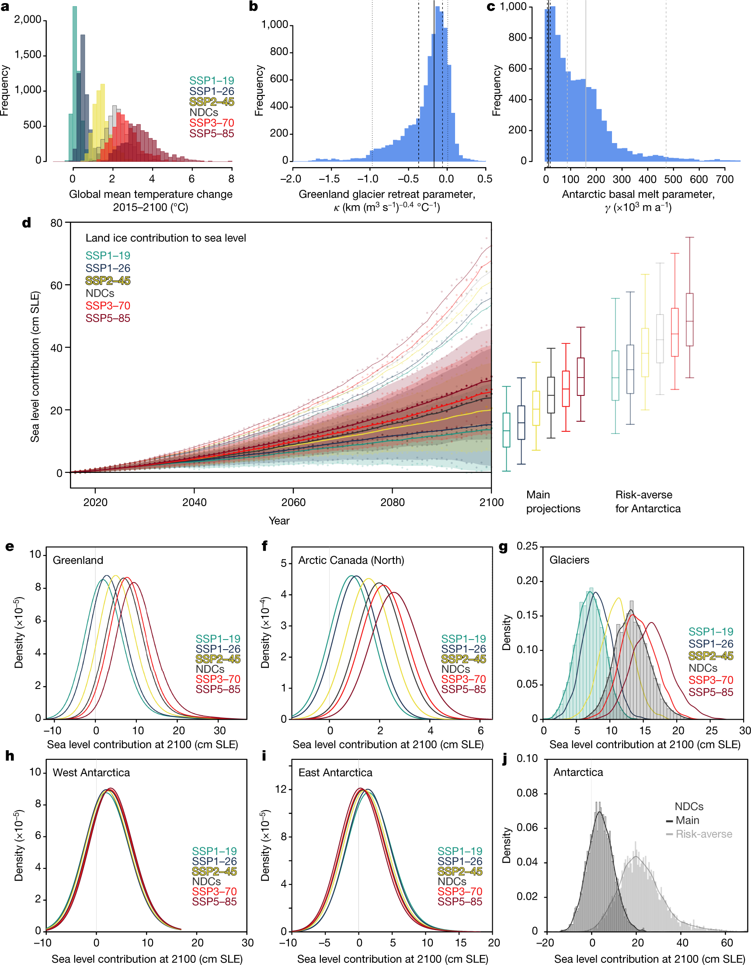
Source: Edwards et al (2021)
Notes:
We still can’t model all of the uncertainty in Antarctica. The top plots show we can see a clear difference between the different emissions scenarios for Greenland, the Arctic and global glaciers. The Antarctic, on the other hand, shows little difference between the scenarios. The choice of ice sheet models also has a big influence – this bottom right plot shows what a difference it can make. Using only the most sensitive models, so those that react most to melt rates and include processes like MICI, increases projected sea level contribution five times over.

Slide 11
Source: Edwards et al (2021)
Notes:
This leads to still a high range in possible sea level. These are the time series of sea level form present day up to 2100, box plots on the right showing contributions at 2100 under the difference scenarios and the effect of using the most sensitive Antarctic models. Here NDCs stands for nationally determined contributions, which is what each nation agreed to do under the Paris Agreement. We can see currently that puts us between the SSP2-4.5 and SSP3-7.0 scenarios, which is around 4C warming.

Slide 12
Source: Edwards et al (2021)
Notes:
We also explored Antarctica’s contribution when using all models, and a subset of the most sensitive models. This showed that if we work with the most risk-averse assumptions, the sea level contribution increases five-fold.

Slide 13
Source: DeConto and Pollard(2016)
Notes:
One of those assumptions is to do with melt rates in Antarctica. At the moment, the fastest melt rate is in this area in WAIS, at Pine Island and Thwaites glaciers. To build the risk-averse projections, we assumed the basal melt rate in Pine Island applied to the whole continent, leading to huge mass loss. As discussed, there is huge uncertainty in and between the ice sheet models being used. What I’ve been doing lately is exploring this by building off of this paper and emulating the ice sheet and glacier models individually. I can then compare my predictions with this paper.

Slide 14
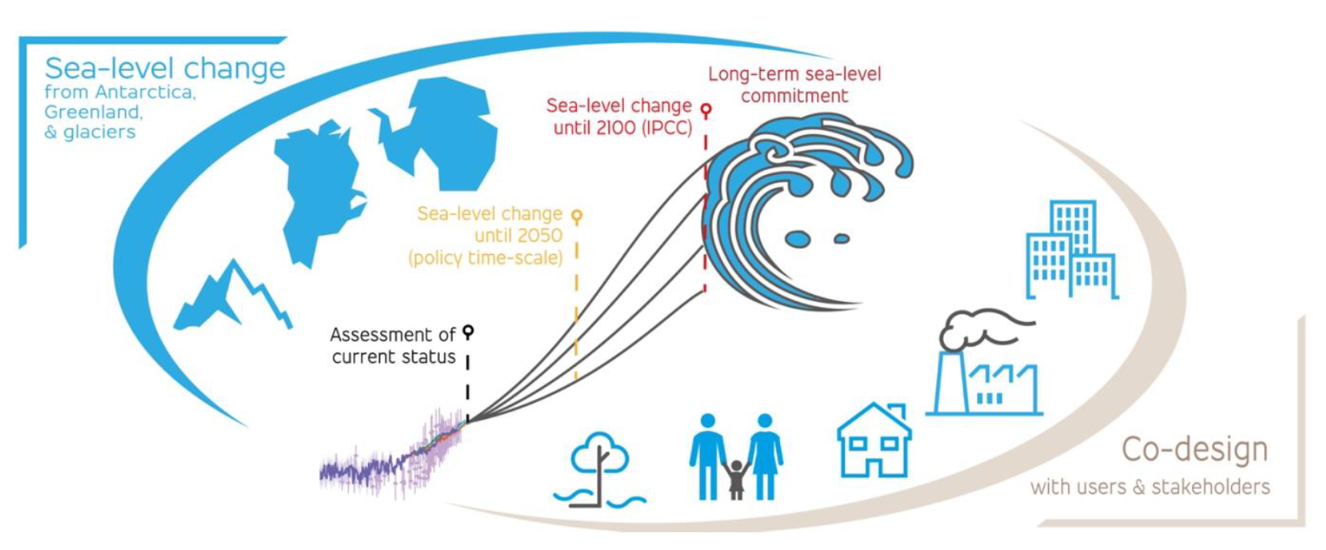
Notes:
Our current work is part of the Protect project, an H2020 funded project predicting sea level-change up to 2500, co-designed with users and stakeholders. Tamsin and I have just finished the experimental design for the project, setting out what emissions scenarios we want to model, what global and regional climate models, ice sheet and glacier models should be used. Once we have our model simulations, we can build our emulators, and will then calibrate them with observations – one way that sensor technology can contribute.

Slide 15
Notes:
It’s still early to have any definite results, but I thought I’d share a little example of what we’re done so far. Modelling up to 2500 allows for long term planning for the effect sea level change will have on our planet. This is especially important for low-lying nations like the pacific island nations, as well as coastal cities. There are various difficulties in this; one such is that these scenarios I described only go up to 2300, so we’ve had to make our own assumptions on what will happen from 2300-2500, as well as the likelihood of emissions matching any of these scenarios that far in the future. So far we’re focused on the two lowest emissions scenarios, and even then we’re seeing sea level of up to 6m by 2500.

Slide 16
What role can new sensor technologies play?
More accurate monitoring of changes to Antarctic mass balance.
Higher spatial resolutions, to track changes in ice velocities – is PIGL an outlier?
Provide better understanding of uncertain processes, e.g. could satellites find evidence of MICI in AIS?
Provide detailed sets of observations with which we can calibrate our models.

