Slide 1
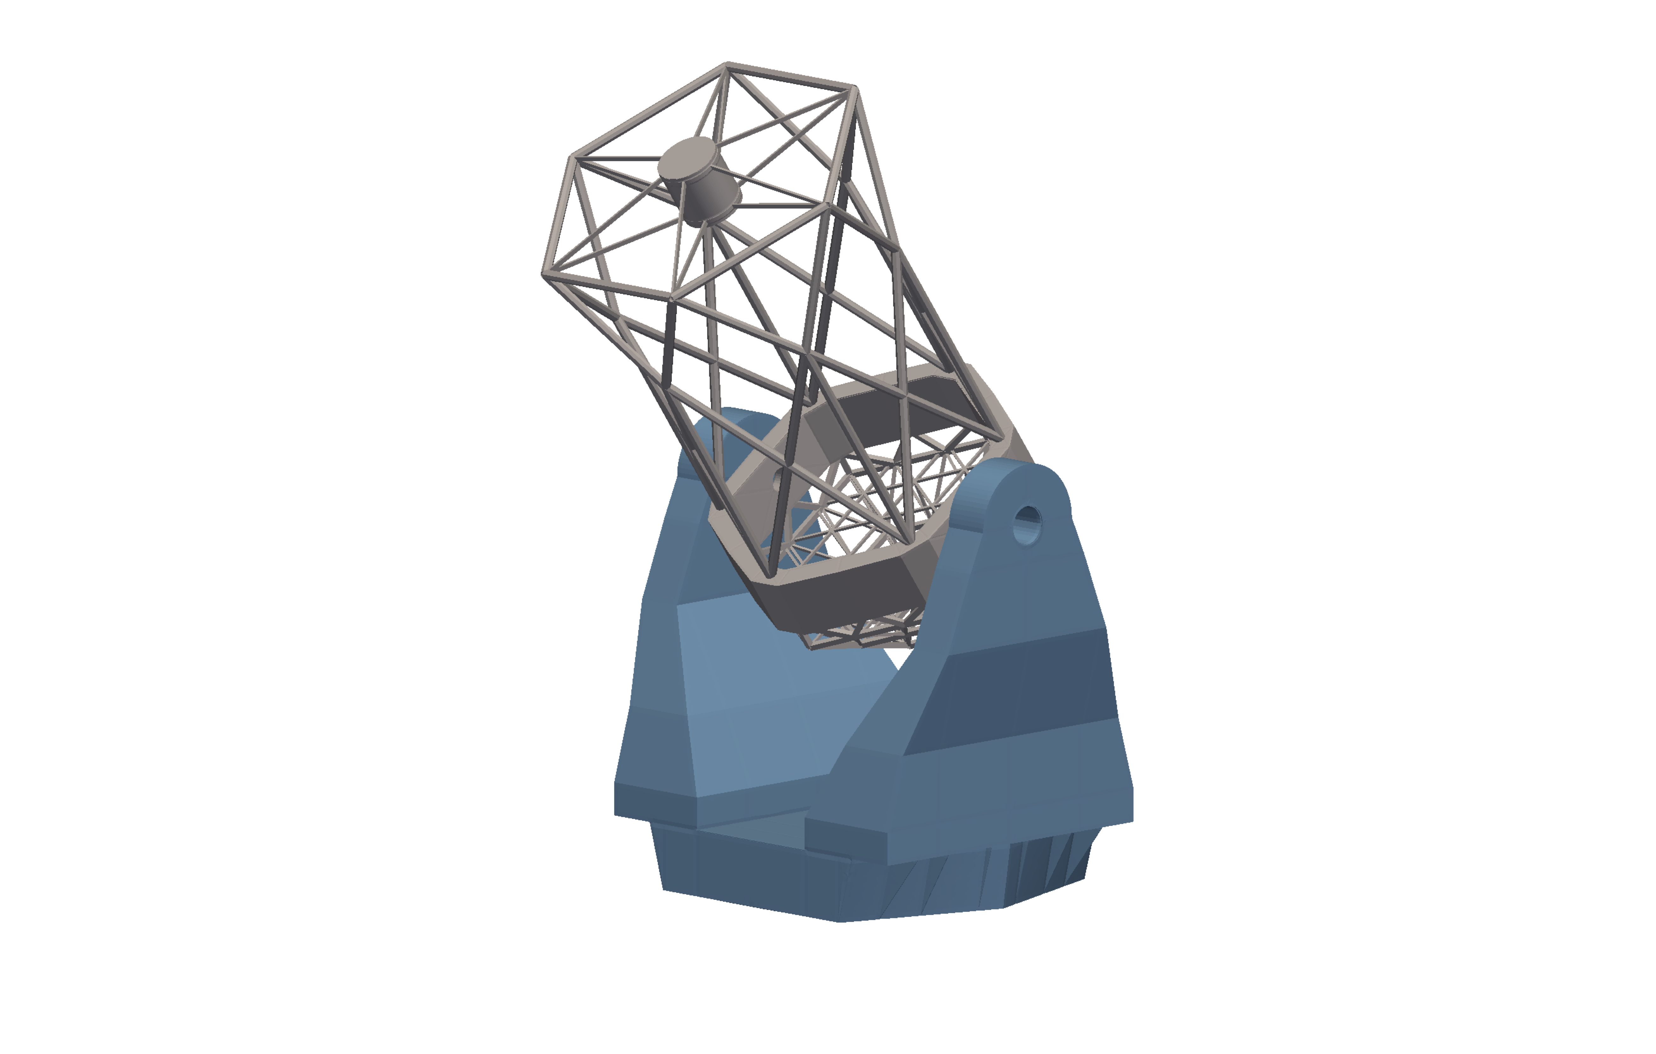





Follow-up with the NRT
Helen Jermak, NRT Project Scientist
On behalf of the NRT Project Team
Sky image by Hannah Newport
NRT render by Cesar Rodriguez
Slide design Cíara Naughton

Slide 2
Overview
Summary/update of NRT project
NRT observing strategy
LT summary/update
LT in the context of Galactic supernovae

Slide 3
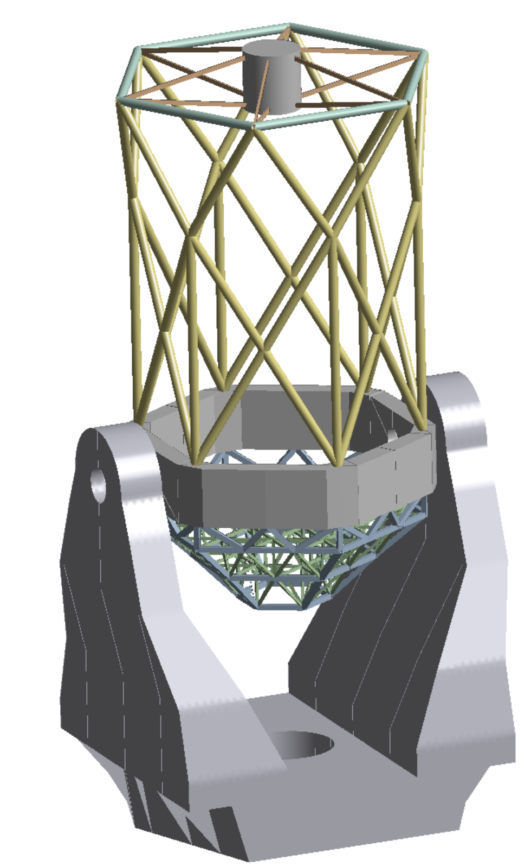
NRT summary/update
4 metre-class optical telescope
Joining the LT on La Palma: joint observatory
Designed for rapid follow-up of time-domain objects
Site approval: will replace existing CMT
18 hexagonal segment mirror
Co-hosting of 7 instruments at Cassegrain
Rapid time-to-target of 30 seconds (from receipt of trigger to data acquisition)
PDR successfully completed in early 2022, team working towards CDR in 2023
First light in 2026
Cesar Rodriguez
robotictelescope.org

Slide 4
Observing Strategy
Plentiful targets of opportunity cannot easily be assigned to specific users (leading to possible duplication)
PI might ‘waste’ individual allocated time
NRT exploring fully autonomous and robotic, intelligent look-ahead scheduler
ToO overrides, linked to brokers and marshals.
Classification of 10,000 targets/year (r=20.5 and brighter).
A factor of 5 increase over the number of spectral classifications (2012) delivered worldwide in 2019 (Kulkarni+ 2020)
Cenko+ (2020) ‘ToO policies are constructed to encourage groups to pool resources, work together (where sensible), and maximize the science possible from any given dataset’

Slide 5
Observing Strategy
Time allocations
SPEC time
Traditional time allocation similar to the LT
Based on partner contributions
Predominantly spectroscopic follow-up
Data access for all partners
~40% of total observing time
Targets selected by group of PIs/superusers

Slide 6
SPEC Time
Key science product for the New Robotic Telescope.
Up to ~40% of the telescope time is dedicated to transient follow-up.
Provide (predominantly) rapid spectroscopic classification of targets of opportunity
Science oversight committee will manage target selection (informed by science working groups).
All SPEC data will be made freely available to NRT partners
Addresses the central challenge of target-of-opportunity science (extremely high rate of discovery of new targets of opportunity)
Avoids repeat observations
Frees up more observing time for individual users (and no need to write proposals)
ToO co-ords added by ‘superuser’ along with priority ‘standard’ or ‘urgent’.
Interested users request follow-up observations using own time allocation.
NRT selects highest scored object to take spectrum
Spectrum released to users in minutes.
Notes:
Beneficial to you? Do you anticipate issues in identifying new targets from alerts?
Any other facilities producing candidates for your area?
Integrating transient brokers or marshals? Which ones? Direct integration useful?
Instrument specification for SPEC time. SPRAT? R~300 4000-8000Å
Signal to noise requirements, wavelength optimisation?
Photometric or Polarimetric ‘SPEC’ observations?

Slide 7

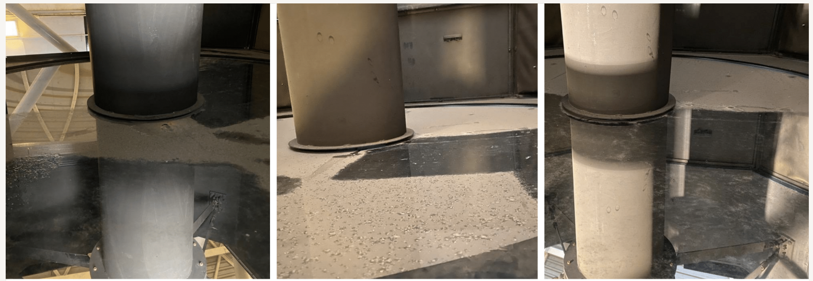
LT summary/update
2 metre fully autonomous optical telescope in La Palma
Robotically observing for 18 years (this month!)
Highly impactful science
Flexible instrumentation suite: low-cost, science-driven simple instrumentation
Operated almost entirely ‘normally’ during covid
First full engineering visit in two years carried out last month
Mirror hand-cleaned (~55% to ~76% reflectivity)

Slide 8
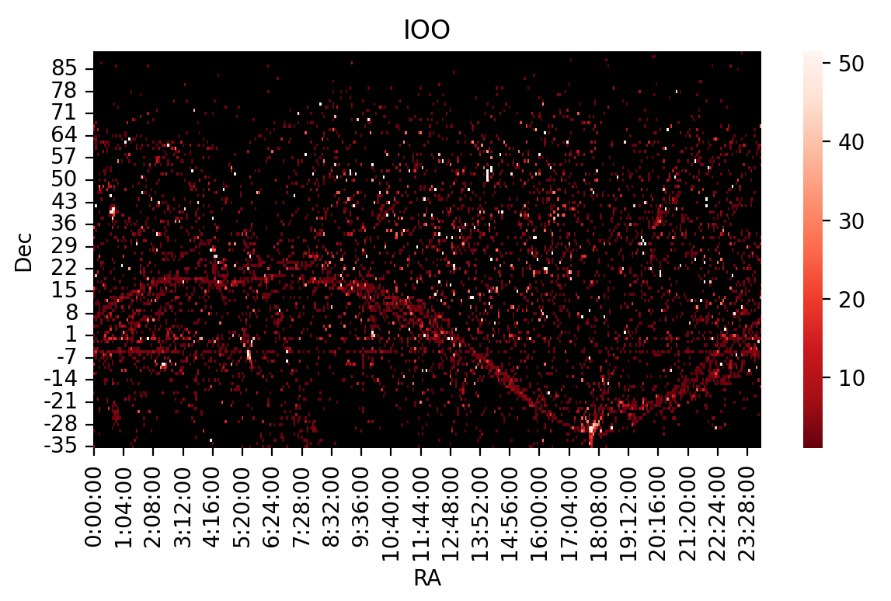
LT science (imaging)
Notes:
Excluding NSO data

Slide 9
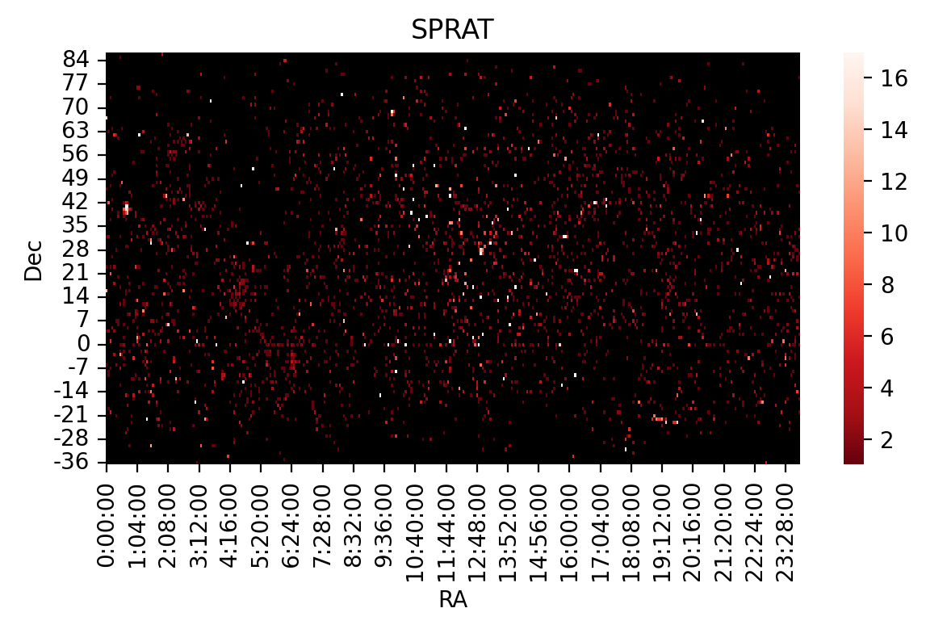
LT science (spectroscopy)

Slide 10
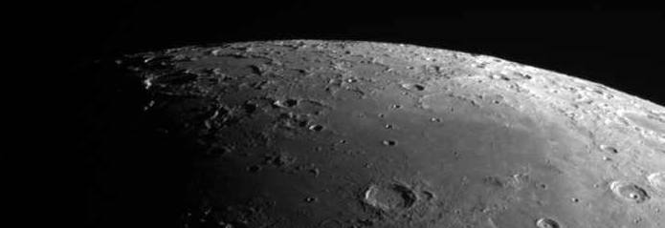
Galactic Supernova Event
Bright, ToO event
Current option: LT
Rapid response observations with LT: what’s required?
Imaging and spectroscopy
LT already provides imaging of bright objects for National Schools’ Observatory
Spectroscopy for bright objects: not currently used/requested

Slide 11
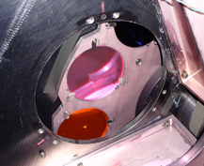
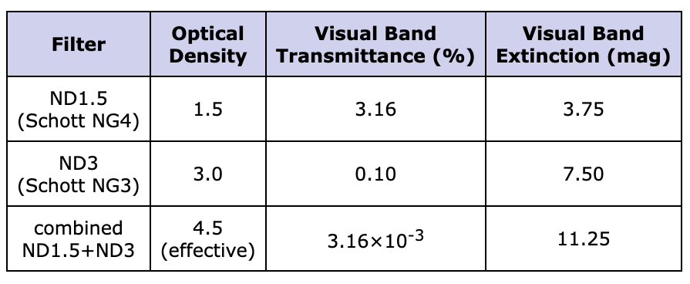
Imaging options (LT)
IO:O main imager on LT
Used for imaging of bright objects: Moon (-12), Jupiter (-9), Venus (-4)
Two filter selection mechanisms:
  a 12-position filter wheel for Sloan, Bessell and H-alpha filters
  a pair of slide mechanisms housing neutral density (ND) filters
  an exposure may use any single position of the filter wheel, and either or both of the NDs.
Defocussing options
New Bonn shutter
S. Bates
https://telescope.livjm.ac.uk/TelInst/Inst/IOO/

Slide 12
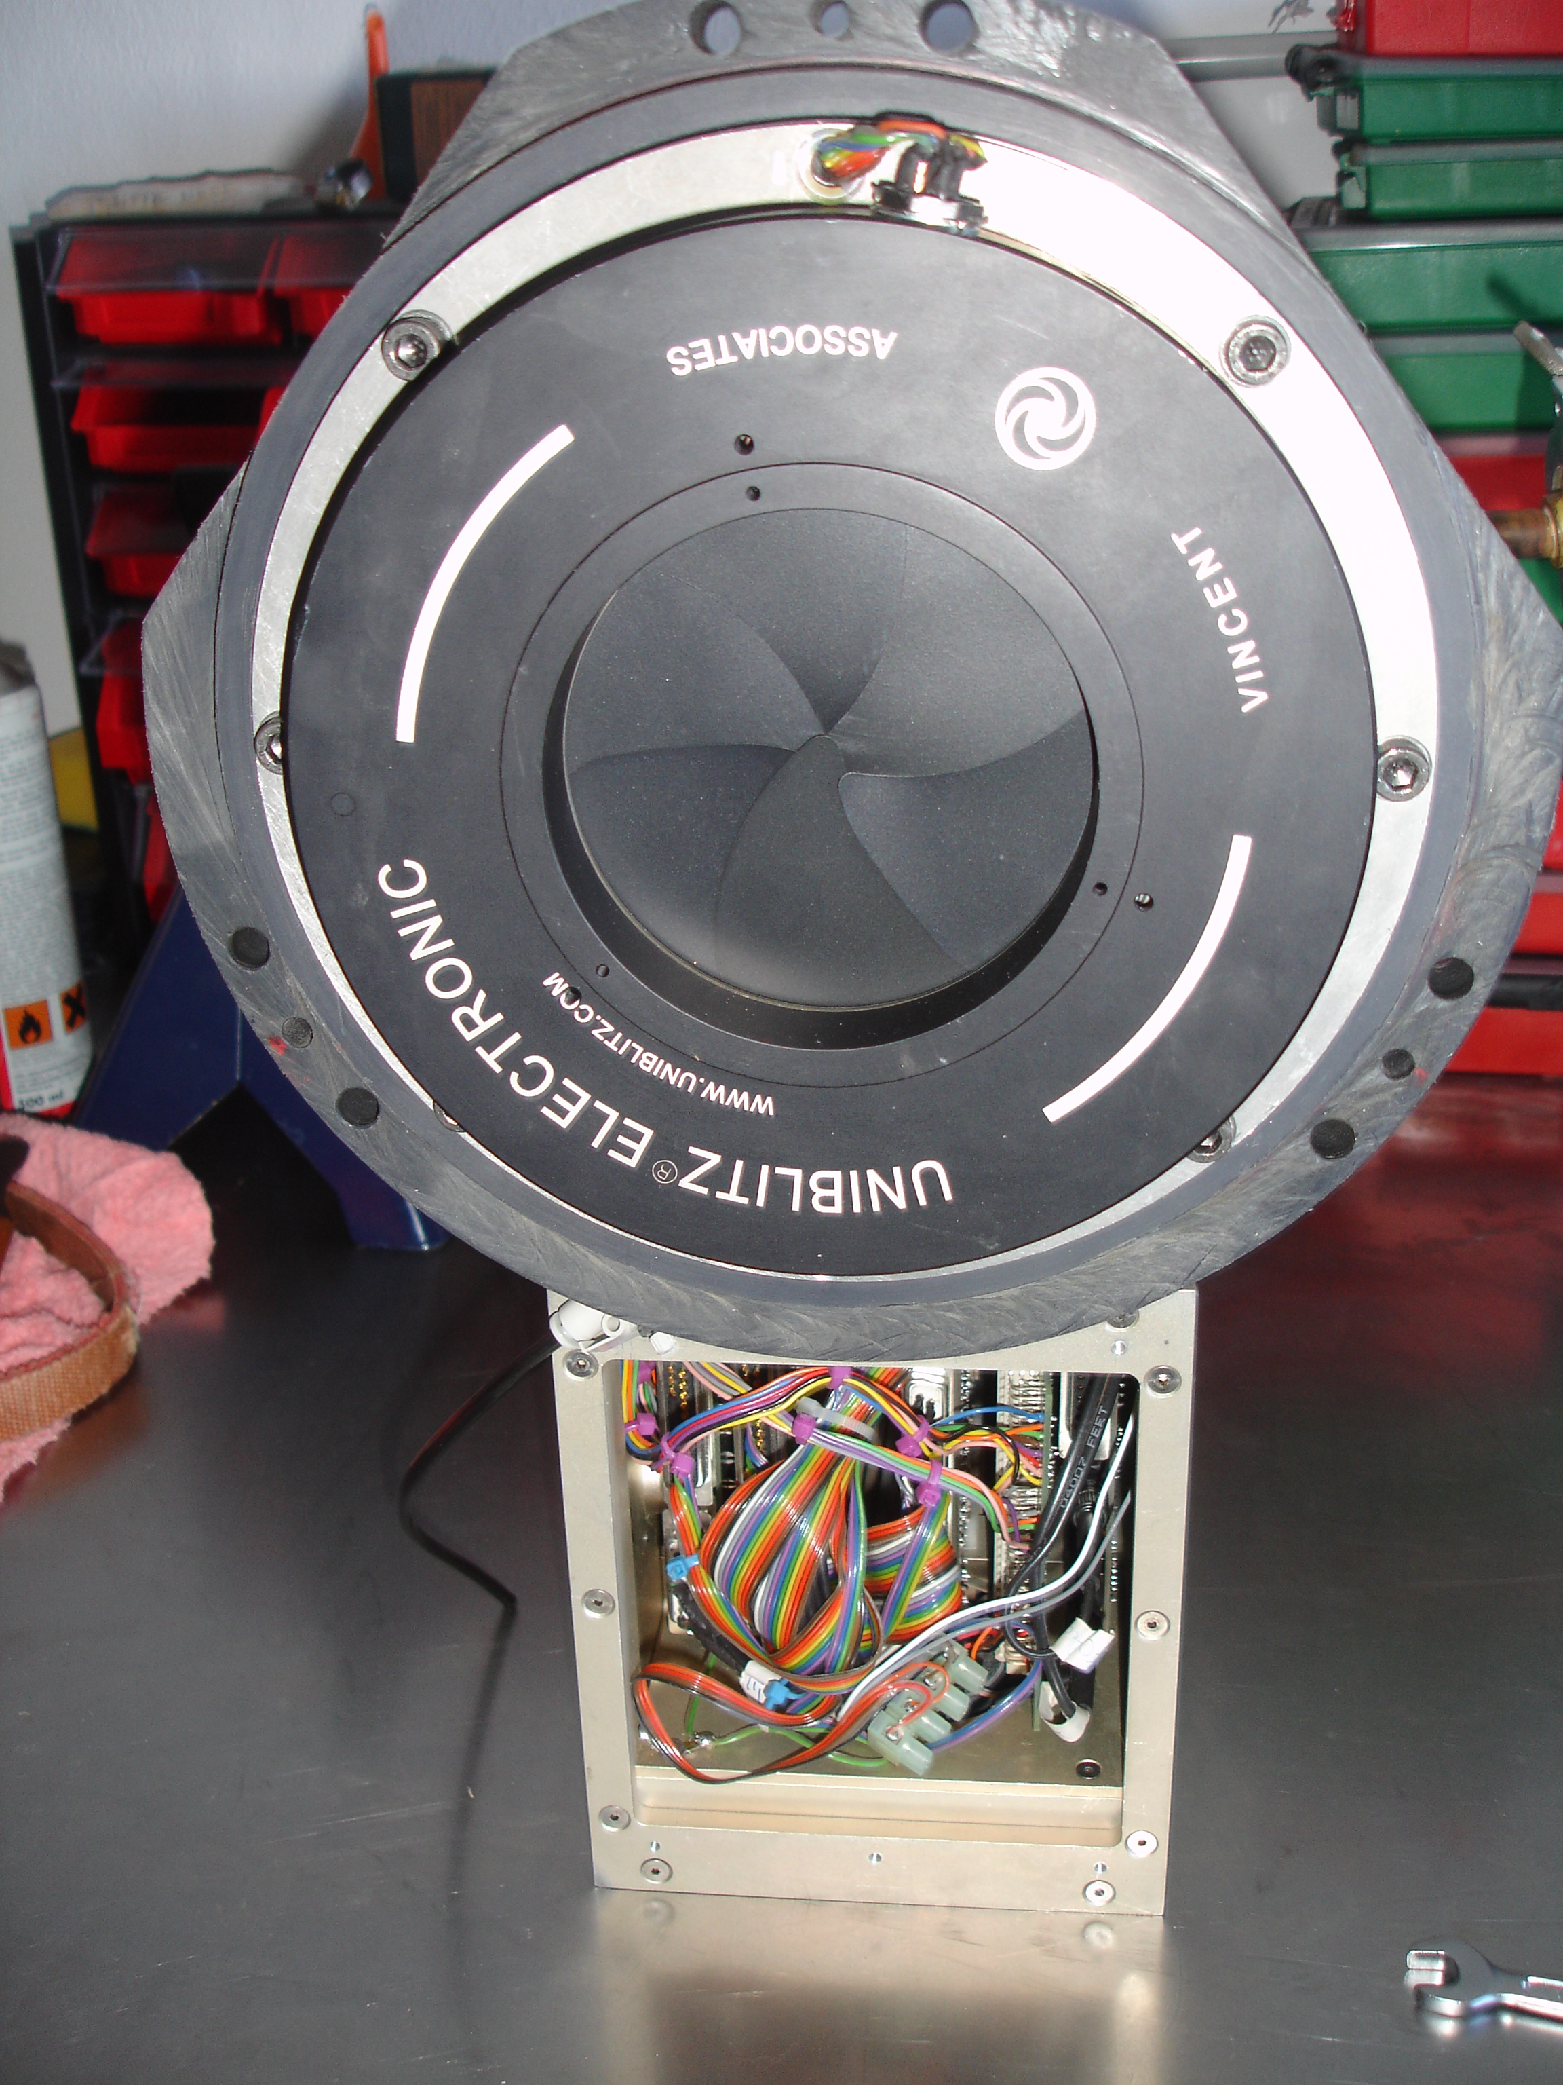
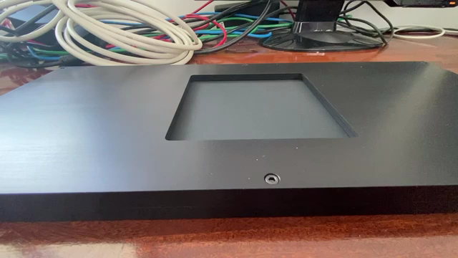
IO:O shutters

Slide 13
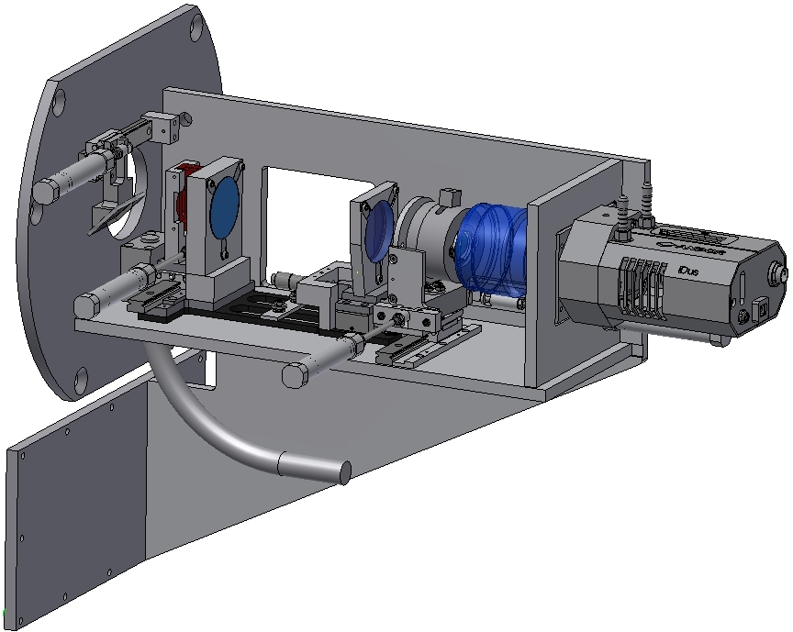
Spectroscopy options (LT)
SPectrograph for the Rapid Acquisition of Transients (SPRAT)
Low resolution spectrograph (R~350)
Current limiting bright magnitude is ~10 B mag
Defocussing not conducive with acquisition
Acquisition through IO:O/SPRAT available but only with set exposure times (would saturate).
Would require ~1 month software work
Possibility for slit-less exposure (telluric lines?)

Slide 14
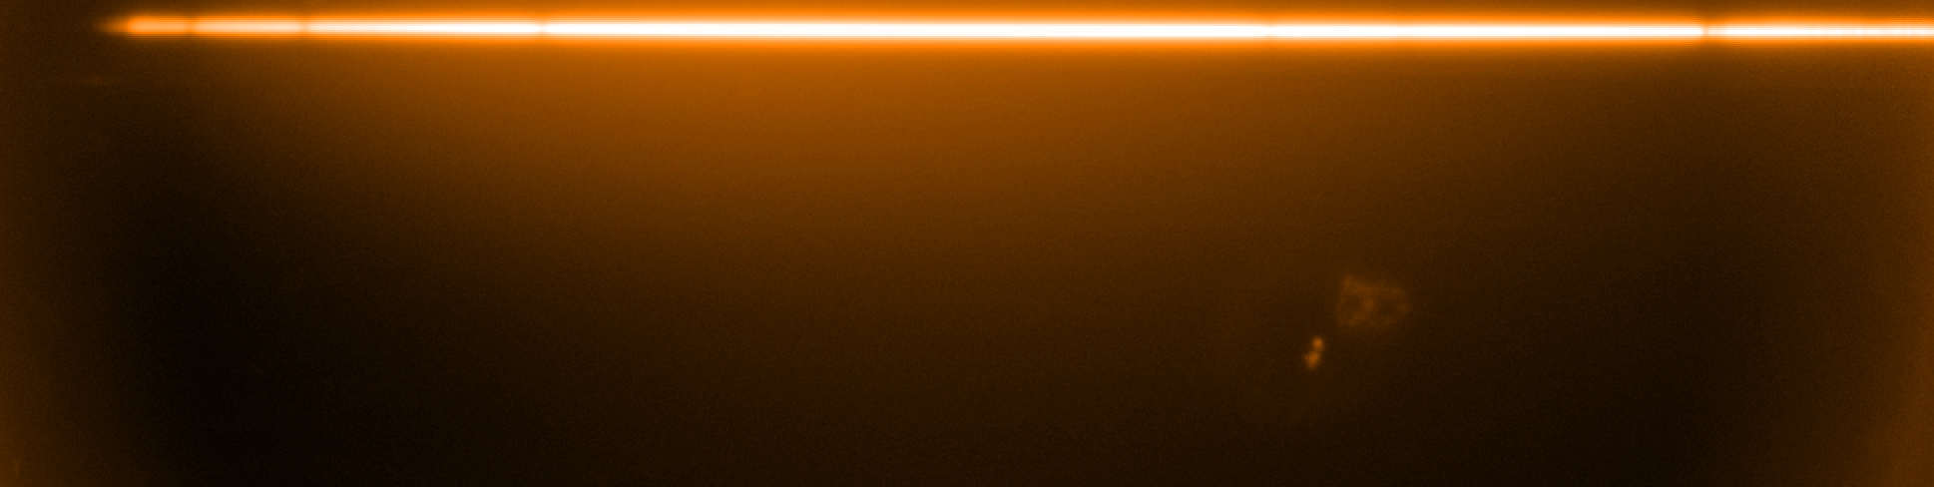
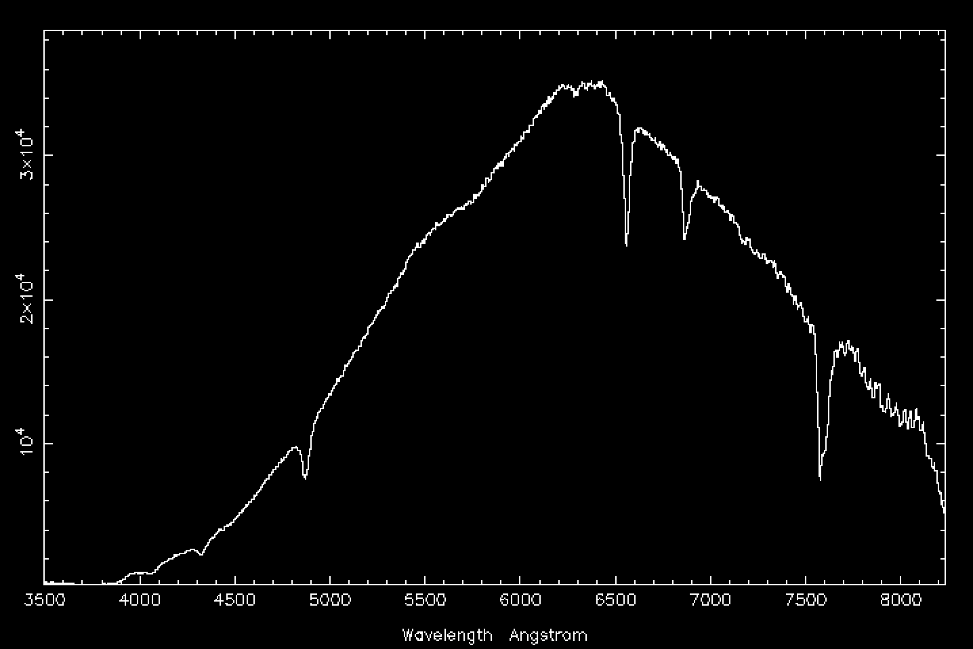
Spectroscopy options (LT)
100 ms slit-less spectrum of Vega (0.0 mag)
Requested ~4pm 6th April, visible from ~2am
Reduced spectra available at ~5am
Potentially observe -1 or -2 mag objects
Hydrogen Balmer lines
And telluric lines at
6867 and 7494

Slide 15
Summary
Bright objects risk saturation for larger telescopes
Flexible and adaptable science case for LT and NRT
Rapid response (observation carried out the night of the alert)
NRT reserved for fainter/faded transients
LT already has science case for imaging bright objects through schools program
Spectroscopy a bit more difficult:
  Slit-less spectra easily provided
  Slit spectra would require software work
Is there a demand for SPRAT slit-exposures for Galactic SNe follow-up or would amateur spectrographs suffice?

